Slide 1
Bridging and Belonging: A Responsibility and Inheritance of the Dream
January 18, 2021
john a. powell, Director
Othering & Belonging Institute
Othering & Belonging Institute

Slide 2
What is Belonging, Bridging and Breaking?
Notes:
Bonding

Slide 3
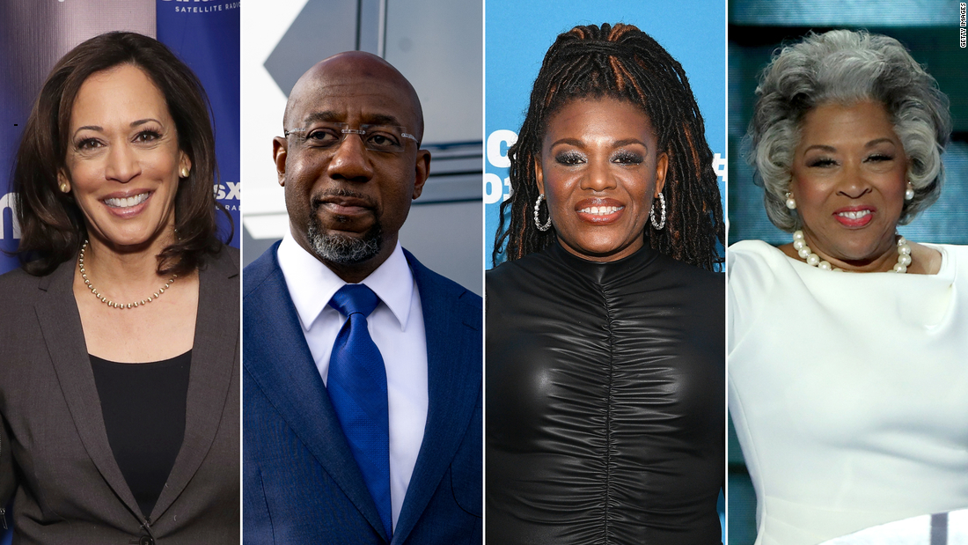
Belonging
Belonging or being fully human means more than having access. Belonging entails being respected at a basic level that includes the right to both co-create and make demands upon society.
Belonging
Notes:
“Belonging means more than just being seen. Belonging entails having a meaningful voice and the opportunity to participate in the design of social and cultural structures. Belonging means having the right to contribute to, and make demands on, society and political institutions.”
HBCU Graduates are paving the way

Slide 4
Exclusion
Inclusion
Belonging
Notes:
Belonging is othdogol. Not assimilation and the infinite other. Belonging co-constitutive in and other.

Slide 5
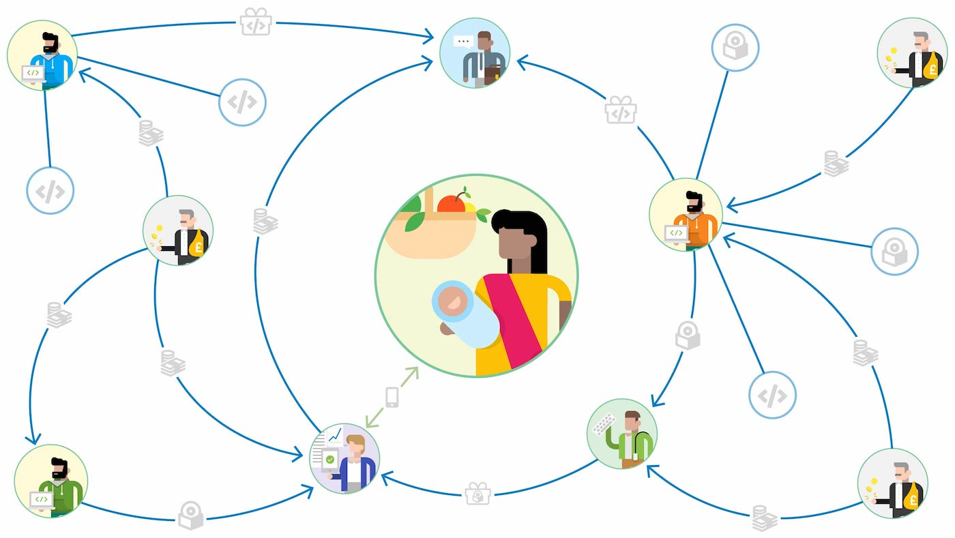
Bridging in All Facets of Life and Work
A just and inclusive society will see all of its members as inside our circle of belonging.
Notes:
Belonging is the construction of society we are striving toward.
We need to bridge in all areas of our life.
Bridging within your own social and professional circles will help you to bridge with the communities you serve and strengthen your commitment to targeted Universalism

Slide 6
Interrogating Dualism
Othering and belonging
Bridging and breaking
Targeted Universalism
Notes:
Othering & belonging already discussed previously; shift focus to bridging & breaking and targeted universalism
Discuss institute’s name change from Haas Institute for a Fair and Inclusive Society to OBI

Slide 7
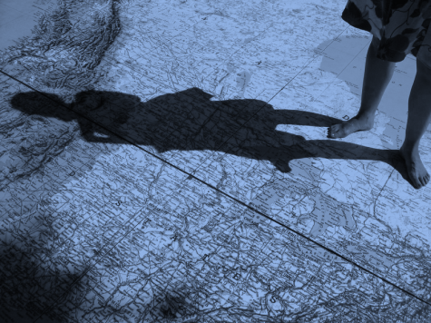
The problem of “Othering” is the problem of the 21st century
Notes:
The Problem of the 21st Century”] john says: “Over a century ago, WEB Dubois predicted that ‘the problem of the 20th century is the problem of the color line.’ Today, the problem is othering.
Looking around the world, we see inter-group conflict as central to almost every human problem: territorial disputes, war and conflict, climate change, migration, economic inequality. Group identities and differences informs almost all of them.

Slide 8
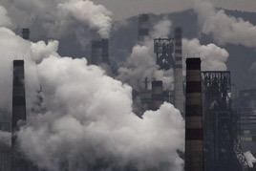
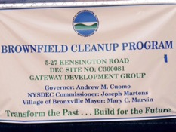
Bridging On the One Hand, Breaking on the Other
BREAKING
Social ties among an exclusive group who explicitly push away from other groups who are seen as dangerous or a threat.
BRIDGING
Social ties that link people
together with others across a cleavage that typically divides society.

Slide 9
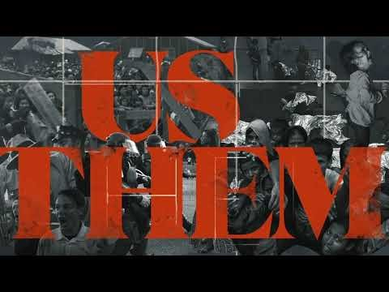
https://www.youtube.com/watch?v=PGcbFj4J_gc

Slide 10
Rapid change produces collective anxiety:
Change in demographic
Climate, Tech
Globalism, pandemics
Fear, anger, Othering
Breaking
Leadership, Meta-Narrative, Structures, Organizing
Bonding
Empathy, belonging, inclusion
Increase in anxiety
Connecting on similarities, common threads of identity
Notes:
Ontological Threat
The people that protest the most are not in fact poor whites, but those afraid of losing their power.

Slide 11
Who belongs? Who is in the we? We need a better story

Slide 12
Breaking and Bridging
There are short bridges and long bridges.
Some bridges require more effort to build and maintain. Others are a short distance.
As bell hooks reminds us, bridges are walked on.
Notes:
Similarly, there are different forms of bridging. Bell hooks reminds us that bridges are walked on. Instead of dealing with the devil, we can develop our bridging social capital by building short bridges.

Slide 14
Bridging Communities
Belonging
Empathy
Inclusion
Set narrative to
Increase in Anxiety
Breaking
Communities
Fear
Anger
Othering
Increase in Diversity

Slide 15
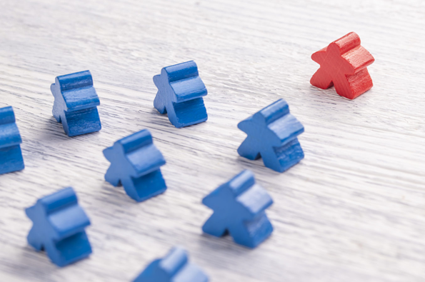
Indices of Othering
Lack of effective voice
Lack of representation
Lack of recognition
Lack of power
People can experience strong othering in one or some of these areas and low or no othering in others. When someone experiences othering on all of these indices, then the othering is more likely durable. High durability also exists when othering happens between the interpersonal, structural, and cultural.

Slide 16
sexuality
class
ability
skin tone
gender
race
ethnicity
religion
age
Othering is a generalized set of common processes that engender marginality and group-based inequality across any of the full range of human differences
Notes:
john says: “We define othering as follows. It’s important to emphasize that othering is marginality on the basis of group status – not individual identities or idiosyncratic identities. It’s also not the same thing as alienation.” The content of othering is social not biological or natural.

Slide 17
Notes:
We believe the answer to othering is belonging. We must strive to build a society in which everyone belongs. But belonging is not the same as “saming.” Belonging does not mean making everyone the same through assimilation.

Slide 18
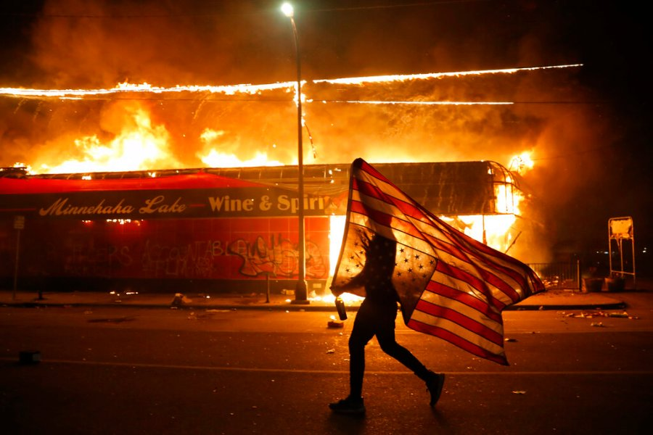
“I’ve come upon something that disturbs me deeply. We have fought hard and long for integration, as I believe we should have, and I know we will win, but I have come to believe that we are integrating into a burning house. I’m afraid that America has lost the moral vision she may have had, and I’m afraid that even as we integrate, we are walking into a place that does not understand that this nation needs to be deeply concerned with the plight of the poor and disenfranchised. -Reverend Martin Luther King Jr.

Slide 19
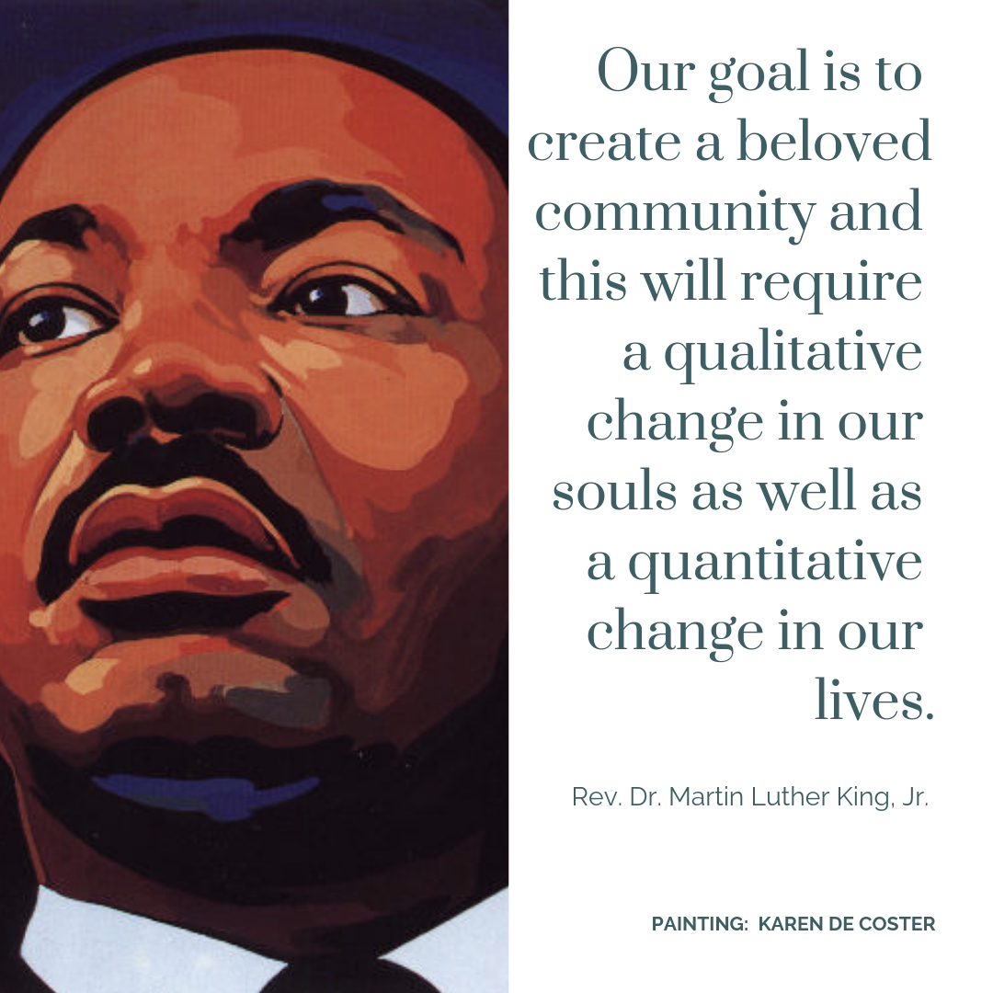
Belonging
Notes:
“But the end is reconciliation; the end is redemption; the end is the creation of the beloved community. It is this type of spirit and this type of love that can transform opposers into friends. ... It is the love of God working in the lives of men. This is the love that may well be the salvation of our civilization.”

Slide 20
“We are all androgynous, not only because we are all born of a woman impregnated by the seed of a man but because each of us, helplessly and forever, contains the other -- male in female, female in male, white in black and black in white. We are a part of each other. Many of my countrymen appear to find this fact exceedingly inconvenient and even unfair, and so, very often, do I. But none of us can do anything about it.” - James Baldwin
January 18, 2021
john a. powell, Director
Othering & Belonging Institute
Othering & Belonging Institute
Notes:
Pandemic 400,000 deaths

Slide 21
Who are the patriots?
Notes:
BLM or Confederate flag. Two pictures next to each other. Lets, personal/interpersonal intuitional Structural

Slide 22
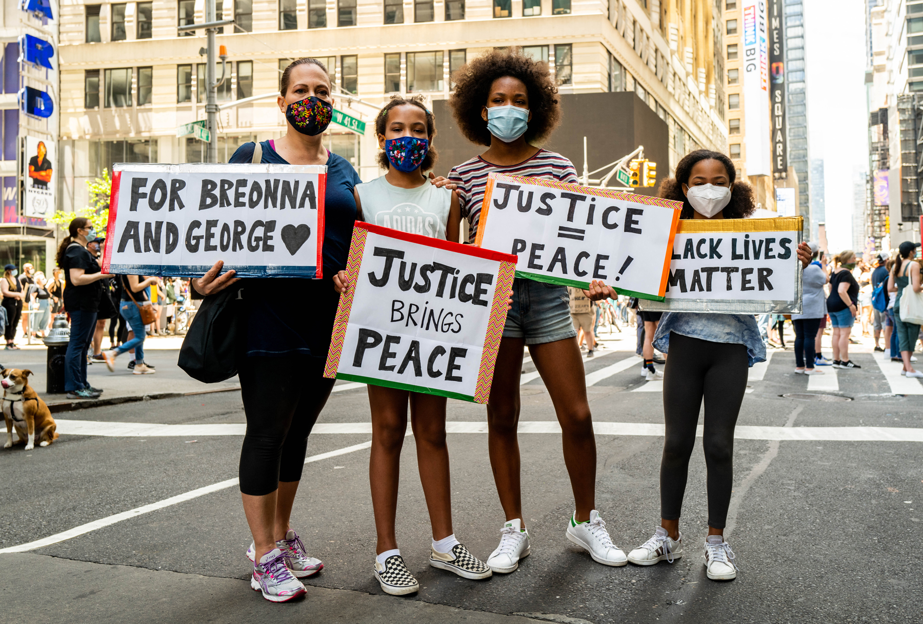
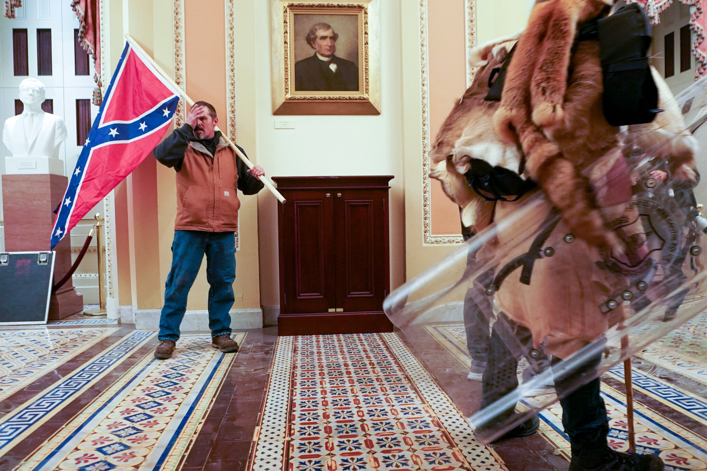
Notes:
BLM or Confederate flag. Two pictures next to each other. Lets, personal/interpersonal intuitional Structural

Slide 23
Bridging
Bonding
Putnam’s Theory of Social Capital
Breaking
Linking

Slide 24
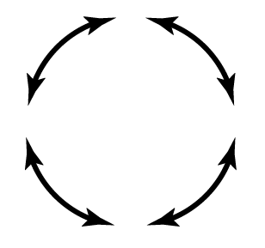
Agency
Belonging
Responsibility
Power
Care

Slide 25
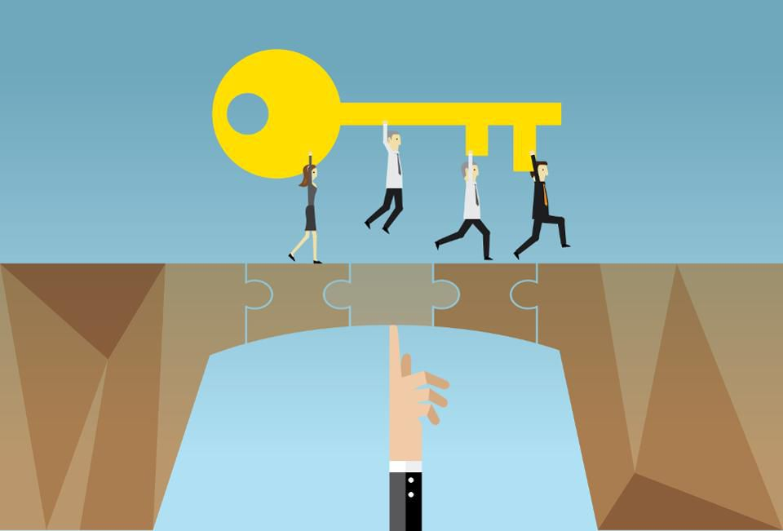
Power Matters
Bridging may look different where there is a power differential. Power is positional, structural, and hierarchal.
People can gain power through linking social networks and creating social capital.
Individuals can build relationships with institutions and individuals who have relative power to access resources.
Power also shifts.
For example: people of color may have more power than whites in certain settings. (e.g. an anti-racism convening)

Slide 26
Be hard on structures Softer on people

Slide 27
