Slide 1


NCACH Annual Summit
Othering and Belonging
PRESENTER:
john a. powell
Director, Haas Institute
DATE:
April 12, 2019

Slide 2
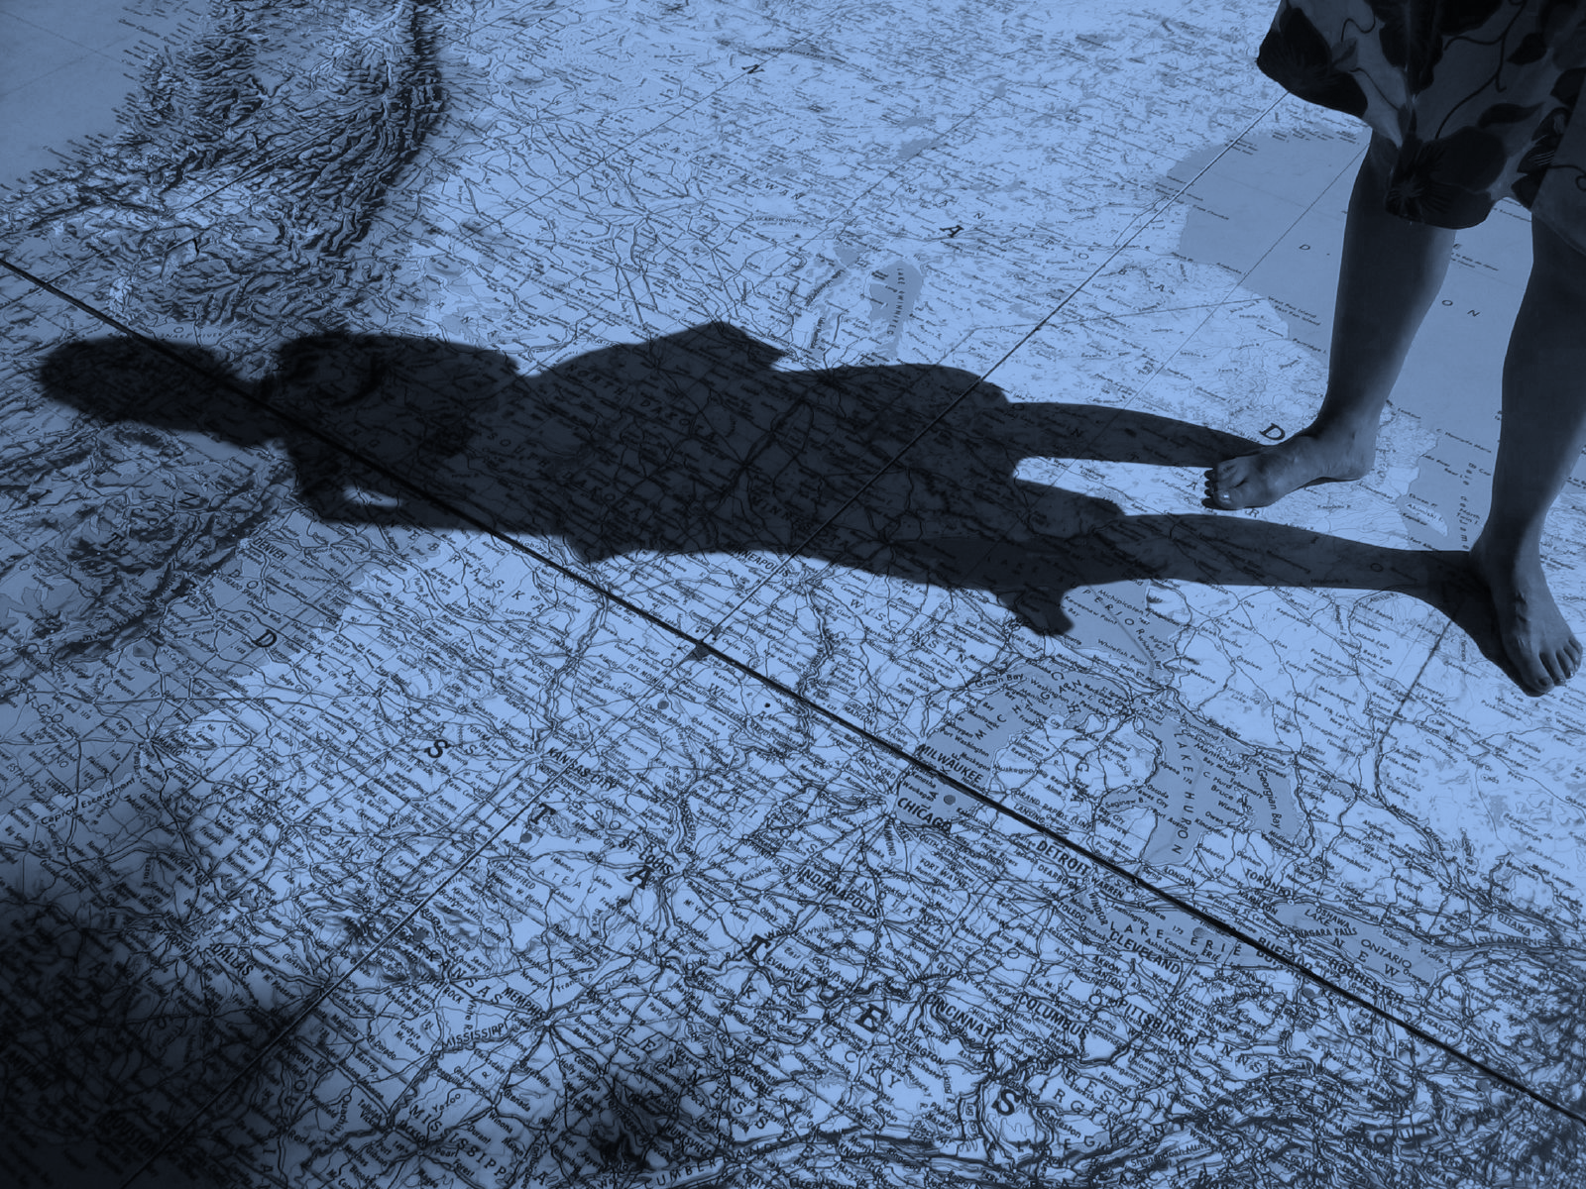
Understanding and addressing disparities is important but incomplete in address health problems today

Slide 3
The problem of “Othering” is the problem of the 21st century.

Slide 4
SAWUBONA

Slide 5
sexuality
class
ability
skin tone
gender
race
ethnicity
religion
age
Othering is a generalized set of common processes that denies someone’s full humanity based or them being less than and/or a threat to the favorite group
Notes:
john says: “We define othering as follows. It’s important to emphasize that othering is marginality on the basis of group status – not individual identities or idiosyncratic identities. It’s also not the same thing as alienation.”

Slide 6
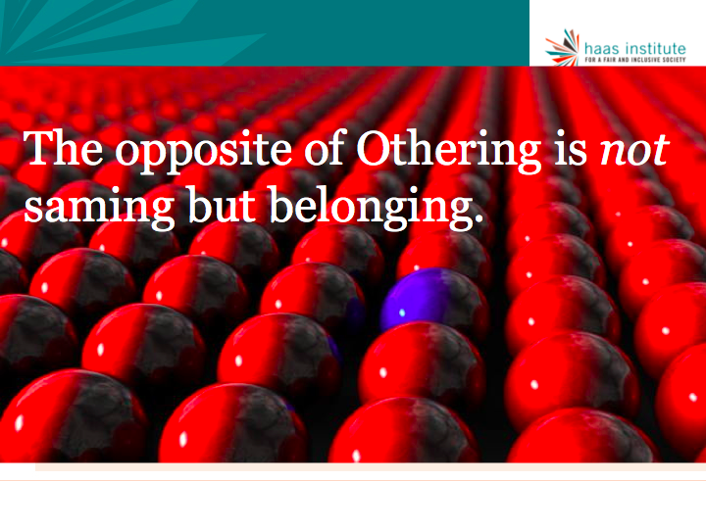
Notes:
We believe the answer to othering is belonging. We must strive to build a society in which everyone belongs. But belonging is not the same as “saming.” Belonging does not mean making everyone the same through assimilation.

Slide 7
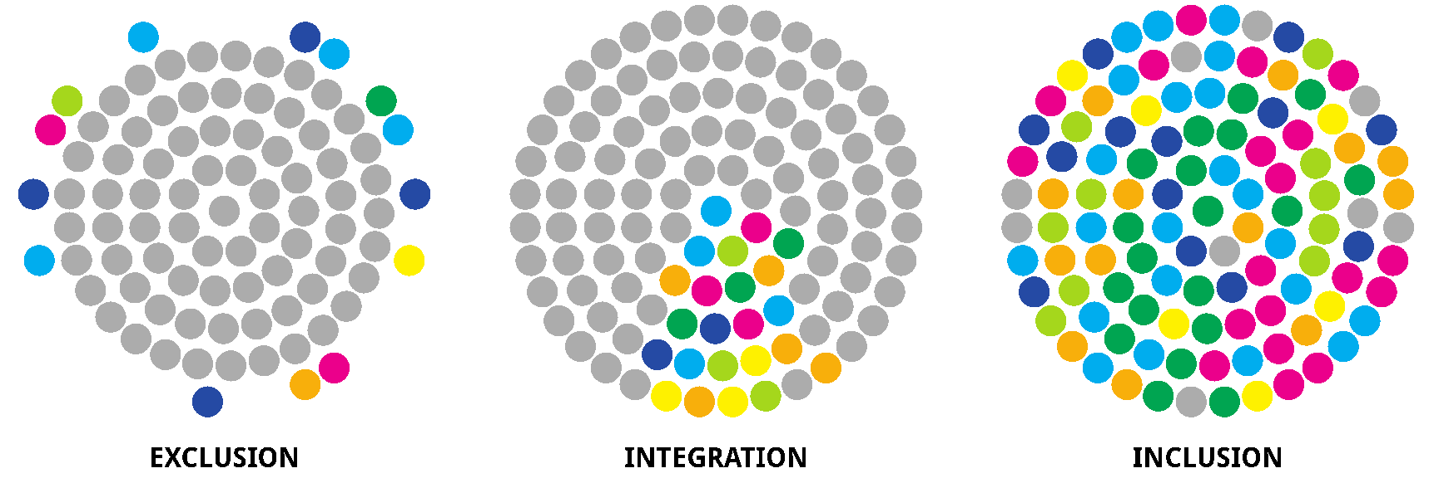
Belonging – Moving towards structural inclusion
Belonging connotes something fundamental about both how groups are structurally positioned within society as well as how they are perceived and regarded.

Slide 8

Bridge — Listen, engage, organize, pactices love.
EXCLUSION
INCLUSION
BELONGING
EQUITABLE INCLUSION
Notes:
Beyond structural safeguards, we need a vision of society that is inclusive with new identities and narratives that inoculate societies from demagoguery and demonization of the “other” while improving the wellbeing of everyone. One possible alternative to the “acculturative” strategies of assimilation, integration, separation, or marginalization is “voice” and “dialogue.” Voice can give expression to group-based needs and issues without resorting to segregation or secession. This approach is consistent with pluralism and multiculturalism in a democracy, and with our macro-goal of expanding the circle of human concern.
What are you belonging to? The form it takes on we co-create
----------
Belonging is related to, but different from inclusion or equity.
Inclusion simply means that a space or an institution is made less exclusionary, and that space or place is accorded for members of traditionally excluded groups. Equity is an effort to try to not only make places or institutions inclusive, but also representative and fair. This graphic illustrates the difference. Equitable inclusion is an improvement over inclusion, but not the same thing as belonging.

Slide 9
Deep Belonging
      Belonging connotes something fundamental about how groups are structurally positioned within society as well as how they are perceived and regarded. How are they positioned in affectcomponent.
      positioned in the collective narrative? Do they get to help shape the story of us.
Notes:
The critical difference is that belonging means that you have a right to participate and co-create the thing to which you belong. Thus, it is the difference from joining an a club to creating a club.

Slide 10
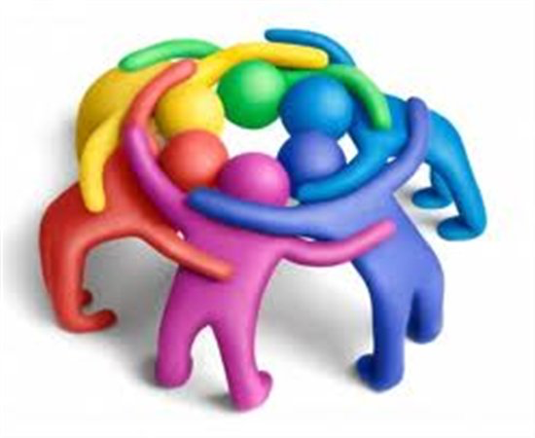
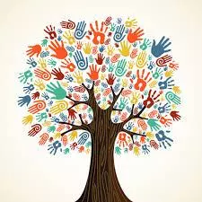
What does belonging mean?
Notes:
Supported by our structures, policies and stories. We have agency in all domains. We are served by all domains. We are seen, connected and caring and cared for.

Slide 11
Supported by our structures, policies and stories. We have agency in all domains. We are served by all domains. We are seen, connected and caring and cared for.

Slide 12


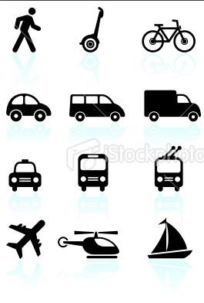
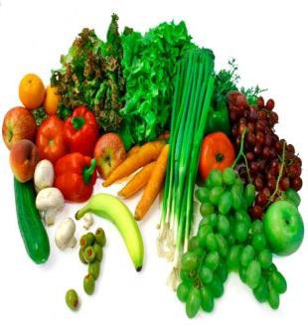




Structural marginalization limits opportunity
We can define opportunity through access to:
EDUCATION
ECONOMIC
TRANSPORTATION
FOOD
HOUSING JUSTICE HEALTHCARE COMMUNICATIONS
This is an issue of membership and belonging.

Slide 13
Othering & belonging within structures
We are all situated within structures but not evenly.
Structures are not neutral.
Power gives us greater positive access to structures and more ability to shape structures.
Cultural Structures
Physical Structures
OUTCOMES
Social Structures
These structures interact in ways that produce a differential in outcomes.

Slide 14
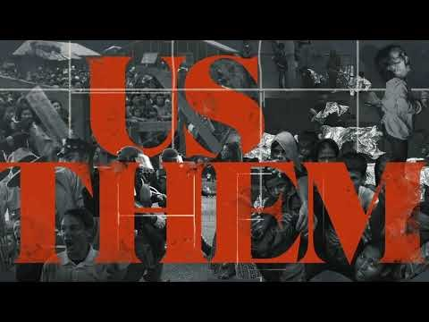
https://www.youtube.com/watch?v=PGcbFj4J_gc

Slide 15
As diversity grows, so does anxiety.
Increase in diversity
Breaking
Fear, anger,
othering
Leadership, Meta- Narrative
Increase in Anxiety
Empathic listening and practice.
Increase in anxiety
Bridging
Notes:
There are two basic responses to this: Bridging or breaking.

Slide 16
There are two competing visions:
One is a smaller and smaller hierarchical we that fears, dominate and controls the other and exploits the earth.
The other vision is an expanding we that shares the earth and each other with dignity and respect and care
These are different not only different visions, they are different we’s.

Slide 17



Narratives of Othering and Belonging
      Breaking: When a group turns inwards and explicitly pushes away from other groups who are seen as dangerous, a threat and less than
      Bonding: Connecting to people like you in some important way with out disparaging others
      Bridging: Ties to people who are unlike you in some important way; stories, structure contact
Notes:
These concepts derive from social capital theory – which is the academic theory about human relationships. There is bonding social capital –which were where groups look inward, or bridging social capital – where groups look to other groups.

Slide 18
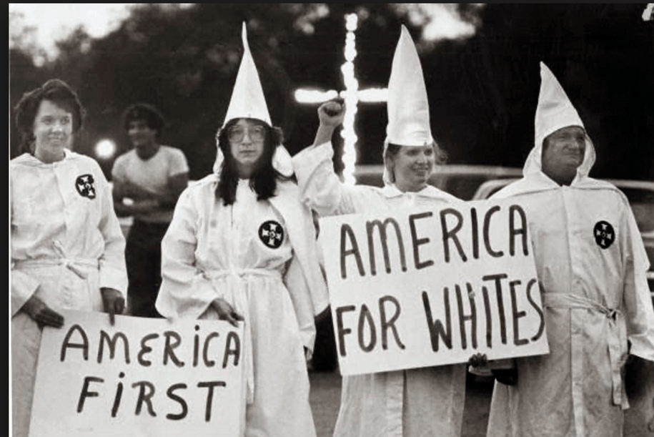
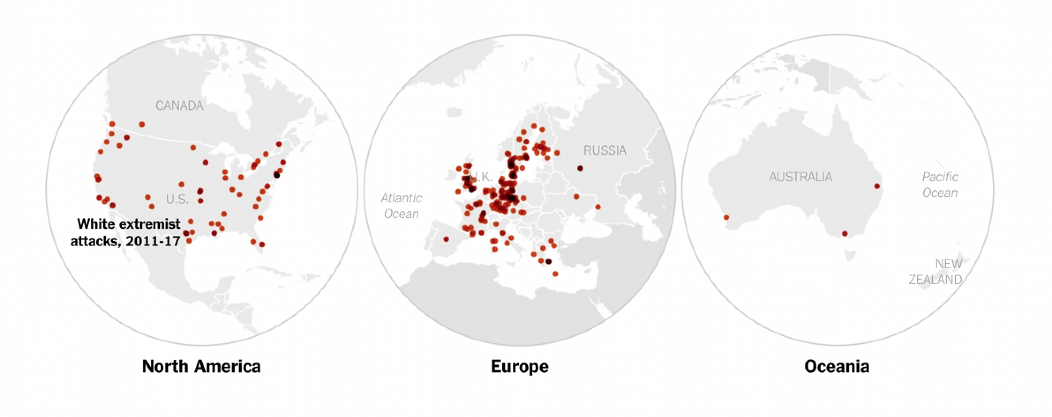
Examples of breaking social capital:
BREAKING
Social ties among an exclusive group who explicitly push away from other groups who are seen as dangerous or a threat.
white nationalism
Notes:
Breaking can be very dangerous. At the extreme, it can show up as genocide or out-group violence. It’s more extreme than bonding, as it is explicitly pushing away from a different group.

Slide 19
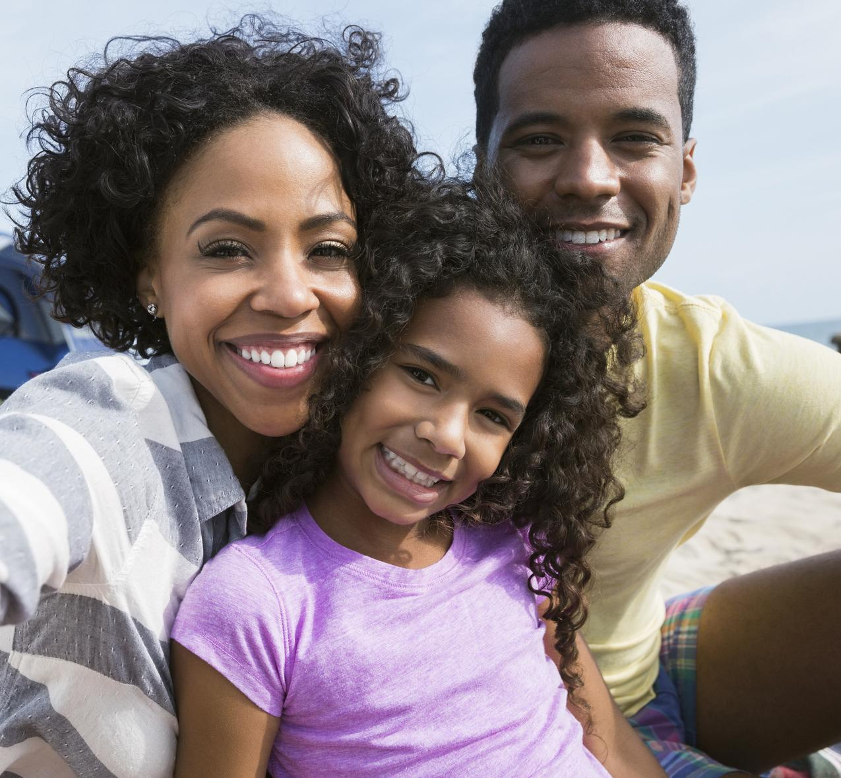
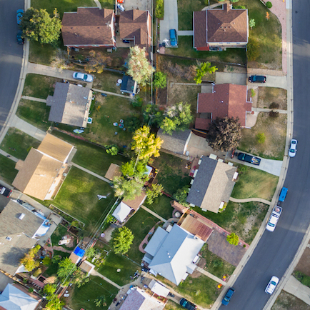
Examples of bonding social capital:
family
BONDING
Social ties that link
people together with others
who are primarily like them along
some key dimension. These are
genuinely easier to build than
bridging social capital.
neighborhood
Notes:
In contrast, Bonding social capital can be a good thing. It can help neighborhoods and communities grow more cohesive.

Slide 20
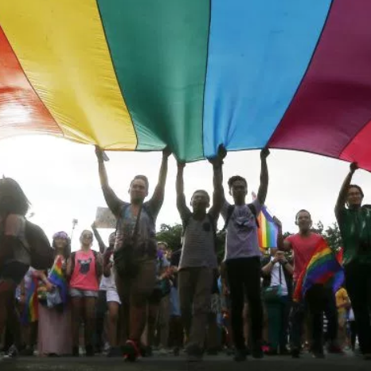

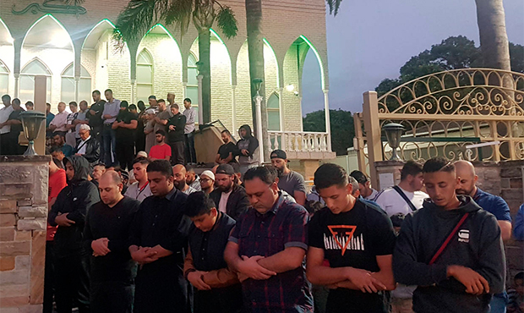
Examples of bridging social capital:
BRIDGING
Social ties that link people
together with others across a cleavage that typically divides society.
lgbtq
Mosque in New Zealand
Notes:
But what we really need is bridging today. We need people who can connect different segments of society and who have the cultural dexterity and skill to do this.

Slide 21

Violence and disorder
Physical hazards
Concentrated poverty
Air and water quality
Social Determinants of Health
School quality
Exposure to toxins
Housing quality
Neighborhood blight
Segregation
Medical care is insufficient for ensuring better health outcomes.
Around 90% of contributors to better health outcomes are social determinants of health.

Slide 22

Violence and disorder
Physical hazards
Concentrated poverty
Air and water quality
Social Determinants of Race
School quality
Exposure to toxins
Housing quality
Neighborhood blight
Segregation

Slide 23


Addressing the social
determinants of health
Involves the medical care and public health systems, but clearly extends beyond these
Requires collaboration with multiple sectors outside of health, including education, housing, labor, justice, transportation, agriculture, and environment

Slide 24
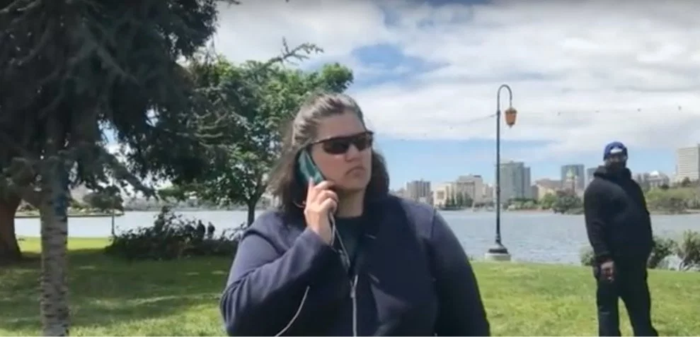

Not Belonging Has Consequences
Notes:
Not Belonging has real life consequences.
In their autobiographies, both Michelle Obama and Justice Sonia Sotomayor described the feeling of “not belonging” at Princeton.
Not belonging shows up in many ways:
It shows up with a white woman calls the police on black people at Lake Merritt here in Oakland (aka BBQ Becky)
When a white woman in San Francisco calls the police on an 8-year old black girl selling water (aka Permit Patty)
It happens when Starbucks calls the police on two black men who were meeting in a Starbucks.
It happens when the police are called on a yale undergraduate who fell asleep in a dorm.
It also happens when a young black man is viewed with suspicion and chased in a quiet neighborhood (Trayvon Martin) or when the police are called on a Harvard professor trying to get into his home (Henry Louis Gates).
Not belonging is the assumption that a person doesn’t belong there, based upon their identity or appearance.

Slide 25
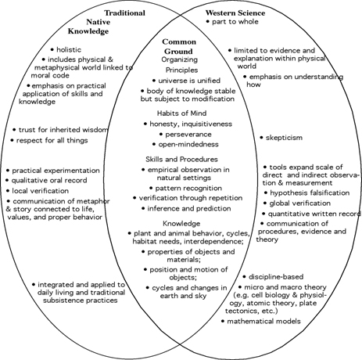
Frameworks of Health: Healing, Self, and Health in Native Communities

Slide 26

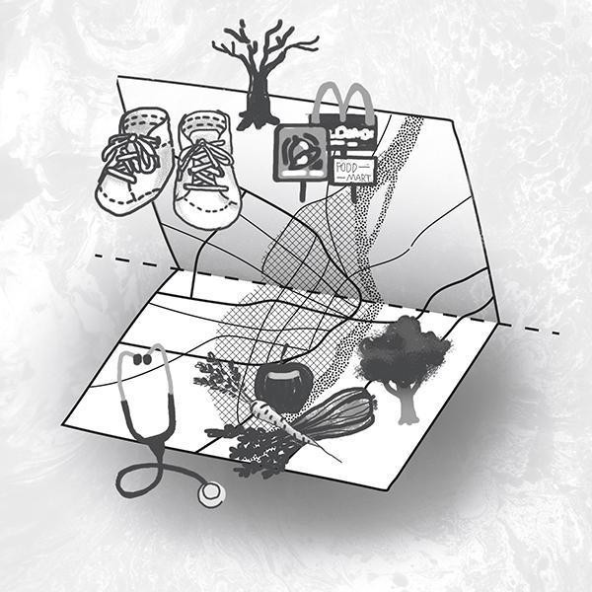
Health Healthcare
Where you live matters. It matters a lot!

Slide 27
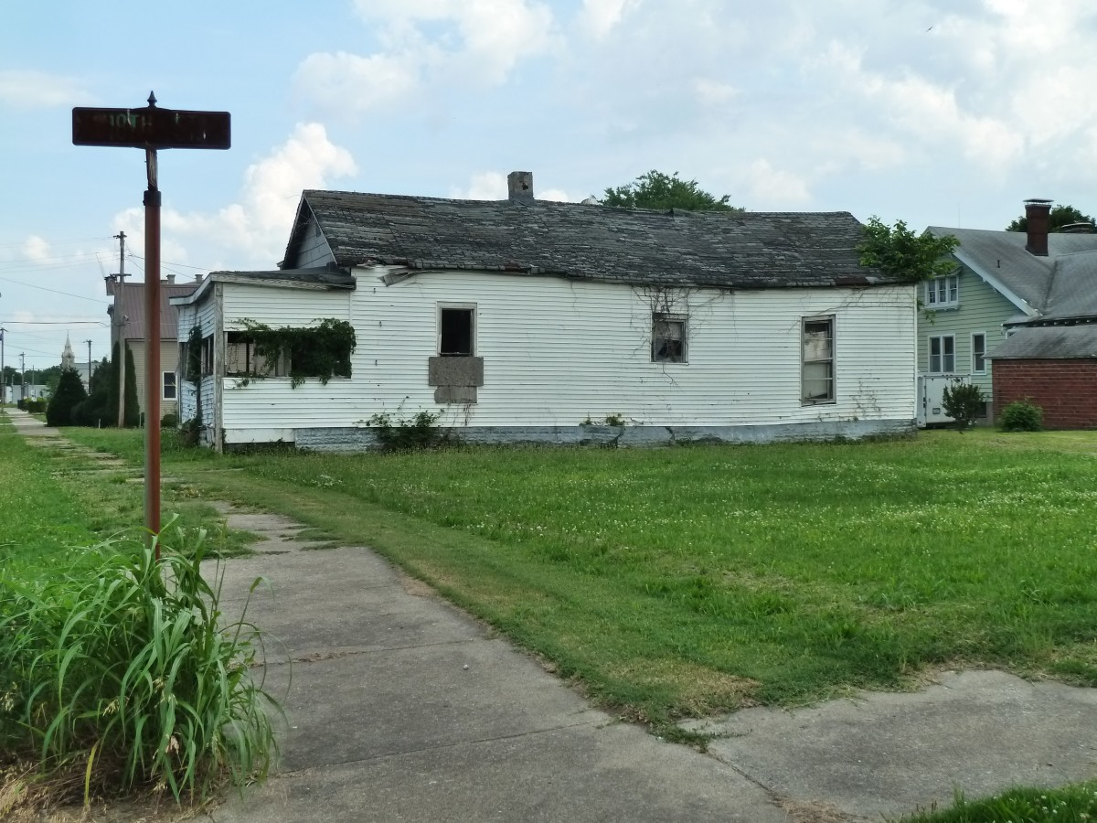
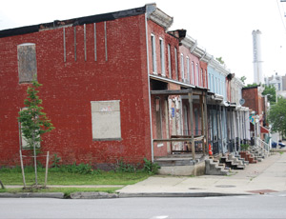
Health and Space
Your environment has a profound impact on your access to opportunity.
Both your environment and your access to opportunity have a profound impact on your health.

Slide 28
Othering & Health: Mechanisms
Institutional discrimination can restrict access to quality education and jobs that create group differences in SES
Segregation can create pathogenic residential conditions
Conscious and unconscious discrimination can lead to reduced access to desirable goods and services
Internalized othering (acceptance of society’s negative characterization) can adversely affect health
Othering can create conditions that increase exposure to traditional stressors (e.g. unemployment, over-policing and criminalization)
Experiences of discrimination may be a neglected psychosocial stressor

Slide 29


Health, Situatedness, and Trauma
Opportunity structures can affect our bodies. Childhood trauma has a profound effect on brain development and health outcomes, which can lead to additional issues in children (behavioral, PTSD, etc.)
Example: Children exposed to racial trauma early are more likely to contract asthma when exposed to toxic air. Children exposed to high levels of violence are more likely to have elevated asthma incidences

Slide 30
Health, Discrimination, and Stress
Everyday discrimination is positively associated with:
-- coronary artery calcification (Lewis et al., Psy Med, 2006)
-- C-reactive protein (Lewis et al., Brain Beh Immunity, 2010)
-- blood pressure (Lewis et al., J Gerontology: Bio Sci & Med Sci 2009)
-- lower birth weight (Earnshaw et al.,Ann Beh Med, 2013)
-- cognitive impairment (Barnes et al., 2012)
-- poor sleep [object. & subject.] (Lewis et al, Hlth Psy, 2012)
-- visceral fat (Lewis et al.,Am J Epidemiology, 2011)
-- mortality (Barnes et al., J Gerontology: Bio Sci & Med Sci, 2008)
See also David R. Williams, “The House That Racism Built: Consequences and Opportunities for Health Equity”

Slide 31
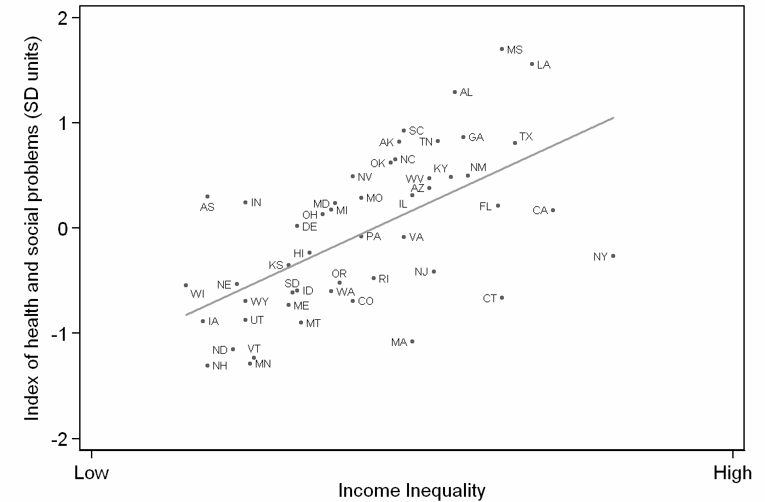
Index of health and social problems in relation to
inequality among U.S. states
Source: Wilkinson & Pickett, The Spirit Level (2009)

Slide 32
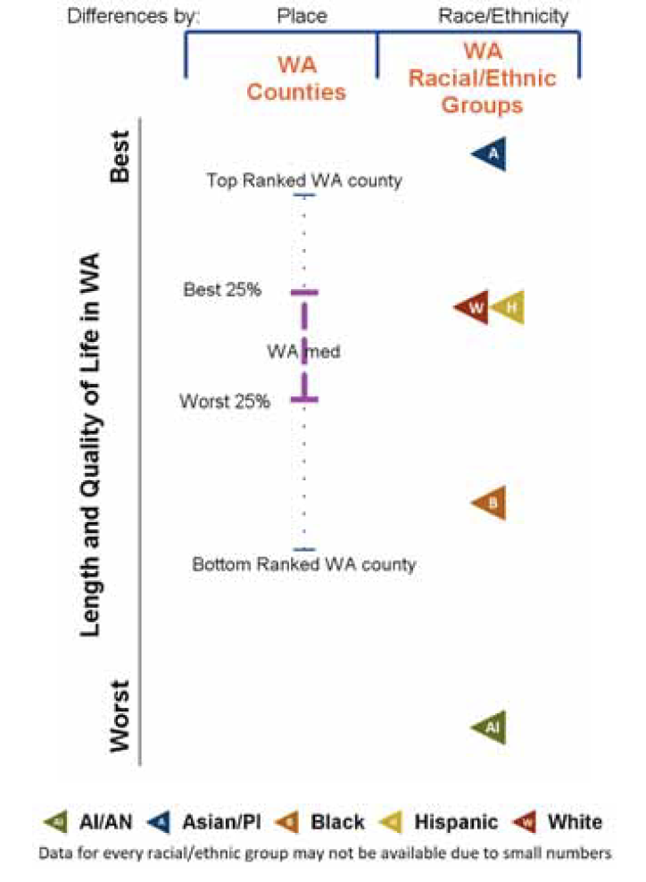
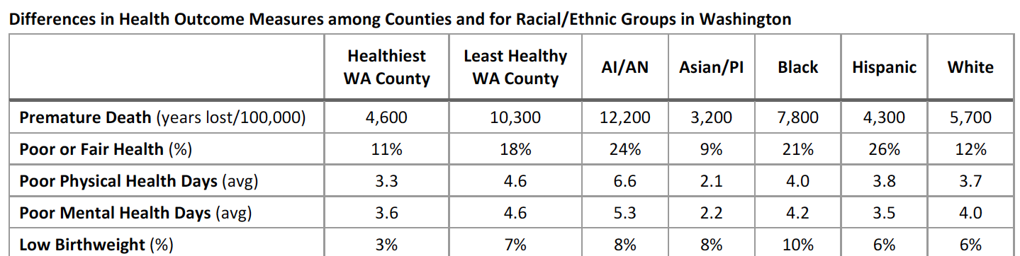
2019 County Health Rankings Report – Robert Wood Johnson Foundation
Notes:
Note: the differences in health outcome measures is the EXACT same in 2019 as 2018, no changes (bad or good) in one year

Slide 33
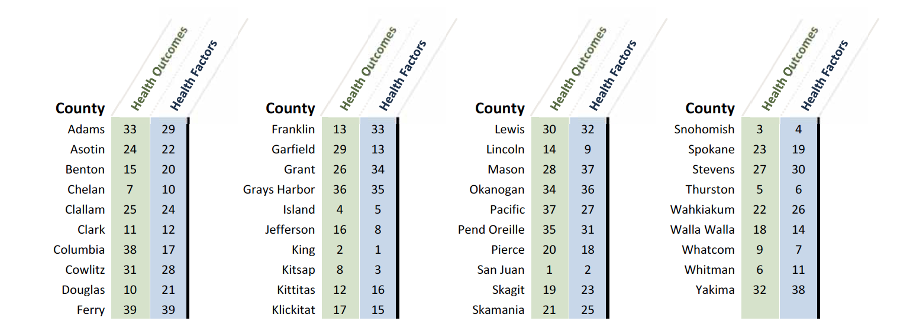
Health Outcomes by Washington County
2019 County Health Rankings Report – Robert Wood Johnson Foundation
Notes:
The arrows are next to the four counties relevant to the folks for the conference

Slide 34
Demographics by County
 | Chelan | Douglas | Grant | Okanogan
% AI/AN | 2.0 | 2.1 | 2.2 | 13.0
% Hispanic | 28.1 | 31.8 | 41.7 | 20.0
% 65+ years | 18.4 | 17.2 | 13.5 | 21.2
% Rural | 27.2 | 26.6 | 38.7 | 80.0
2019 County Health Rankings Report – Robert Wood Johnson Foundation

Slide 35
Health Rankings by County
 | Chelan | Douglas | Grant | Okanogan
Physical Environment County Ranking | 23 | 33 | 32 | 29
Length of Life County Ranking | 6 | 5 | 25 | 31
Social-Economic Factors County Ranking | 15 | 18 | 25 | 34
% Children in Poverty | 17% | 19% | 20% | 29%

Slide 36
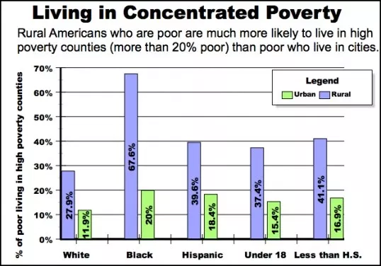
Rural Poverty
Nationwide, 2006-2010
Tracey Farrigan, Department of Agriculture’s Economic Research Service

Slide 37
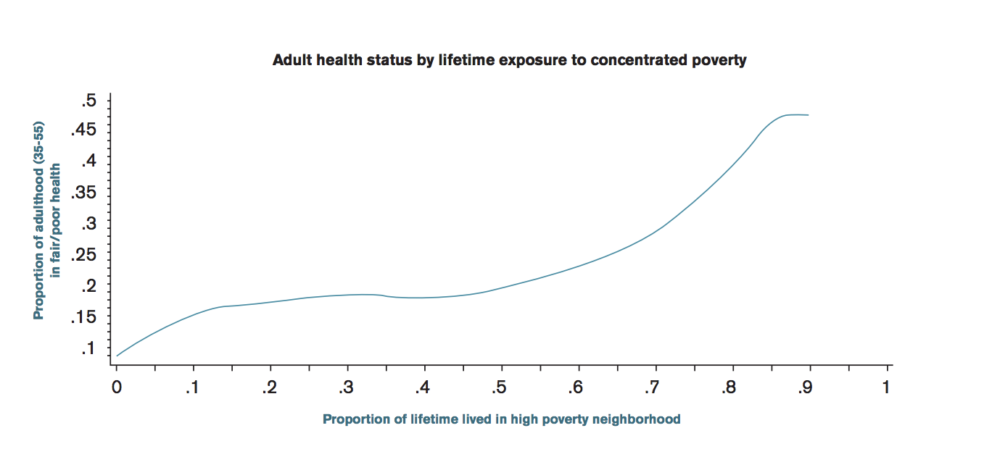
The Sick Side of Town: How Place Shapes Disparities in Health, Robin Pearce & Haas Institute

Slide 38
Allostatic Load
10 biomarkers
High-risk thresholds * 127 mm HG
80 mm HG
30.9
5.4%
4.2 g/dL
66 mg/dL
168 mg/dL
0.41 mg/dL
9 μmol/L
225
Systolic blood pressure
Diastolic blood pressure
Body Mass Index
Glycated hemoglobin
Albumin
Creatinine clearance
Triglycerides
C-reactive protein
Homocysteine
Total cholesterol
* = < 25th percentile for creatinine clearance; >75th percentile for others
Geronimus, et al., AJPH, 2006

Slide 39
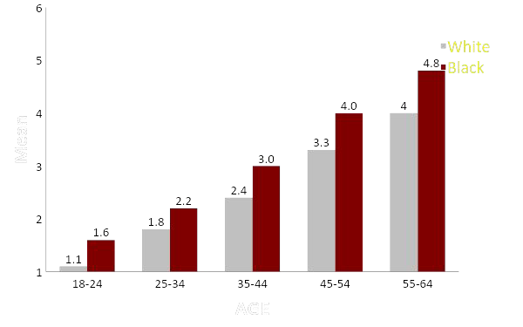
Mean Score on Allostatic Load by Age
Geronimus, et al., AJPA, 2006

Slide 40
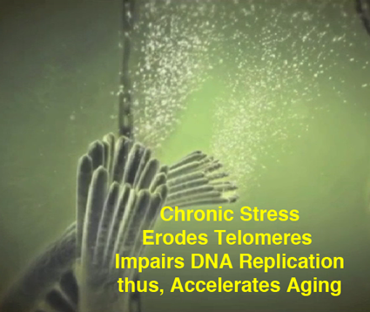
Stress, Trauma, Anxiety and Life Expectancy
Telomeres are chromosome components that are associated with cellular aging and risk for heart disease, diabetes and cancer
Chronic stress and childhood adversity shortens telomeres.

Slide 41
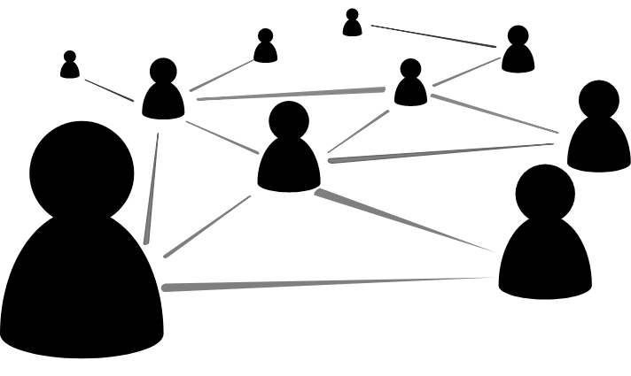
Health and Networks
Family Networks: self-reinforcing wealth transmission
Social Networks: self reinforcing income (jobs) transmission
Neighborhood Networks: self-reinforcing public goods that rely on wealth and income
Institutional Networks: selecting for admission
Black
Black

Slide 42
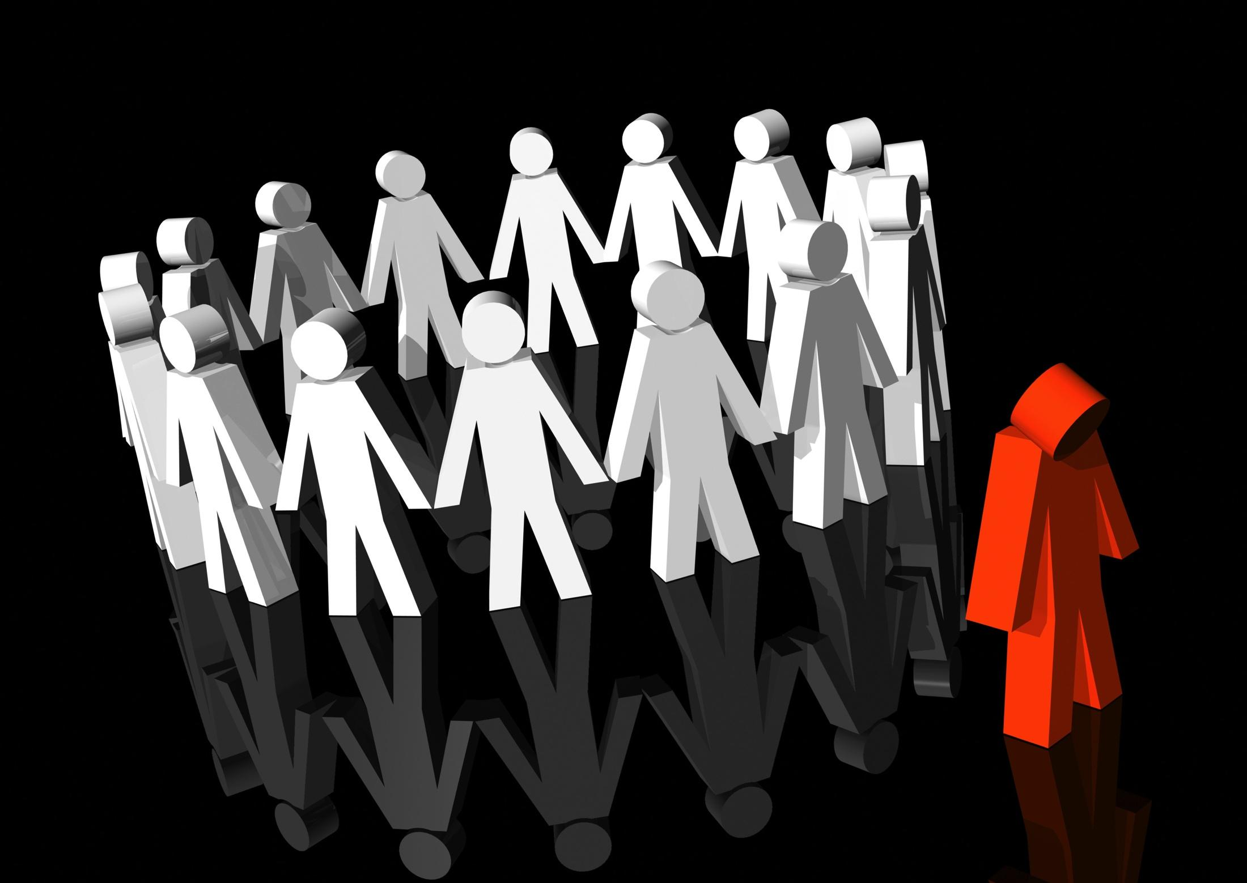
Social Isolation on Health Outcomes
The immigrant health paradox :
Recent new immigrants have, on average, better health than native-born Americans, even when though they are poorer.
Over time, their health outcomes become markedly worse. Isolation increases risk for cardiovascular disease, infectious diseases, diabetes, and strokes.
If your environment gives you cues that you are not valuable and have little prospects for a good future, you internalize that devaluation.
Strong social networks and hopefulness promote better health

Slide 43
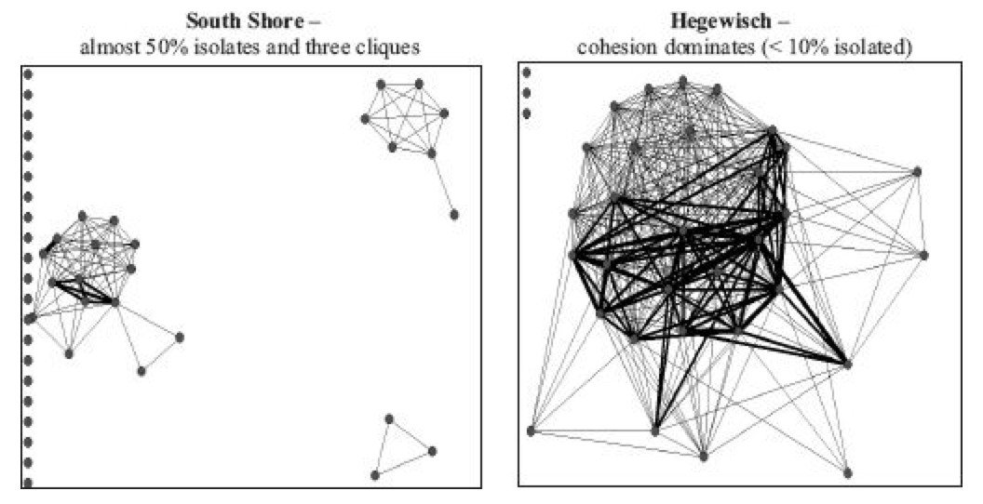
Race, Networks and Resilience
Connections to Community Leaders
Black
White/Asian
[Robert Sampson 2012]

Slide 44
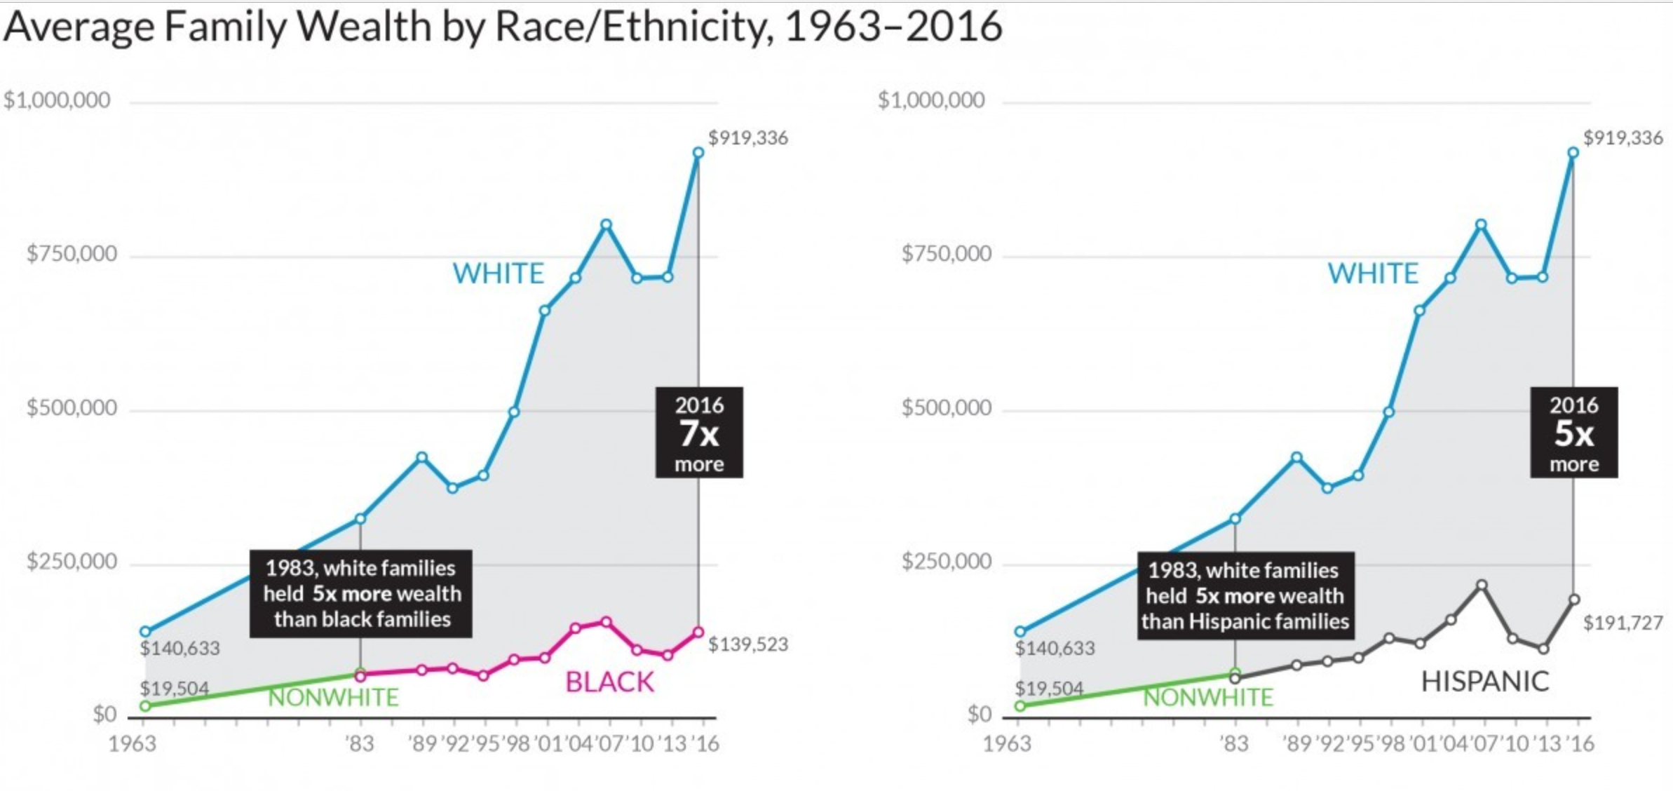
Race and Networks

Slide 45
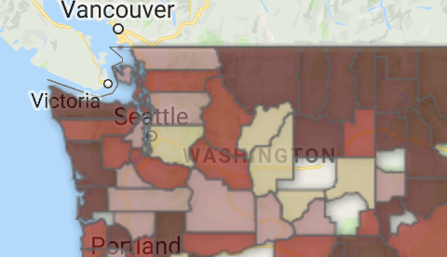
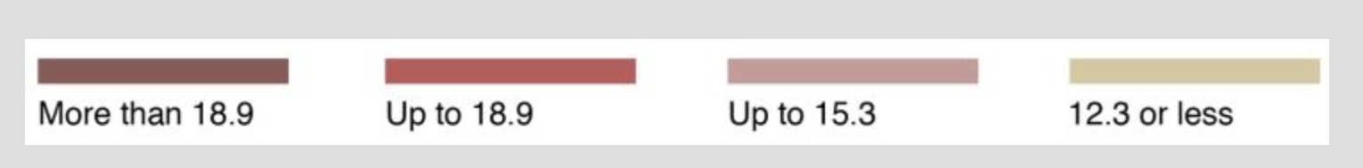
Suicide Rates in Washington
United States: 13/100,000
Washington State: 15.78/100,000
Okanogan County: 22.8/100,000
Chelan County: 12/100,000
American Indians + Alaska Natives die by suicide at a higher rate than every other ethnic and racial group.
Suicide Rates
Numbers from 2014
Washington Dep’t of Health
Notes:
Note that Okanogan County includes part of the Colville Confederated Tribes

Slide 46



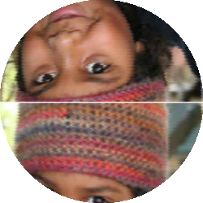



How to measure progress

Slide 47


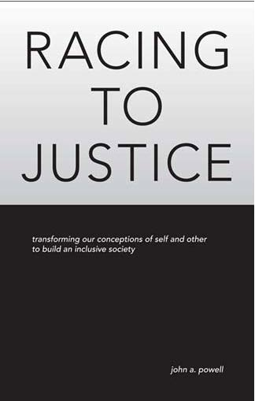

For more information, visit: http://www.iupress.indiana.edu/catalog/806639
Like the Haas Institute on Facebook www.facebook.com/haasinstitute

