Slide 1
Co-Creating and Leading: Moving Forward a Society of Belonging in a Time of Othering
February 3rd , 2020
john a. powell, Director
Othering & Belonging Institute
Othering & Belonging Institute

Slide 2
Notes:
“A global protest movement focused on racial inequality has opened the window of opportunity to address systemic and structural racial inequality, and the aperture seems wider than at any point since perhaps Reconstruction.”
Over 350 cities, from New York to Portland, have erupted in protest to the George Floyd killing, calling for justice and systemic change. Over 4000 around the globe

Slide 3
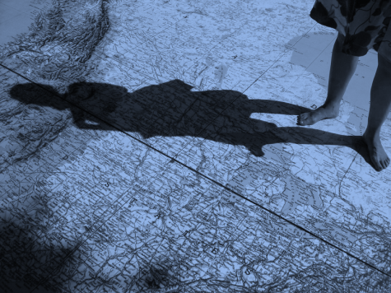
The problem of “Othering” is the problem of the 21st century
And the possible demise of the nation state as we know it
Notes:
The Problem of the 21st Century”] john says: “Over a century ago, WEB Dubois predicted that ‘the problem of the 20th century is the problem of the color line.’ Today, the problem is othering.
Looking around the world, we see inter-group conflict as central to almost every human problem: territorial disputes, war and conflict, climate change, migration, economic inequality. Group identities and differences informs almost all of them.

Slide 4
https://www.youtube.com/watch?v=PGcbFj4J_gc

Slide 5
Rapid change produces collective anxiety:
Change in demographic
Climate, Tech
Globalism
Fear, anger, Othering
Breaking
Leadership, Meta-Narrative, Structures, Organizing
Bonding
Empathy,
Compassion, Belonging
Increase in anxiety
Connecting on similarities, common threads of identity

Slide 6
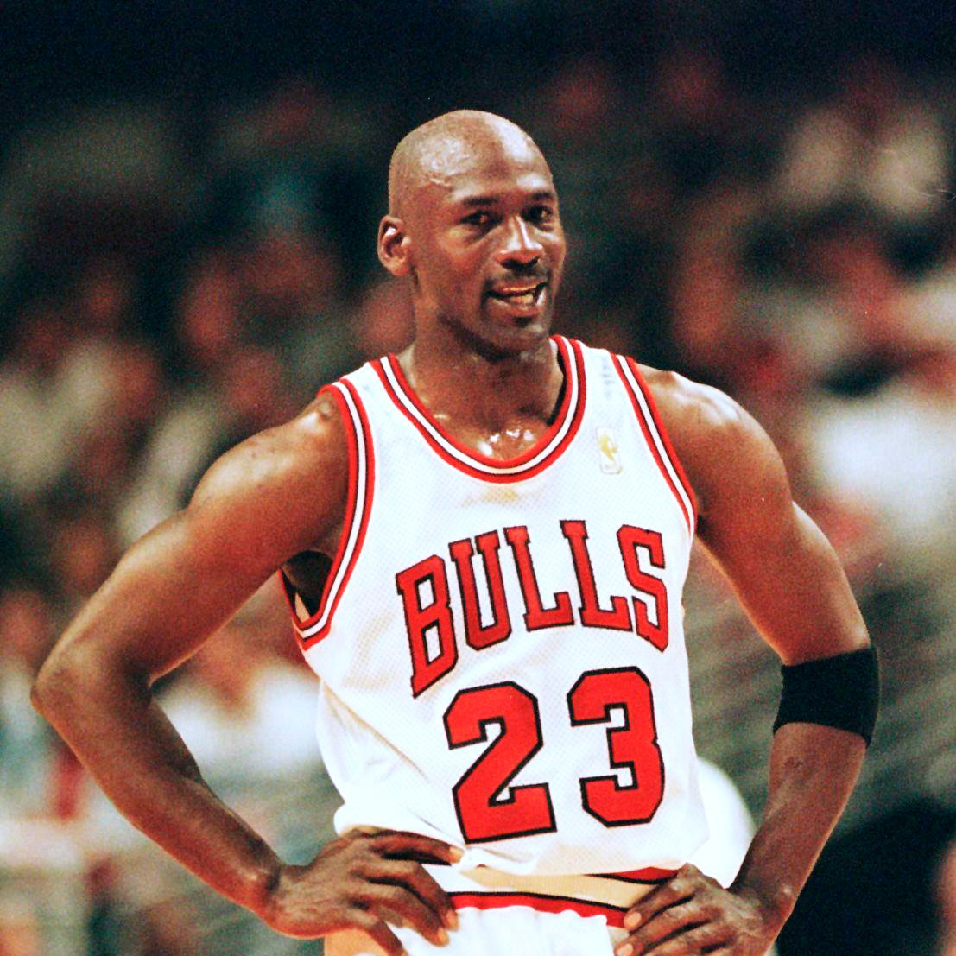
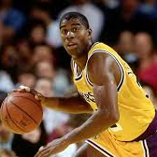
Michael Jordan
Magic Johnson

Slide 7
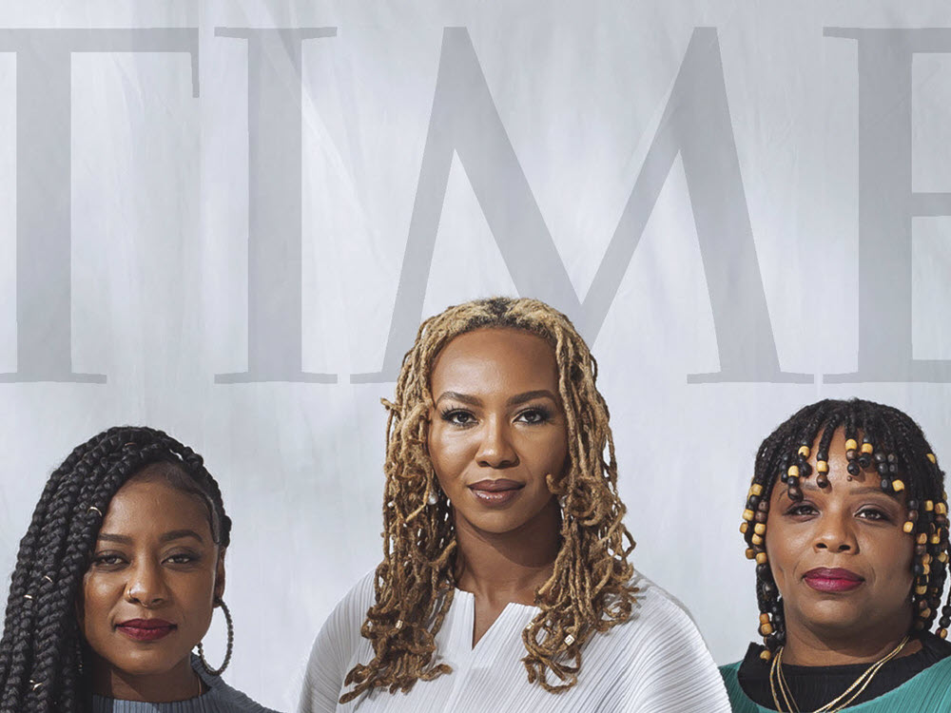

Slide 8
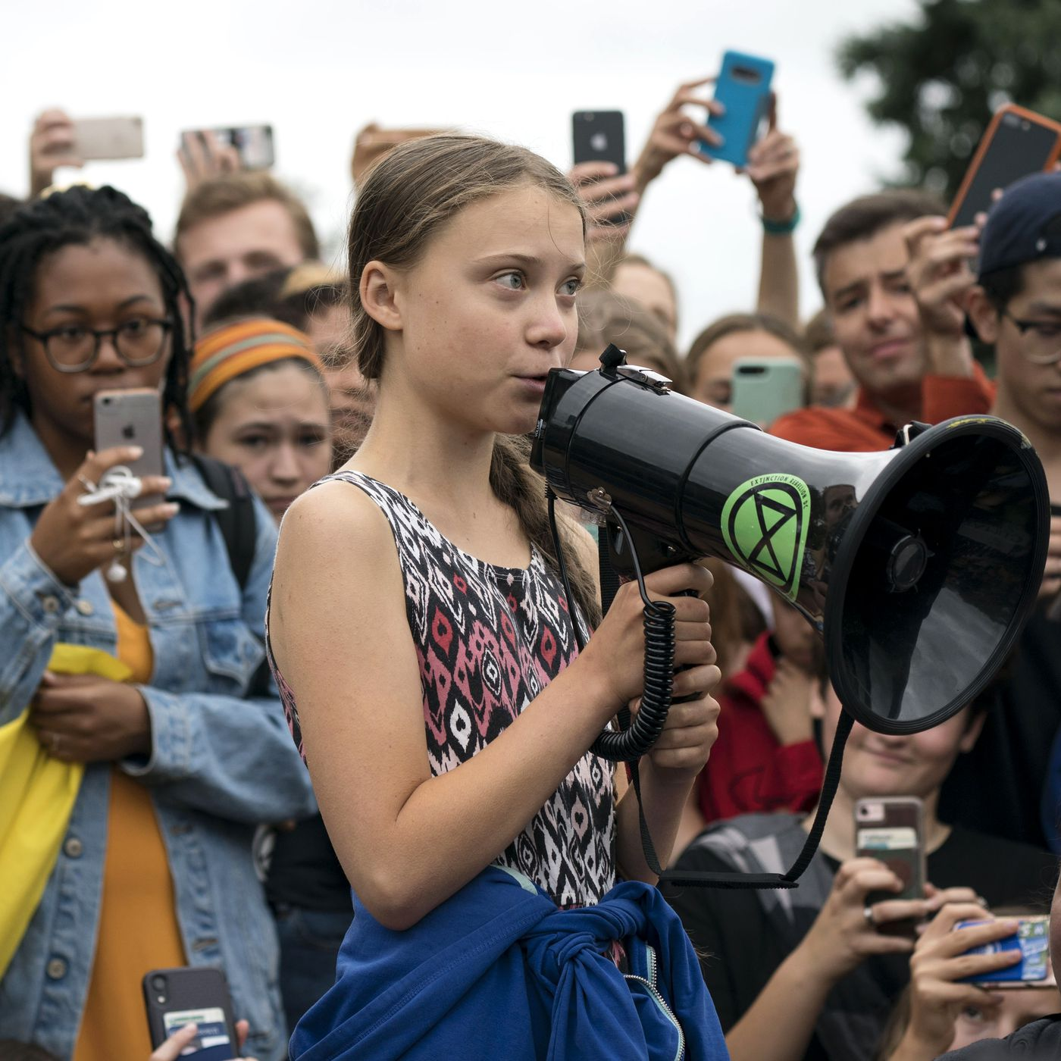

Slide 9
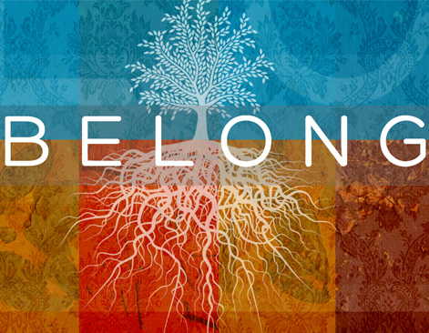
Belonging
Belonging or being fully human means more than having access. Belonging entails being respected at a basic level that includes the right to both co-create and make demands upon society.
Belonging
Notes:
“Belonging means more than just being seen. Belonging entails having a meaningful voice and the opportunity to participate in the design of social and cultural structures. Belonging means having the right to contribute to, and make demands on, society and political institutions.”
Belonging means being fully viewed as a human, but also as a full member of society and of the community. It means having dignity and voice.

Slide 10
Agency
Belonging
Responsibility
Power
Care

Slide 11
Heart of Belonging: co-creating & being seen

Slide 12
Exclusion
Inclusion
Belonging

Slide 13
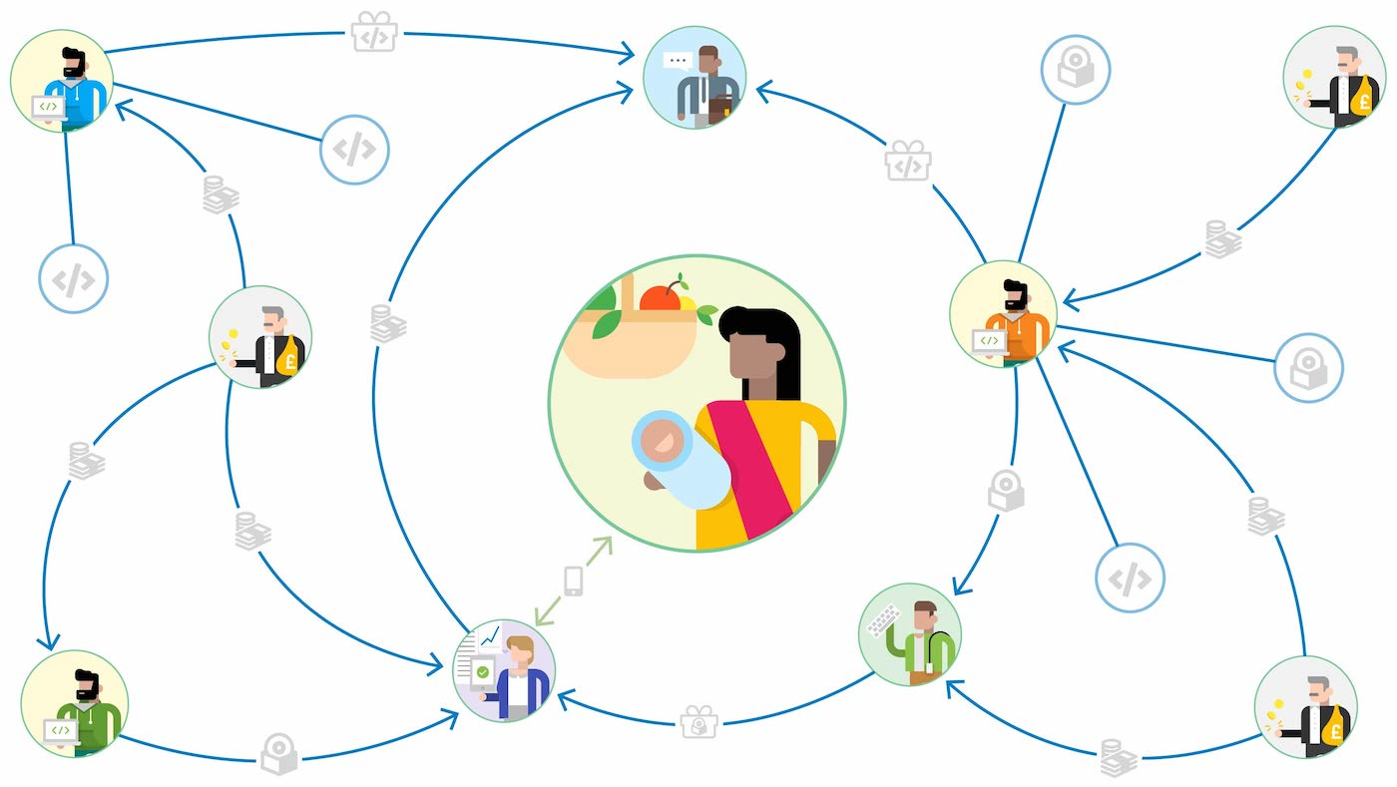
Bridging in All Facets of Life and Work
A just and inclusive society will see all of its members as inside our circle of belonging.
Notes:
Belonging is the construction of society we are striving toward.
We need to bridge in all areas of our life.
Bridging within your own social and professional circles will help you to bridge with the communities you serve and strengthen your commitment to targeted Universalism

Slide 14
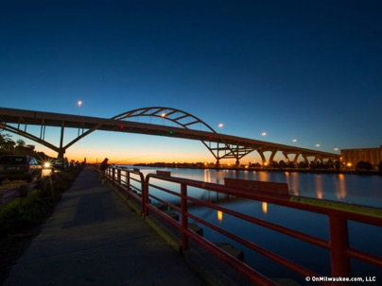
Breaking and Bridging
There are short bridges and long bridges.
Some bridges require more effort to build and maintain. Others are a short distance.
As bell hooks reminds us, bridges are walked on.
Notes:
Similarly, there are different forms of bridging. Bell hooks reminds us that bridges are walked on. Instead of dealing with the devil, we can develop our bridging social capital by building short bridges.

Slide 15
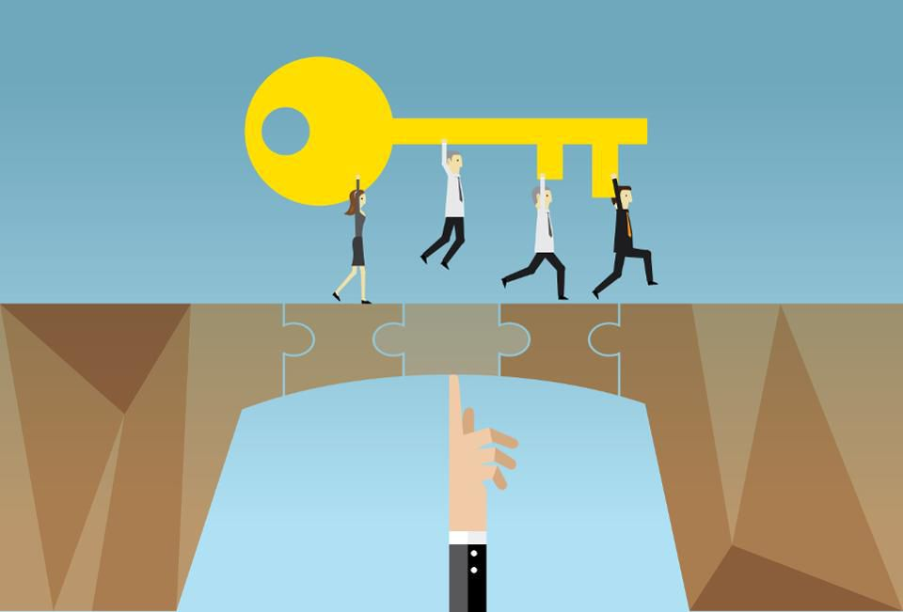
Power Matters
Bridging may look different where there is a power differential. Power is positional, structural, and hierarchal.
People can gain power through linking social networks and creating social capital.
Individuals can build relationships with institutions and individuals who have relative power to access resources.
Power also shifts.
For example: people of color may have more power than whites in certain settings. (e.g. an anti-racism convening)

Slide 16
Creating space where everyone is heard
This does not require flattening the hierarchy of the organization but understanding investment, experience, and responsibility.
Those with the same investment, experience, and responsibility will have the same say.
A leader’s role is to create space and make sure everyone can contribute, considering the multiple identities in the room.
Leaders must contend with an emphasis on making sure marginal voices are heard and an emphasis on empathetic listening
We all need to be recognized and heard. This is not the same as getting everything we want or being right but valuing each other.
Consider:
Who has the most power in the room? Who has the most authentic voice?
How can leaders reinforce marginalized voices and ideas?
Design of the room

Slide 17
Targeted Universalism Operationalizes Belonging
Goals and universal, strategies are targeted based on situatedness.
Each group’s differences must be taken into account
T/U is designed through careful consideration of positionality and situatedness
It is inclusive of all regardless of differences, it expands the ‘we’
T/U is both a communications strategy and operational strategy
It promotes bridging and avoids breaking and scarcity

Slide 18
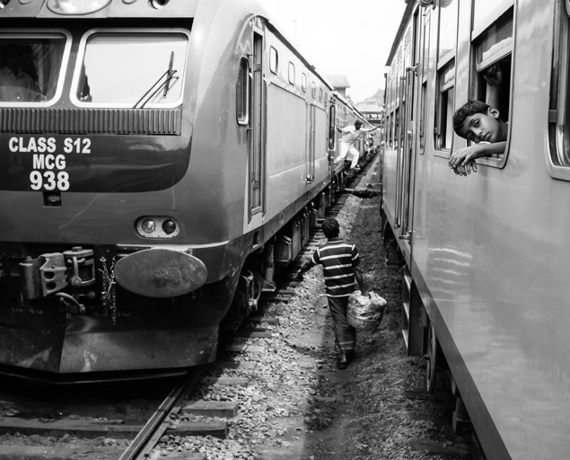
Bridging or Breaking?
The stories we tell will create the both future we inhabit. Who we are to be.
Notes:
We could include people on the train, but what about changing the destination?
We need the courage to question our destination and lay the foundation for a different future.

Slide 19
Who belongs? Who is in the we? We need a better story The leader holds the story of us

Slide 20
