Slide 1
Implicit Bias: U.S. & Global Perspectives
Professor john a. powell
Executive Director, Haas Institute for a Fair and Inclusive Society
Robert D. Haas Chancellor’s Chair in Equity and Inclusion
University of California, Berkeley
Healing History Conference| Caux, Switzerland — July 4, 2013

Slide 2
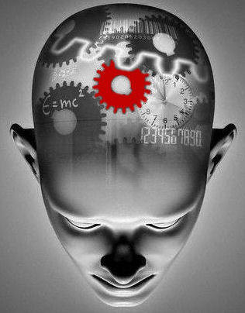
The Brain and Othering
Human brain: process 11 million bites of information in a second
Consciously aware of any 40 of these, at best
Only 2% of emotional cognition is available to us consciously
Messages can be framed to speak to our unconscious
The process of Othering occurs in our unconscious network: this can lead to racial, ethnic, or language bias,
Brooks, David. The Social Animal: A Story of How Success Happens. http://www.guardian.co.uk/science/2011/may/08/david-brooks-key-to-success-interview.

Slide 3
The Circle of Human Concern
LGBTQ persons
Citizens
Felons
Children
Mothers
Elderly
Undocumented immigrants
Black and Latinos
Non-public/non-private space
Notes:
As the expansion of the corporate sphere occurs, marginalized individuals and groups are pushed out of the “circle of human concern” as full members of our society.

Slide 4
Implicit Bias or I/B
The mind naturally makes association: this is intelligence and human
I/B is negative associations that people unknowingly hold, which can be inconsistent with conscious beliefs
Developed in 1995 by Anthony Greenwald and Mahzarin Banaji
I/B influences our feelings, judgments, and perceptions
Implicit Association Test (IAT) introduced in 1998
Since 1998, over 4.5 million people have taken the IAT online in 34 different countries
Currently there are 15 IATs
Religion
Presidents
Skin-tone
Race
Asian
Sexuality
Weapons
Gender-Career
Arab-Muslim
Native
Gender-Science
Weight
Disability
Age
Notes:
Implicit biases: “Attitudes and stereotypes that are not consciously accessibly through introspection” (Kang, et al., 2012, p.1132).
Bullet point 2: If subconscious memories can influence our actions, associations can also influence our attitudes and behavior; thus measures that tap into individual differences in associations of concepts should be developed
Operates “on the assumption that if an attidude object evokes a particular evaluation (positive or negative), it will facilitate responses to other evaluative congruent and co-occurring stimuli” (Dasgupta & Greenwald, 2001, p.801)

Slide 5
Awareness Test

Slide 6
Our Brains in Action: Creating Associations
Please state the color of the text
Blue
Bleu
Red
Rouge
Green
Vert
Black
Noir
Green
Vert
Red
Rouge
Blue
Bleu
Black
Noir
Black
Noir
Blue
Bleu
Green
Vert
Red
Rouge
Green
Vert
Green
Vert
Black
Noir
Blue
Bleu

Slide 7
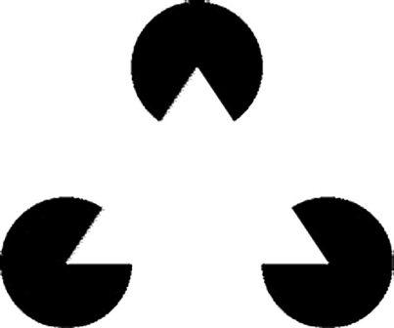
Our Brains in Action: Filling in the Gaps
What shapes do you see?

Slide 8
Our Brains in Action: Filling in the Gaps
Our subconscious fills in the lines for us, to form a shape we are familiar with

Slide 9
Another Way to Think About the Unconscious Mind at Work: Habits
Habits (or mental pathways) are behaviors that we engage in without thinking
Like schemas, individual habits are created and influenced by our environment
While habits can come from the structures & systems we occupy, those structures also have their own habits – the “way things are done.”

Slide 10
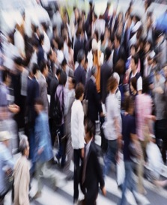
Putting It All Together
Automatic categorization, learned associations, and “filling in the gaps” act in concert to comprise schemas
Schemas are like the filters or frames through which our subconscious manages the 11 million bits of information we receive every second
They are learned and acquired in childhood and in our adult lives
When we encounter things that don’t fit within the schemas that we already have, we experience cognitive dissonance

Slide 11
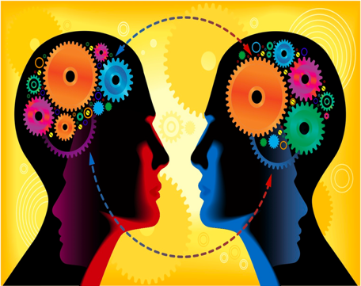
Where Do Schemas Come From?
Schemas are social. They exist in our environment, language, metaphors, etc.
The unconscious is not just an individual or internal phenomenon
The unconscious is social and interacting with the environment
Because we still live in a highly segregated nation, many of us have limited social contact with people of other races
The media—“local” news, television shows, radio, magazines—mediate many people’s experiences of other races

Slide 12
What Does This Have to Do with Racial Equity?
Social categories (race, gender, nationality, religion, sexual orientation etc.) comprise some of the most powerful schemas operating at the subconscious level
These schemas give rise to implicit bias

Slide 13
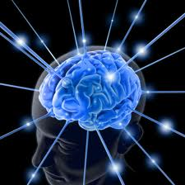
Reacting Before We Even Realize It
The subconscious mind uses three processes to make sense of the millions of bits of information that we perceive
Sorting into categories
Creating associations between things
Filling in the gaps when we only receive
partial information
These three processes together add up to schemas, which are the “frames” through which our brains help us understand and navigate the world

Slide 14
Race in America: Implicit & Explicit Bias
“More Americans have attitudes that are both implicit and explicitly racist than when the same survey was conducted four years ago…
When measured by an implicit racial attitudes test, the number of Americans with anti-black sentiments jumped to 56%, up from 49% during the last presidential election.”
— Paul Harris, The Huffington Post (2012)
Notes:
In an AP survey done in 2011, 52% of non-Hispanic whites expressed anti-Hispanic attitudes. That figure had risen to 57% in the implicit test in 2012.

Slide 15
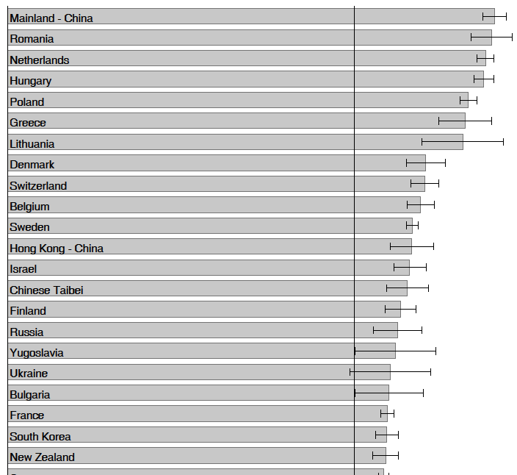
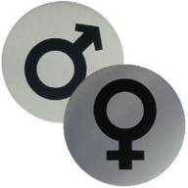
Global Perspectives on Gender: Implicit Bias cont.
Trends in International Mathematics and Science Study (National Academy of Sciences, 2009)
International study with more than half a million participants in 34 countries: 70% harbor implicit stereotypes associating science with males more than females
Highest in Mainland China, Romania, and the Netherlands
In countries whose citizens stereotyped most strongly, boys achieved at a higher level in eighth-grade science and math
Implicit stereotypes may contribute to continuing underachievement and under-participation among girls and women in science compared to their male peers
Notes:
Nosek, B. A., Smyth, F. L., Sriram, N., Lindner, N. M., Devos, T., Ayala, A., Bar-Anan, Y., Bergh, R., Cai, H., Gonsalkorale, K., Kesebir, S., Maliszewski, N., Neto, F., Olli, E., Park, J., Schnabel, K., Shiomura, K., Tulbure, B., Wiers, R. W., Somogyi, M., Akrami, N., Ekehammar, B., Vianello, M., Banaji, M. R., & Greenwald, A. G. (2009). National differences in gender-science stereotypes predict national sex differences in science and math achievement. Proceedings of the National Academy of Sciences.

Slide 16
Stereotypes and Biases: Cognitively, We Cannot Avoid Them!
Intelligence is associational and emotional
We cannot live without schemas
Having biases and stereotypes, however, do not make us racist; it makes us human
Working for equity and justice requires engaging at three levels:
The subconscious
The conscious
Structural/environment
Structural
Conscious
Subconscious
Notes:
Acknowledging biases is human
Efforts to be colorblind can increase racial anxiety and tension
Create positive associations and experiences
Constructive to name anxieties
Pay attention to structures and the work they are doing: make them work for us
Research has confirmed that instead of repressing one’s prejudices, if one openly acknowledges one’s biases, and directly challenges or refutes them, one can reduce them (The Art of Happiness by the Dalai Lama and Howard Cutler)

Slide 17
Impact
Achieving Transformative Change
Power
(Organization & Collaboration)
Structural Arrangements
Implicit Bias
(Communication)
How do we ensure that our everyday work it is not hindering transformative change, but rather supporting it?

Slide 18
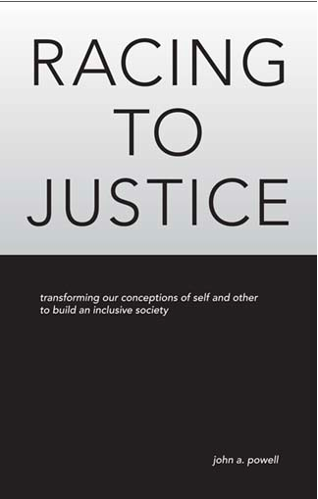
For more information, visit: http://www.iupress.indiana.edu/catalog/806639

Slide 19
Global Perspectives on Race: Implicit Bias & Othering
Work-related prejudice against Arab-Muslims in Sweden (Agerström & Rooth 2008)
Blaming tactics of the Greek financial crisis (Theodossopoulos 2013)
Greek Panamanians blame austerity measures on mainland Greeks for “lazing around” and “relying on subsidies”
Prejudice against Italy’s Cécile Kyenge (Povoledo 2013)
Increasing multicultural nature of Italian society vs. undercurrent of racism/xenophobia (immigrants as scapegoats for high unemployment numbers)
Burma’s political debate over ethnicity and religion (Latt 2013)
“Mixed-blood” as default category for Burma’s Muslim population (4-10%)
Demonized as “terrorists and troublemakers” who foment violence
Notes:
Results of Agerström & Rooth show that implicit prejudice toward Arab-Muslims is held by a large number of employers, especially toward Arab-muslim males. The latter group was specifically viewed to hold a lower productivity rate and more likely to be seen as lazy when related to native Swedish males (158 employers were used in survey)
Theodossopoulos interviews Greeks who had migrated abroad to Panama City during the postwar and the post-Greek civil ware era (early 1950s) under the force of another financial and political “Greek crisis.” He finds that Greek-Panamanians implicitly blame mainland Greeks in the civil sector for the current financial crisis because of their financial mismanagement. “The Greeks of Greece, their argument goes, have lived in a state of affluence for the last 20 or 30 years, working less, having more leisure, relying on subsidies—and bureau- cratic machinations—to eat/swallow (na tron) European or government money.”
Kyenge is Italy’s first black national official as minister of integration. Although an Italian citizen, she was born in the Democratic Republic of Congo and moved to Italy at the age of 19. Derogatory comments made against Kyenge are some of the first to take place outside the sphere of Italian sports, where xenophobic chants and insults are commonplace; immigrants as scapegoats for high unemployment numbers (http://www.nytimes.com/2013/06/23/world/europe/slurs-against-italys-first-black-national-official-spur-debate-on-racism.html?pagewanted=2&_r=2)
Burma has an 89% majority of Theravada Buddhists. The government has been utilizing racist discourse against its Muslim population (mostly Bengalis) that has led to extreme anti-Muslim rhetoric (http://www.irrawaddy.org/archives/38437)
Attack against immigrants in South Africa (undocumented immigrants from Zimbabwe) – stigmatizing folks during financial
Burqua in France (4 Muslim women – how do they place themselves in society – French, British, US, Egyptian) – female muslim body in France – Colorblind society (Lecran – largest black French in France)
The Golden Dom – Albamians trajetory toward fascism (people look like me, but different social standing) – communist and gay/lesbian (anarchist and fascists) – Bohrs victims of their own prejudice – implicit bias in order to survive
Description of the slideshow

Slide 20
Appendix: Resources
Websites
Implicit Association Test: https://implicit.harvard.edu/implicit/demo
Project Implicit: http://www.projectimplicit.net
Equal Justice Society: www.equaljusticesociety.org/law/implicitbias
Implicit Bias & Philosophy International Research Project: http://www.biasproject.org

Slide 21
Appendix: Resources cont.
Bibliography: Implicit Bias Internationally
Baker, D. P., & Jones, D. P. (1993). Creating gender equality: Cross-national gender stratification and mathematical performance. Sociology of Education, 91-103.
Banaji, M. R. & Heiphetz, L. (2010). Attitudes. In S. T. Fiske, D. T. Gilbert, & G. Lindzey (Eds.), Handbook of Social Psychology (pp. 348-388). New York: John Wiley & Sons.
Binder, J., Zagefka, H., Brown, R., Funke, F., Kessler, T., Mummendey, A., et al. (2009). Does contact reduce prejudice or does prejudice reduce contact? A longitudinal test of the contact hypothesis among majority and minority groups in three European countries. Journal of Personality and Social Psychology, 96, 843-856.
Dunham, Y., Baron, A. S., & Banaji, M. R. (2006). From American city to Japanese village: A cross-cultural investigation of implicit race attitudes. Child Development, 77, 1268-1281.
Gonzales, P., et al. (2004). Highlights from the Trends in International Mathematics and Science Study (TIMSS) 2003 (US Dept of Ed., Washington, DC) (NCES no. 2005-005).
Guiso, L., Monte, F., Sapienza, P., & Zingales, L. (2008). Culture, gender and math. Science 320: 1164-1165.
Lummis, M., & Stevenson, H. W. (1990). Gender differences in beliefs and achievement: A cross-cultural study. Developmental Psychology, 26(2), 254.
McGrane, J. A. and White, F. A. (2007), Differences in Anglo and Asian Australians' explicit and implicit prejudice and the attenuation of their implicit in-group bias. Asian Journal of Social Psychology, 10: 204–210. doi: 10.1111/j.1467-839X.2007.00228.x
Nosek, B. A. & Banaji, M. R. (2002). [Polish Language] (At least) two factors moderate the relationship between implicit and explicit attitudes. In R.K. Ohme & M. Jarymowicz (Eds.), Natura Automatyzmow (pp. 49-56), Warszawa: WIP PAN & SWPS.
Nosek, B. A., Smyth, F. L., Sriram, N., Lindner, N. M., Devos, T., Ayala, A., Bar-Anan, Y., Bergh, R., Cai, H., Gonsalkorale, K., Kesebir, S., Maliszewski, N., Neto, F., Olli, E., Park, J., Schnabel, K., Shiomura, K., Tulbure, B., Wiers, R. W., Somogyi, M., Akrami, N., Ekehammar, B., Vianello, M., Banaji, M. R., & Greenwald, A. G. (2009). National differences in gender-science stereotypes predict national sex differences in science and math achievement. Proceedings of the National Academy of Sciences, 106, 10593-10597.

