Slide 1
Panel 2: Innovative Equity Solutions with Data OBI’s data projects and impacts
April 30, 2025
Samir Gambhir, Director, Equity Metrics Program

Slide 2
Equity Metrics Program
The goals of Equity Metrics program are:
To present analytics of social, environmental, and economic conditions in the built environment as they relate to inequity and social justice, drawing from empirical research, data, and surveys.
To develop diagnostic tools and metrics to identify and measure socio-economic outcomes that reflect marginality and exclusion using available data sources, data science and mapping technologies.
To provide potential solutions and framework for combating structural and institutional barriers towards belonging and inclusion, and to influence and support social justice work of other scholars.

Slide 3
Equity Metrics Projects
Opportunity Mapping 2.0 (https://belonging.berkeley.edu/opportunity-mapping-project)
CTCAC Opportunity Mapping (…/ctcac-opportunity-mapping)
Single Family Zoning Analysis (…/single-family-zoning-analysis)
Zoning Reform Tracker (…/zoning-reform-tracker)
Inclusiveness Index (…/inclusiveness-index)
Analyzing Proposition-13
Racial Disparities Dashboard (…/racial-disparities)
California Zoning Atlas (…/california-zoning-atlas)
San Jose AFFH Project (…/san-jose-affordable-housing-project)
Racial Segregation Research (…/racial-segregation-research)

Slide 4
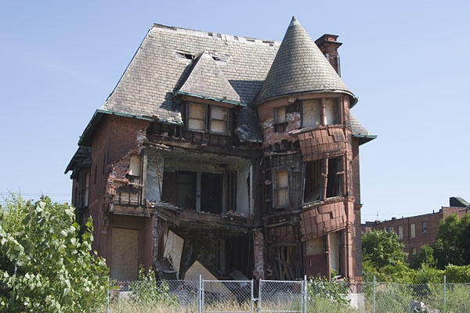
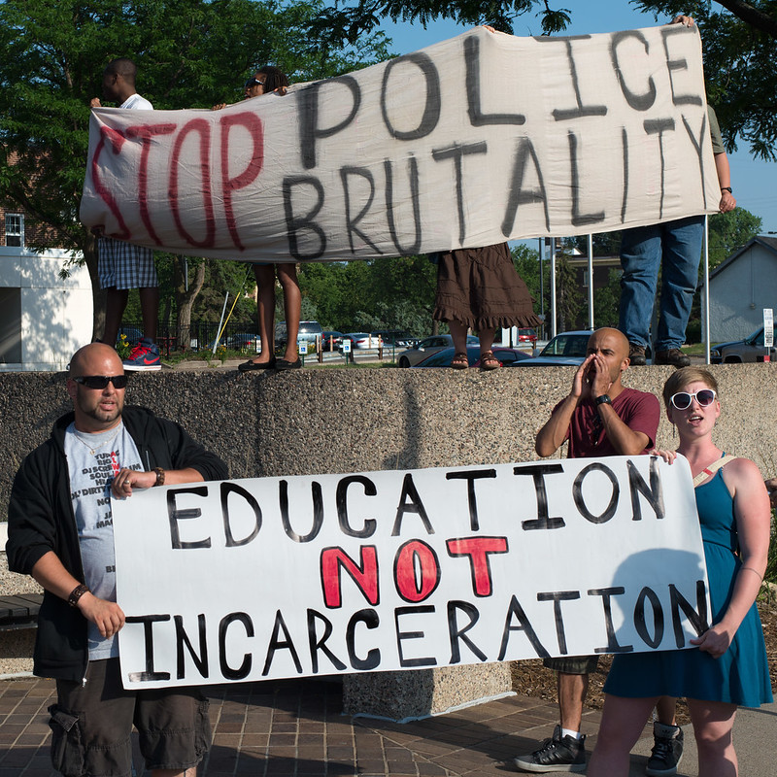
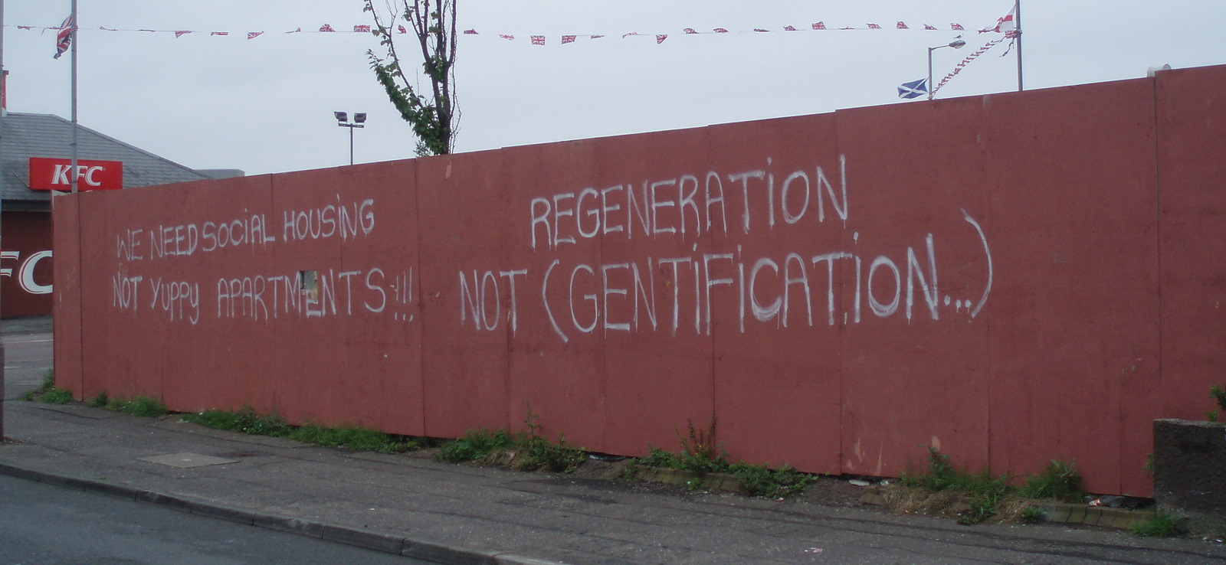
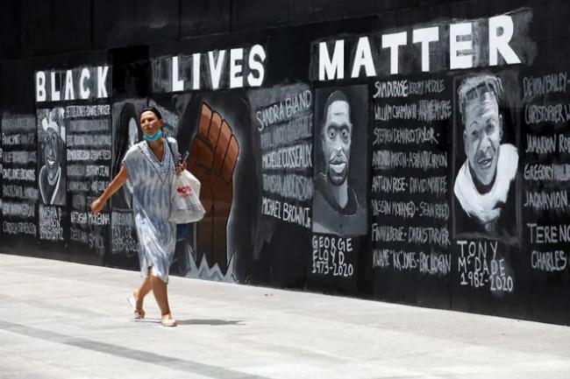
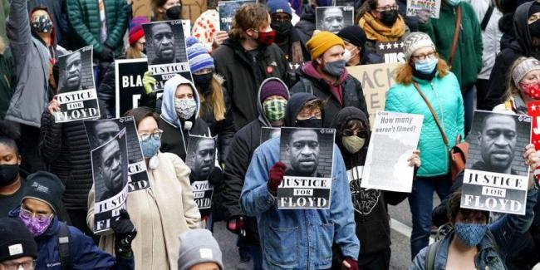
Events

Slide 5
Racial residential segregation
Centrality of segregation
Current and historical events
Policies promoting inequities
Disparities in life outcomes
Housing as a mechanism
Where you live determines your life outcome

Slide 6
Segregation and neighborhood
Where we live determines our life outcomes
Structures and institutions in our living environment either limit or promote fair access to opportunity
These structures produce amenities/resources that can define neighborhoods as opportunity-rich or opportunity-poor and highlight spatial/racial inequities.

Slide 7
Measures of Segregation
Dissimilarity index, Exposure index, Isolation index
Location Quotient, Entropy score/index
Divergence index:
Multi-race, small area measure
Compares the relative proportions of racial groups at smaller and larger geographies, looking for the degree of “divergence” between the two geographies, such as between a census tract and a county.
Value is "0" when the demographics of a smaller geography does not differ, or diverge, from that of the larger geography, suggesting no segregation, whereas higher values suggest higher divergence, and hence higher segregation.
Technical appendix (https://belonging.berkeley.edu/technical-appendix)

Slide 8
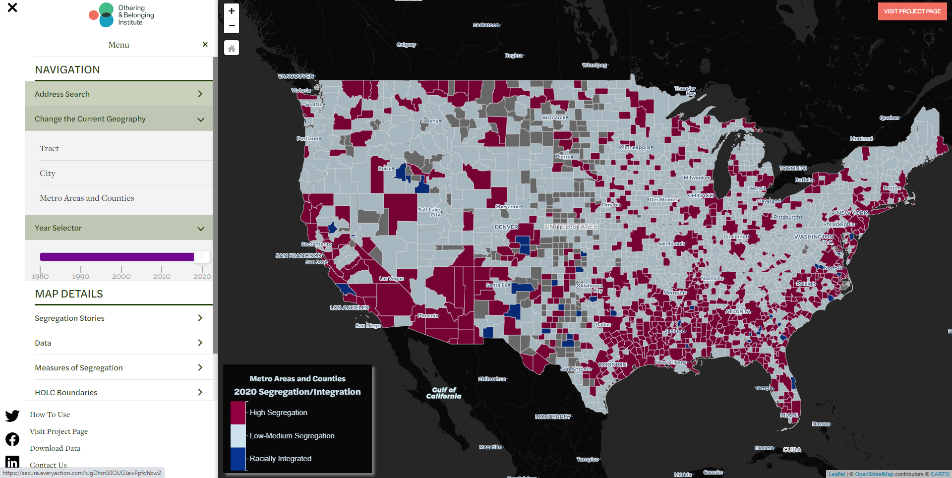
https://belonging.gis-cdn.net/us_segregation_map/?year=2020

Slide 9
The Roots of Structural Racism
23.6% of metropolitan areas were more segregated in 2020 than they were in 2010, and 54% of metropolitan areas were more segregated in 2020 than in 1990.
Out of roughly 120 large cities with population at or above 200,000, only two cities – Colorado Springs, CO and Port St. Lucie, FL – turned out to be integrated as per our functional segregation-integration measure
Link to the report: https://belonging.berkeley.edu/roots-structural-racism

Slide 10
The Roots of Structural Racism
Neighborhood poverty rates are highest in segregated communities of color (21 percent), which is three times higher than in segregated white neighborhoods (7 percent)
Black children raised in integrated neighborhoods earn nearly $1,000 more as adults per year, and $4,000 more when raised in white neighborhoods, than those raised in highly segregated communities of color
Latino children raised in integrated neighborhoods earn $844 more per year as adults, and $5,000 more when raised in white neighborhoods, than those raised in highly segregated communities of color
Household incomes and home values in white neighborhoods are nearly twice as high as those in segregated communities of color
Homeownership is 77 percent in highly segregated white neighborhoods, 59 percent in well-integrated neighborhoods, but just 46 percent in highly segregated communities of color

Slide 11
Impacts
Wide coverage of the project in the media
Used as an input into Opportunity Mapping
Analyzed zoning output in relation to segregation
Data available on request for researchers and scholars to analyzeissues areas in relation to segregation
Releasing the next version/update soon

