Slide 1
Mónica Meltis Véjar
Data Cívica
Bksy: @mmeltisv.bsky.social
X: @monicameltis
@datacivica

Slide 2
Introducción
El porqué de Datos para la vida
The motives behind Datos para la vida
It’s a project that looks to:
Contribute to the betterment of public data about homicides
Introduce an intersectional perspective for the analysis of homicidal violence in Mexico
Recognising our biases and their implications (belonging- and othering)
Institutionalization of those biases

Slide 3
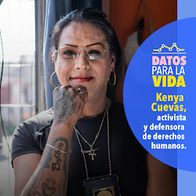
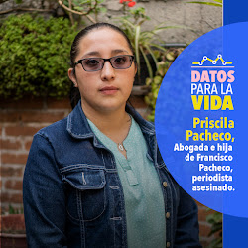
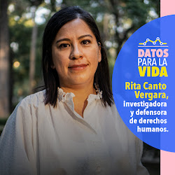
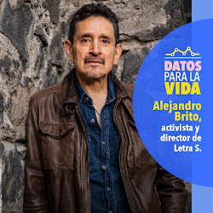
Datos para la vida
The research behind Datos para la vida
our research: what does intersectional data/registries mean?
Our research employed a mixed methodology, using both qualitative and quantitative methods to gather and analyze information
We divided our research in two: first we analyzed the methodolgy and the statistics of the biggest mortality dataset produced in México: el Registro de Mortalidad del INEGI
This information is produced by the National Institute of Statistics and Geography
Then we gathered an extensive compilation of recommendations provided by organizations and experts dedicated to document different types of homicide cases in Mexico & Latinamerica: sexual workers, migrants, people with dissabilities, HIV activists, gender and sexual diversity

Slide 4
Datos para la vida
Current Data
The data we currently have to study homicides and femicides in mexico
- The mortality records produced by the INEGI is the only dataset in Mexico that currently provides detailed information about the victims and the agressions they suffered
- The mortality records include information such as the sex, age, education and residence of the victims as well as the dates, places where they were killed and the type of agressions that caused their death
- In other words, through this data we can extract information about the identity, the body and the context of the victims

Slide 5
Datos para la vida
Current Data
The data we currently have to study homicides and femicides in mexico
- The data produced by the Mortality Records is rich in information, but it has important limitations for the study of homicidal violence
- There is information that is incomplete or simply excluded:
There is no information about the gender identity or orientation of the victims
The informal jobs of the victims are not captured
The only information about the victims racial identity is a binary variable that tries to capture if the victim spoke an indigenous language, but it’s only captured for 1 in every 5 victims
The only agressions that are captured are the ones that prove to be fatal according to the forensic doctors, any sign of torture or sexual abuse is excluded
There are almost 50000 victims whose fatal aggressions are unknown as they remain unclassified
The relation between the victims and their aggressors is only know in 7% of the cases

Slide 6
Datos para la vida
Needed Data
The data we need have to improve the study homicides and femicides in mexico
-The information that is incomplete or excluded is necessary to understand the specific violence patterns different demographic groups or minorities face
-Different victims face different vulnerabilities and suffer different aggressions from different types of aggressors
-There are physiological conditions that may work as vulnerability or marginalization factors, such as: genetic , degenerative or autoimmune diseases
-Even if not fatal, there are different types of aggressions (such as torture or sexual aggressions) that could point to different type of aggressors with different motives

Slide 7
Datos para la vida
Datos sobre la identidad de las víctimas
What information about the victims' IDENTITY IS NECESSARY TO UNDERSTAND HOW THE VIOLENCE AFFECTS THEM DIFFERENTIALLY?
- Information about their sexual orientation and gender identity
- Consider at least two variables
- Information about racialized people
- Bodily components
- Cultural components
- Information on what people spent their time doing:
- The occupation variable is limited to 14 different categories and excludes vulnerabilized populations such as sex workers and activists and/or human rights defenders
- Occupation” may not be sufficient to collect information that may generate risk.

Slide 8
Datos para la vida
Datos sobre la identidad de las víctimas
What information about the victims' IDENTITY IS NECESSARY TO UNDERSTAND HOW THE VIOLENCE AFFECTS THEM DIFFERENTIALLY?
Common challenges:
- Self-identification per se is not possible.
- Complexity of identities and the possibility of being classified within more than one category.
Recommendations:
- Include the perspective of the person's social family, not only consanguineous.
- To have bodies made up of specialists who periodically review the relevance of the pre-established categories (categorical variables) for the variables related to the identity of individuals.
- In addition to categorical variables that include pre-established values, include open fields where it is possible to record any other term.

Slide 9
Datos para la vida
Datos sobre el cuerpo y el contexto de las víctimas
What information about the body and context of the victims still needs to be victims still needs to be collected?
- The construction of differentiated victimization patterns requires retrieving information about the bodies and the context of the murdered persons in a cross-sectional manner.
- This information allows us to improve the reconstruction of the victims' profile, to understand the aggressions or aggressors involved in their victimization patterns and the possible motivations behind their acts.
- There is currently a lack of information to identify possible physiological conditions that act as factors of vulnerability or marginalization, such as genetic, degenerative, autoimmune or sexually transmitted diseases.
- There is also a gap to know the acts committed during and after the fatal aggressions inflicted, identifying actions of torture, humiliation, cruelty, elimination, concealment or exposure.

Slide 10
Datos para la vida
Datos sobre el cuerpo y el contexto de las víctimas
What information about the body and context of the victims still needs to be victims still needs to be collected?
- Recording the actions of concealment and exposure of the victims' bodies can shed light on the possible strategic or symbolic objectives sought by the perpetrator of the violence.
- Recording acts of humiliation, cruelty, torture and sexual violence is relevant in cases where the victims are targets of exclusion, discrimination, persecution or vulnerability.
- Likewise, the recording of non-lethal aggressions, marks and wounds on the bodies can help to identify the profile of possible perpetrators: certain types of torture and other degrading acts have been identified and are usually carried out by certain specific law enforcement agencies.

Slide 11
Datos para la vida
Datos sobre el cuerpo y el contexto de las víctimas
What information about the body and context of the victims still needs to be victims still needs to be collected?
- During the roundtables, recommendations were made that identified the urgency of documenting the specific type of location where a body is found as well as other spatial characteristics of the crime scene.
- A need that has been repeatedly emphasized is the documentation of threats, history of violence and previous information that could give clues about situations of vulnerability that accompanied the victims during their lives.

Slide 12
Datos para la vida
Próximos pasos
¿what’s next?
During its development, Data for Life sought to identify what data are needed to reduce homicidal violence.
This question should be discussed periodically, so we continue to work to help the rest of civil society and the authorities to take ownership of this discussion.
Data for Life will also seek in its next phases to identify the limitations that Mexican institutions face in implementing proposals for the generation of disaggregated homicide data.

