Slide 1
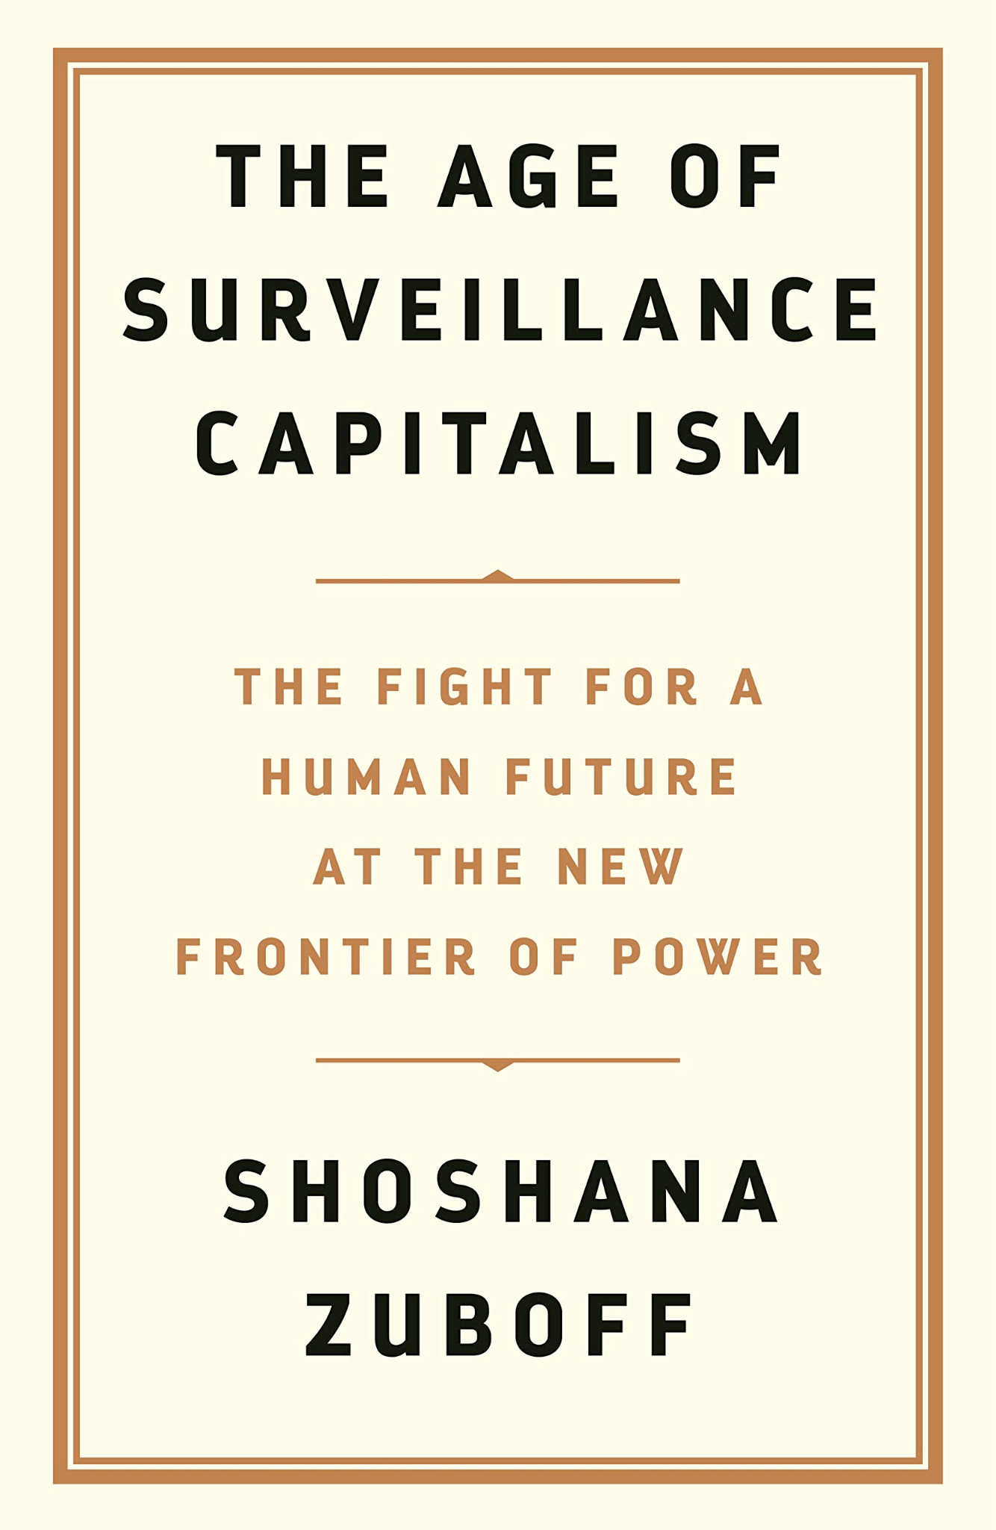
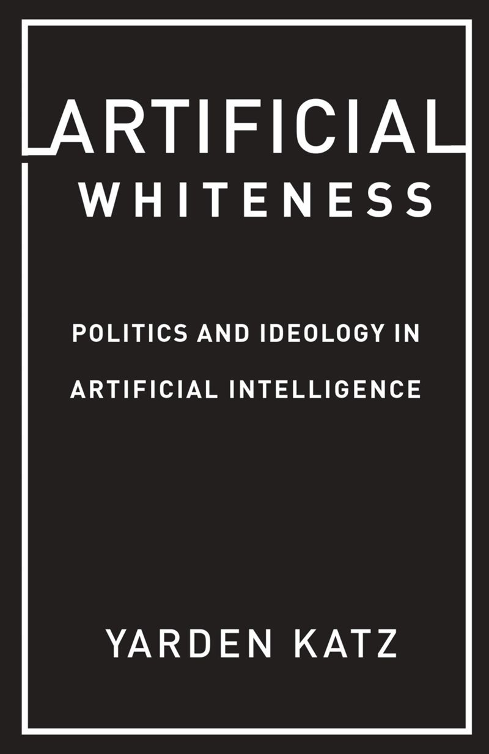
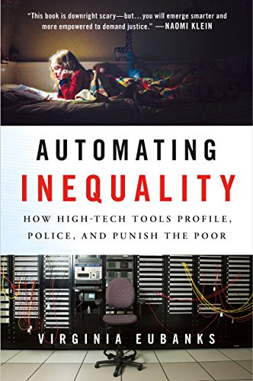
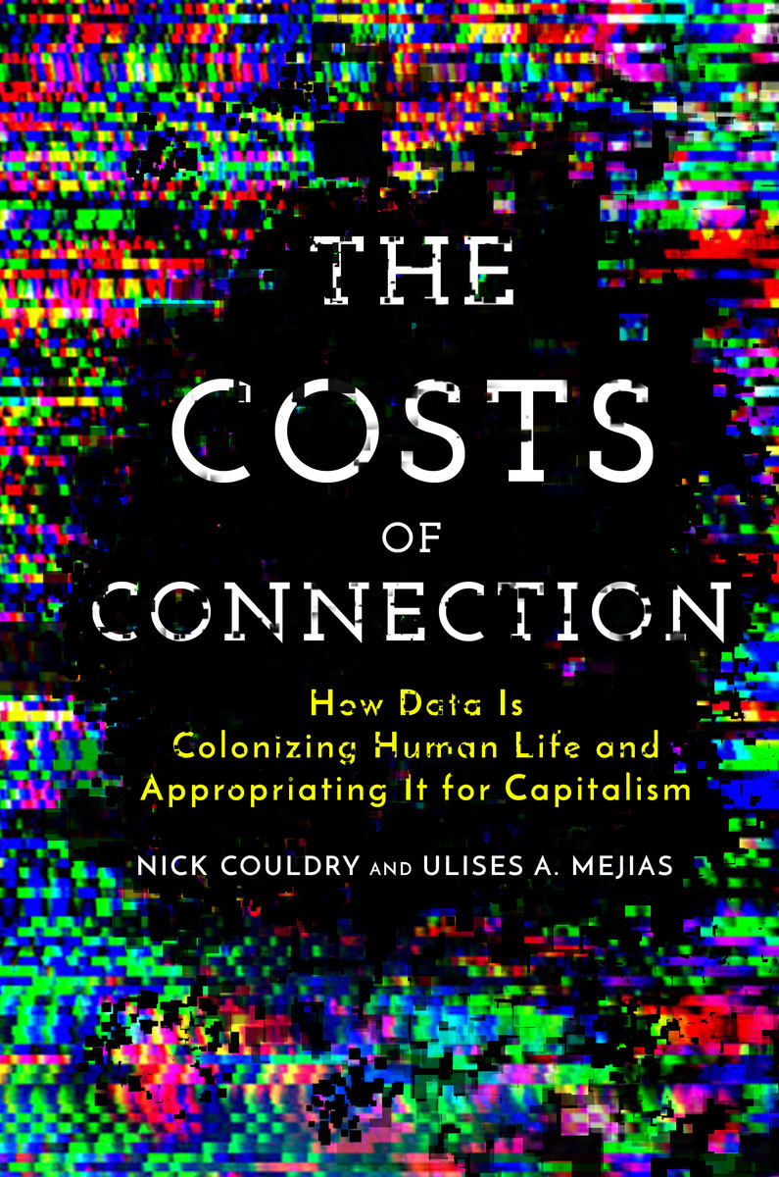
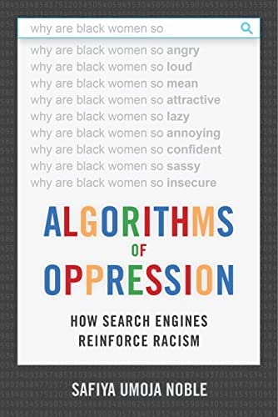
Naming and describing hegemonic data science & AI
Work describing the harmful, discriminatory effects of data & AI
Notes:
Want to begin with a brief reflection on the current moment with respect to data and AI, which is this:
Over the past decade, we have seen the development of a truly amazing body of work that has given us concepts and frameworks to understand the harmful, discriminatory effects of data and AI. This work show very convincingly how our data sets, data systems, our algorithms, and now our AI are accelerating and exacerbating longstanding and persistent social inequalities, such as sexism, racism, colonialism and more. // What these works teach us is that data and AI are not outside of power, or separate from power. In fact power is increasingly concentrated and wielded through data, which we are witnessing very acutely right now as AI systems are permeating the US government at the federal level, restricting and re-allocating grant funding, making decisions about people to fire and agencies to defund, aligning sensitive datasets, and more.

Slide 2
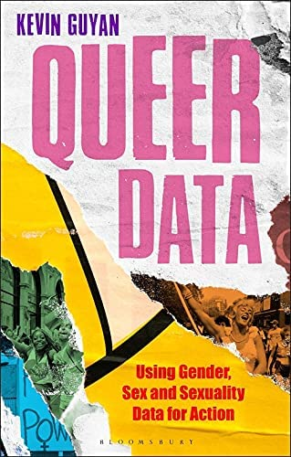
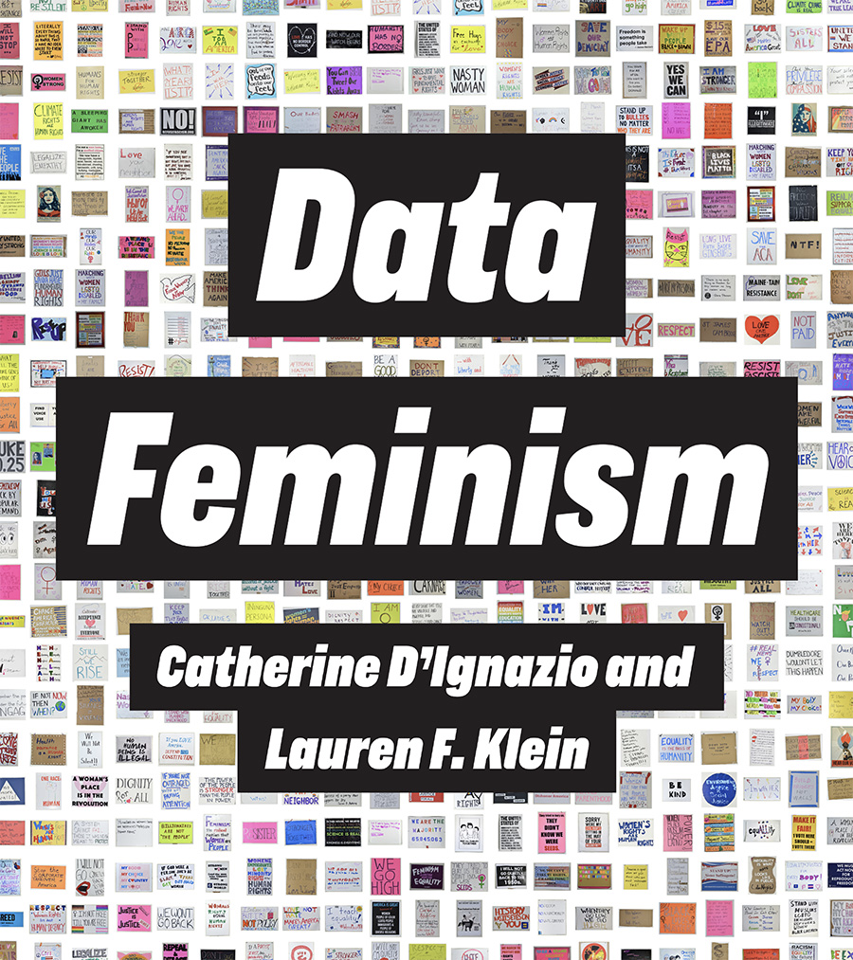
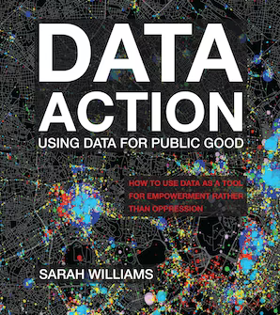
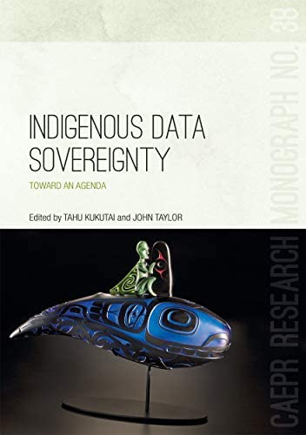
What role does data science have to play in building a more just world?
What role does AI / data / tech have to play in building a more just world?
Notes:
And so this is where a second line of research comes in. This work is not just about documenting harms, and offering concepts to describe the unjust and unequal configuration of power with respect to data–which, just to be clear, is very valuable and still very necessary. But what this other body of work tries to do is be creative and forward-thinking about what it looks like to use data science in the service of justice. It say, yes, we can envision and even build alternative data practices, and data ecosystems, even if they only exist at a small scale or for a weekend. These are approaches that often leverage alternative value systems and worldviews, and draw from feminist, Indigenous, Black, queer, decolonial, and other frameworks.
This is where I would situate my book, Data Feminism, which I wrote with Catherine D’Ignazio, which you can see on the left. We looked to intersectional feminist theory along with the already existing data practices of activists, citizens, journalists, artists and social movements to formulate seven principles for DOING data science in a feminist way.
So what I’m going to do in my time today is talk about some examples from that book, and some that have emerged since, that point to ways of “harnessing data for social justice,” as this panel asks us to do.

Slide 3
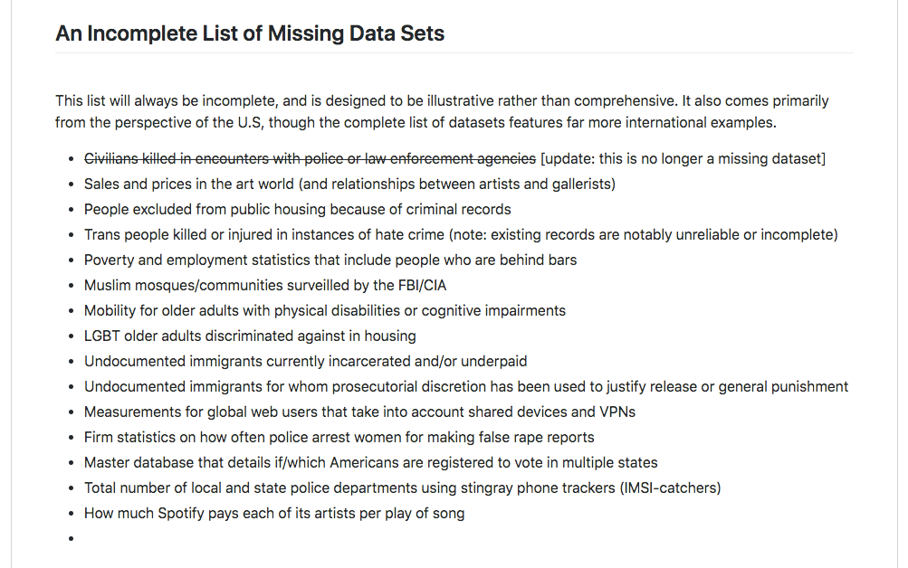
The Library of Missing Datasets by Mimi Onuoha, 2016.
Principle: Examine Power
Principle: Examine Power
Notes:
The first step in this process is to survey the current data ecosystem, and determine what forces of power are shaping it. BY this i mean what forces of power are determining what data exists in the world, and can be used to effect change; and what data does not YET exist in the world, and needs to be created first.
In Data Feminism, we use the example of a artwork, the Library of Missing Datasets, created by Mimi Onuoha, in order to underscore the importance of examining power.
Onuoha’s artwork exists in two forms. The first is as a github repository, which is what you see on the right, which lists the datasets you would expect to exist, because they address issues of pressing social need, but in reality do not.
And the second is in a physical installation. Here, the datasets are the labels on these file folders. You identify a dataset that seems interesting to you, or important, but when you open the folder to learn more, it is empty. The datasets here are physically missing.
The point that Onuoha is trying to make in this piece, is that these datasets are missing for a reason. And the reason is the profound imbalance of power with respect to data collection in the world today. Who has this power? Generally speaking, it’s governments and other moneyed institutions. And again, generally speaking, minoritized groups do not.
This is why a feminist approach to data–and to AI–still needs to begin with an analysis of power. Because far too often, the datasets that we can access, the models they’re used to train – and in turn the research questions, and real world applications, that they can be appropriately be used for – have already been overdetermined by the imbalance of power in the world.

Slide 4
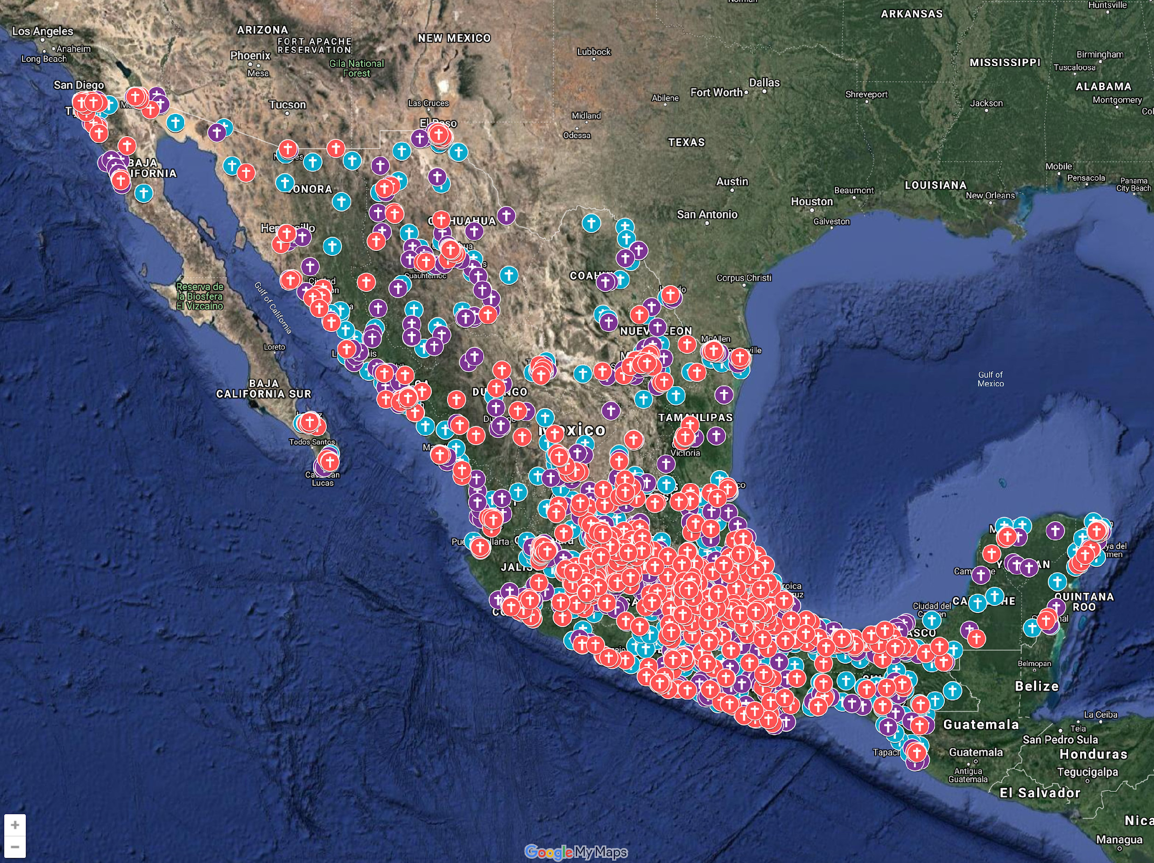
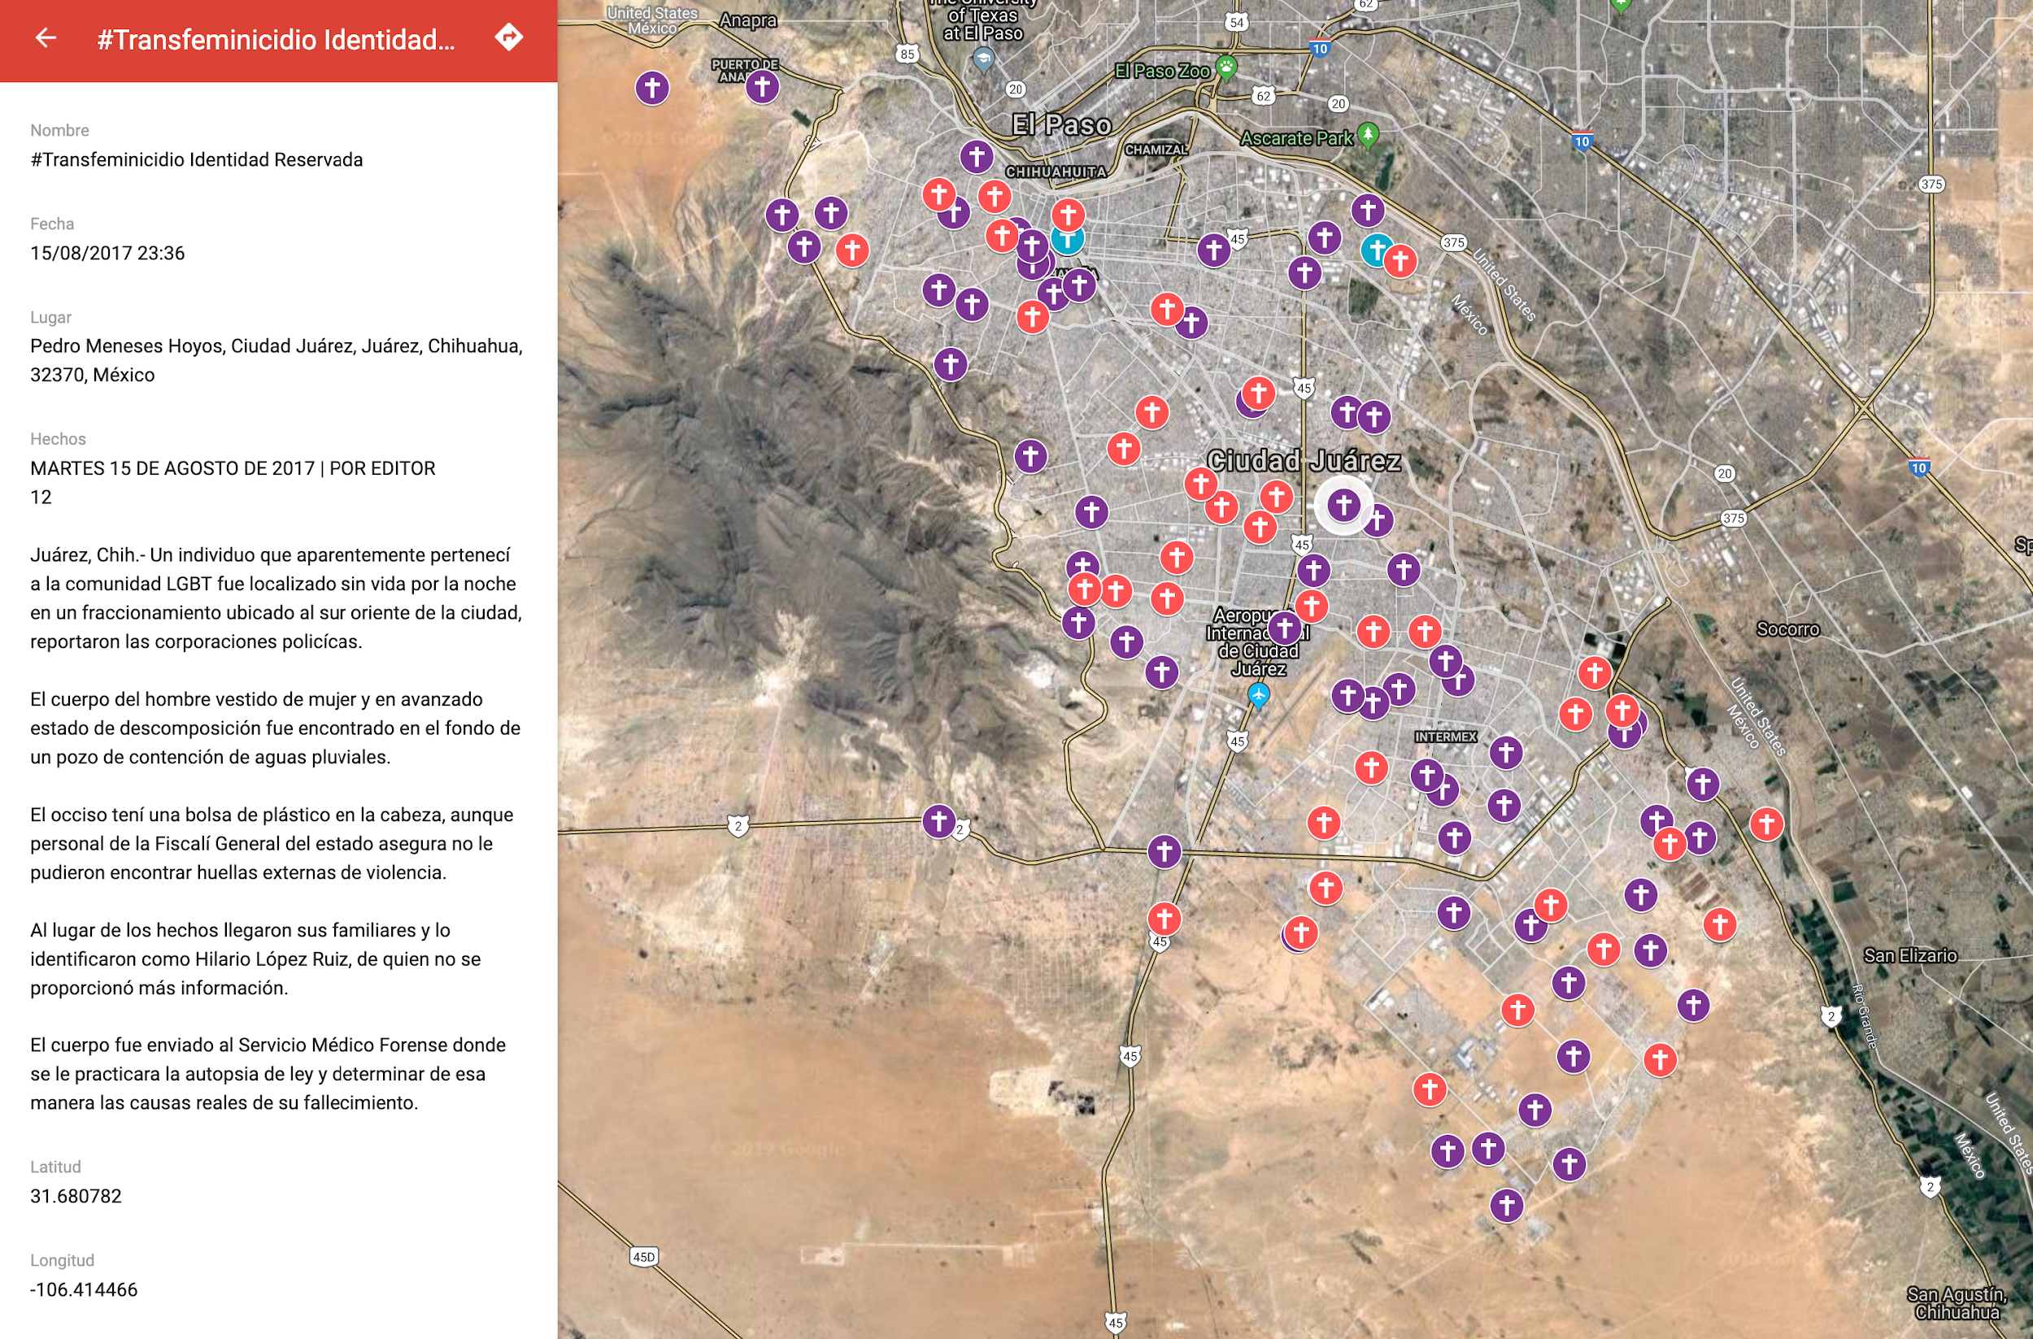
Feminicides in Mexico by María Salguero, 2016-present
#NiUnaMenos
Intervention: Challenge Power with Counterdata
Notes:
So what do we do about the issue of missing data. One example comes to us from feminist data activists in latin america.
In the book we tell the story of Maria Salguero, a Mexican citizen, who identified an instance of missing data relating to an issue that she cared very much about, which is the issue of feminicide.
feminicides are gender-related killings of women and girls, and they include cis and trans women. They are legally defined as crimes in a handful of countries including Mexico, but the State does not systematically collect data on feminicides. Frustrated by the lack of formal action, Salguero has singlehandedly compiled the largest public archive of feminicides in Mexico. She spends 2-4 hours per day logging feminicides on a Google map that she culls from media reports. She has helped families locate loved ones, provided data to journalists and NGOs and has testified in front of Mexico’s Congress multiple times.
In Data Feminism, we describe this as a form of what might be called feminist counterdata - activist data collection that steps in when the state and other institutions have systematically failed to ensure the basic safety of their population. It represents one way to use data to challenge power.

Slide 5
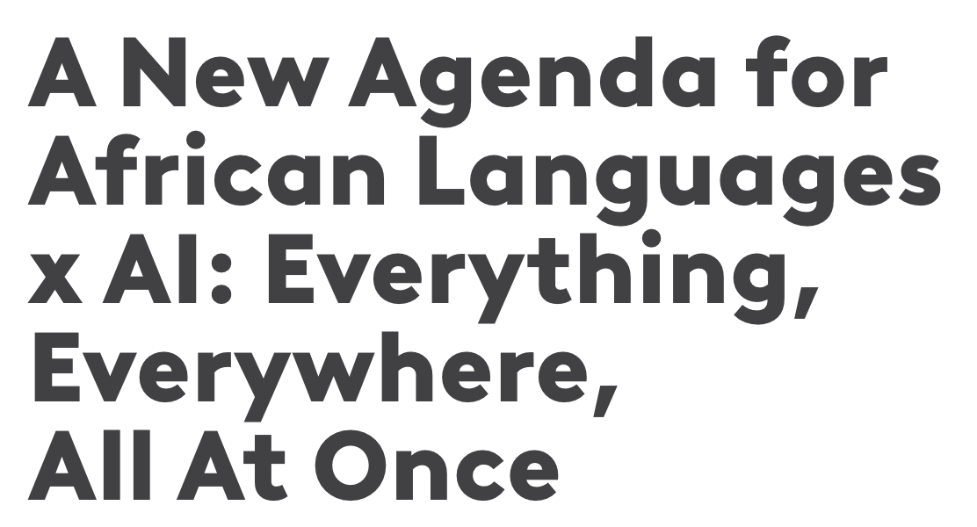
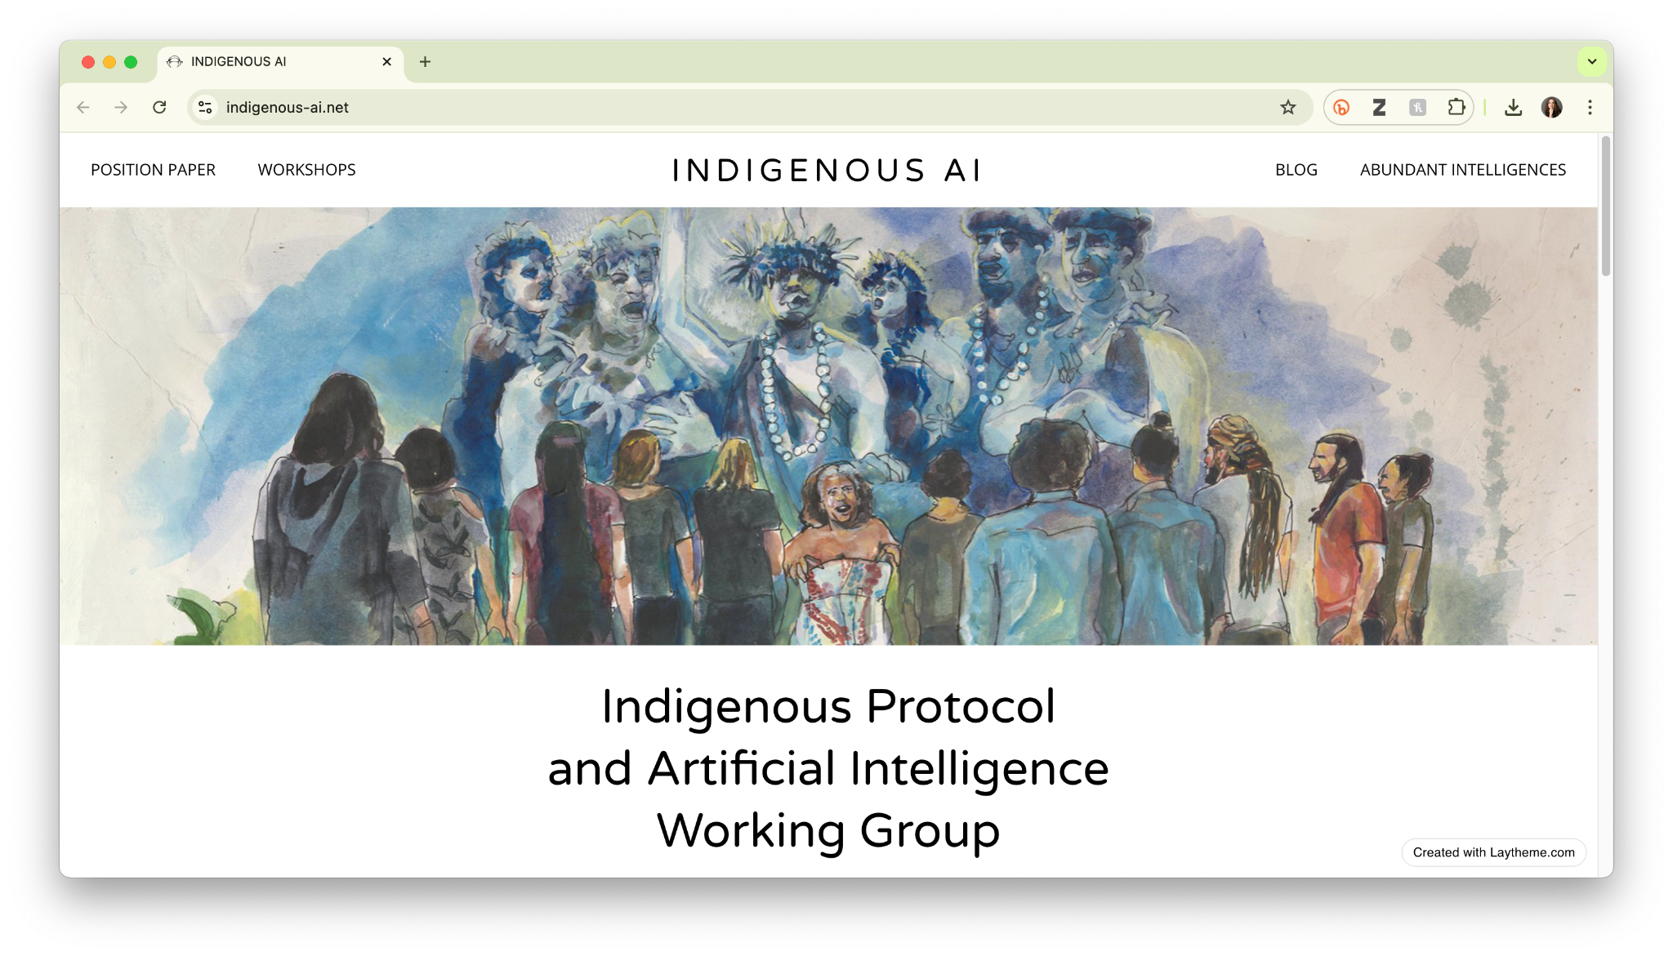
Data Problem: Missing Data
Above: Dr. Vukosi Marivate on “A New Agenda for African Languages x AI” and his company, Masakhane NLP.
Top right: Karen Hao on attempts to create a Māori language model.
Bottom right: The Indigenous Protocol and Artificial Intelligence Working Group.
Intervention: Involve Communities in Data Creation
Notes:
One question people always have about the idea of collecting counter data is, whether it can scale up to meet the demands of AI, with its orders-of-magnitude-larger requirements for training data.
And the short answer is, in certain contexts, yes. Over the past year, in the area of so-called low-resource languages, we have seen a number of efforts to create new datasets of these languages for training AI models–for example the Maori language; // and companies that are working to spur the development of NLP research on African languages.. // But I want to make clear one thing: which is that collecting more data is not the universal solution to issues of missing and biased data. Collecting data on vulnerable populations can very often lead to unwanted exposure or outright harm; and in far too many of cases, efforts to bring “low resource” languages into AI models end up only reproducing existing power differentials. It’s very significant that each of the projects you see up here on the screen are led by people from the communities they seek to support with their work.

Slide 6
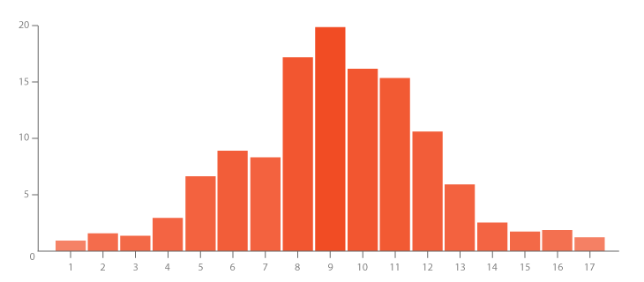
Participatory processes for data science & AI
Feminist design prioritizes the participation of people who have been most marginalized by the system
Feminist design
Feminist design
We center the voices of those who are directly impacted by the outcomes of the design process. – Design Justice Network
Principle: Embrace Pluralism
Notes:
And this point brings me to a broader principle that can help guide all of us in this type of work. It’s a feminist principle, which derives from the work of Sandra Harding, Donna Haraway, and Shaowen Bardzell, and it has to do with the idea embracing pluralism, This essentially means listening to and learning from a range of sources of knowledge.
What’s exciting is that we’ve started to see some of these participatory practices show up in data science, and data-driven research.
And now I’ll briefly talk about two projects, involving AI and ML, that attempt to mobilize this principle.

Slide 7
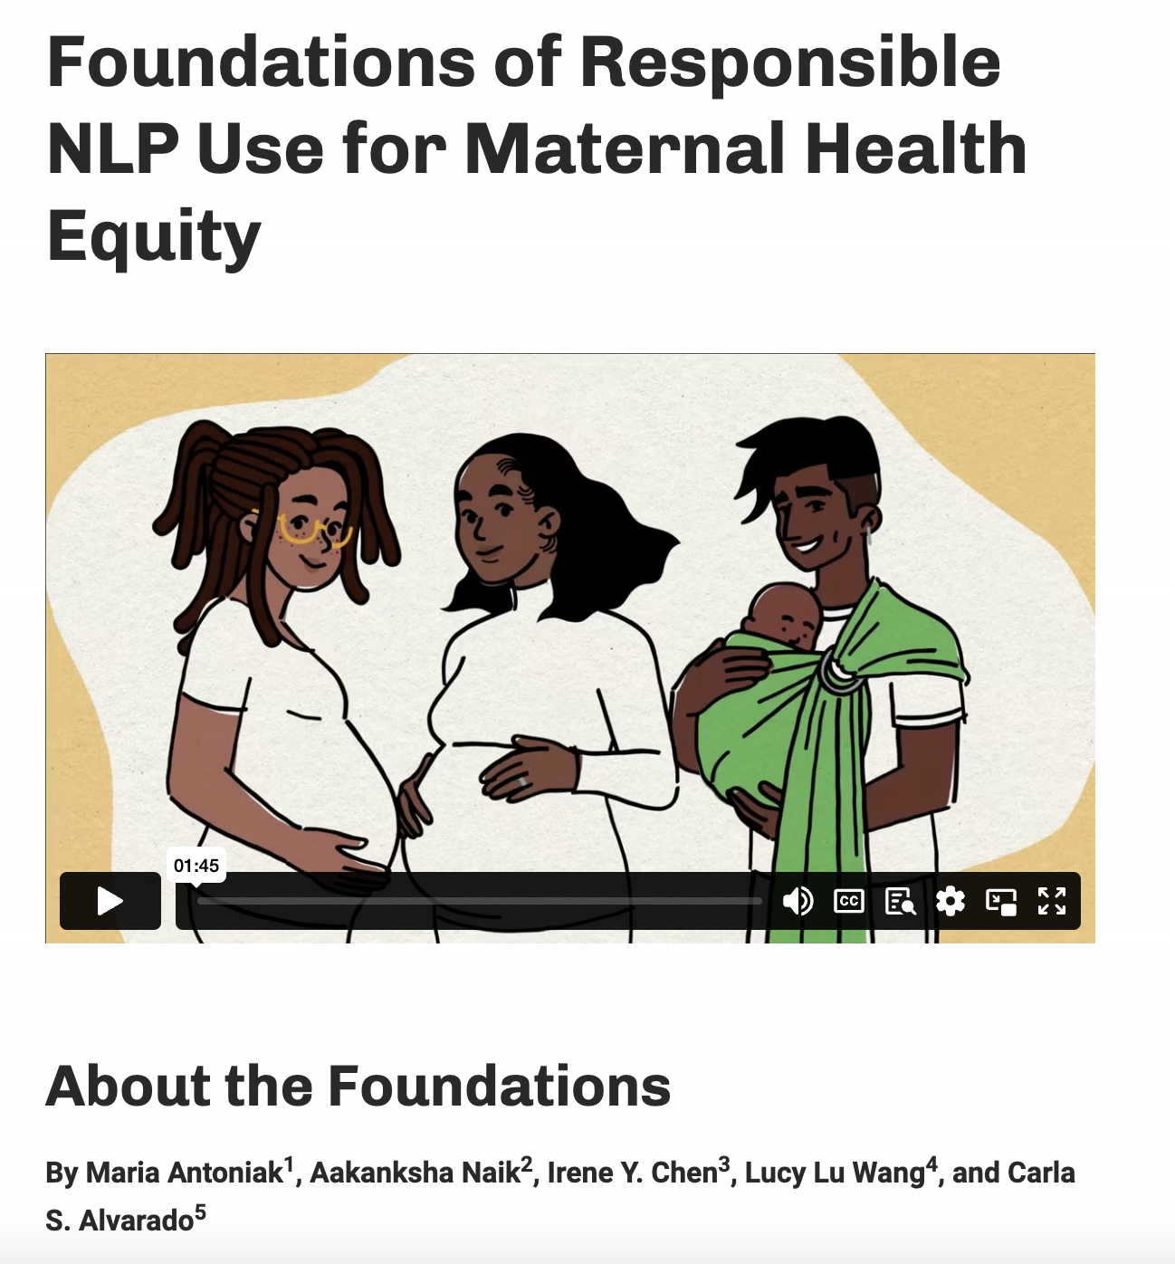
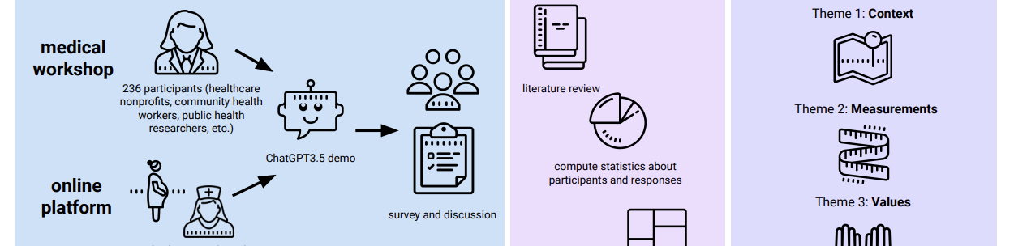
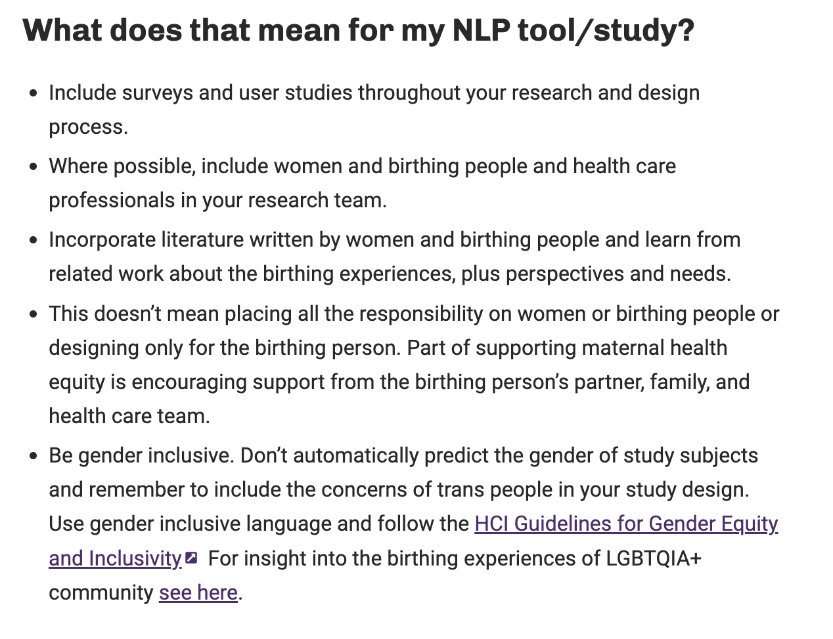
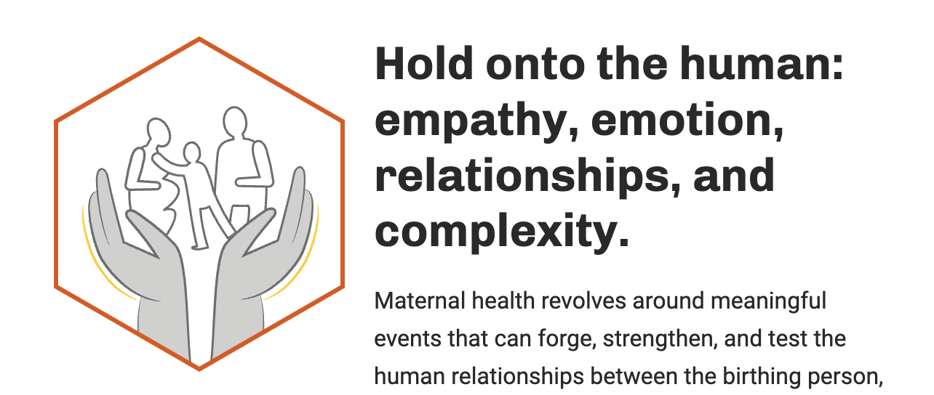
AI co-design for maternal healthcare
Should we build anything?
Co-design workshops
What should we build?
Co-design workshops
How can we bake your language and context into ML models?
Participatory data annotation essions with workshops to debrief
How are the tools working for your group?
3 moth pilots with surveys and workshops to debrief
How can we continue to support you?
WhatsApp groups and annual events
Principle: Embrace Pluralism
Notes:
The first is this project involving the development of a chatbot for pregnant people. The basic idea was that, when you are pregnant, you have a lot of questions, and you might want to be able to ask those questions of a resource trained on trustworthy information rather than bug your friends or your doctor all of the time.
But very crucially, the project leads did not go into the project with their own ideas about what types of questions the chatbot would answer, or when they would answer them. Instead, the team conducted an extended interview process with people who had been pregnant and synthesized the results. The output of the project wasn’t a chatbot, but rather, a set of guidelines for future developers should they seek to build something that was wanted, and would be used.

Slide 8
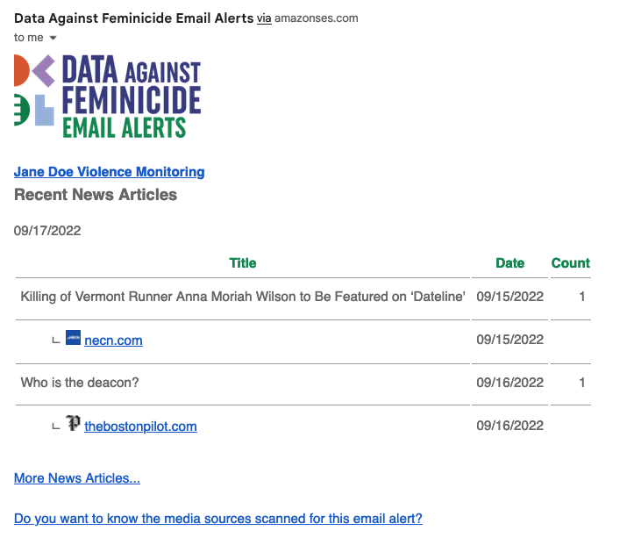
AI co-design with 12 groups
Should we build anything?
Co-design workshops
What should we build?
Co-design workshops
How can we bake your language and context into ML models?
Participatory data annotation sessions with workshops to debrief
How are the tools working for your group?
3 month pilots with surveys and workshops to debrief
How can we continue to support you?
WhatsApp groups and annual events
Principle: Embrace Pluralism
Notes:
The same approach is in play with the Data against Feminicide project, which has sought to build AI systems and digital tools to support data activists like Maria Salguero, whose missing data project I mentioned at the beginning of my talk.
This is actually a project that Catherine has been involved with since writing Data Feminism. And as with the maternal healthcare project, Catherine and her team really prioritized listening to the data activists themselves, and learning from them what tools they might need.
Because building an AI tool was not a foregone conclusion. Catherine and her group held brainstorming workshops to discuss whether digital tools could help to streamline activists' work and/or reduce the emotional toll of this work for them, or whether it would just mean work of another kind.
It has been an iterative process over three years, but Data against Feminicide has now built two tools that are being used by more than 40 human rights monitoring groups.
But i want to come back to the point i made just a minute ago, about how building the AI tool was not a foregone conclusion.

Slide 9
Is AI inevitable?
Notes:
Because this starts to bring me up to my last few slides. //
Recently, there’s been a series of important critiques of AI, which are framed around the question of inevitability. With this framing, scholars such as Mar Hicks are questioning why it is that we don’t seem to have a choice as to whether or not we want AI; instead, it’s presented to us as inevitable.

Slide 10
“It is not inevitable that AI will lead to great public benefits. The outcomes that many of us hope for, or anticipate, are not inherent features of the technology itself.”
–Dr. Alondra Nelson
Notes:
Which is why I find Dr. Alondra Nelson’s subtle shifting of this question to be very helpful. This quote comes from her speech at the recent AI Action Summit, held in Paris, which was attended by multiple heads-of-state and CEOs and the like.
[ READ ]
And what I like about this framing is how it flips the inevitability question around. Whereas the question of inevitability has, to this point, led to discussions of AI’s acceleration of wealth and resource extraction, to its deeply harmful environmental impact, and to its general immiseration of the human experience. And just to be clear, all of these are very legitimate concerns. But Nelson also finds a way to offer us something hopeful.

Slide 11
“These benefits will not emerge only from the invisible hand of market dynamics. They must be cultivated in partnership with civil society and with our democratic institutions. And most critically, AI in the public interest demands the meaningful involvement of the very people whose lives could be transformed by these technologies.”
Notes:
Here’s the rest of the quote, which i won’t read but i will talk about.
What if what might (or might not) be inevitable about AI is “great public benefit”? What if we could find a way to achieve “good” with AI in the areas of “science and education, in healthcare and in the economy”? And most crucially, if this future is possible, but not inevitable, what would it take to get us there?
Again, to be clear, there is a vast chasm between this vision of a data and AI ecosystem that imparts benefit to these areas and the one that is currently being forced upon us, especially coupled with the present administration’s deliberate cuts to federal research and educational infrastructure, not to mention its attacks on academic freedom and for that matter the entire world order–to name only some.
But we all need something to hold on to, especially now, so I for one plan to make this vision of “AI in the public interest,” one that doesn’t just ask but “demands” the involvement of those who stand the most to gain (or lose) by its innovations, the starting point for what I’m working towards

Slide 12
Thanks & be in touch!
Lauren Klein
lklein.com
dhlab.quantitative.emory.edu
@laurenfklein
laurenfklein / EmoryDHLab
@lauren_f_klein
Download Data Feminism infographics in 5 languages at: datafeminism.io

