Slide 1
Territory and Land Acknowledgment
Notes:
Tansi Booshoo kakikawiya kesigatic, sagastas, saali, Rachel wuttunee anishinikaz makwa
dodem kitchenuhmaykoosibik indonjay. Miigwetch Musqueam Squamish and Tsleil-Wautuh on whose
ancestral traditional and unceded lands I am doing this work on. Miigwetch to the Quaquat and
Kwikwitlem nations on who’s territories I live on. What I have just shared with you is a statement of
sovereignty and how I would introduce myself living and working on other Indigenous peoples territories.
My name is Rachel Wuttunee and I am Anishinaabe from Kitchenuhmaykoosib inninuwug in
northwestern Ontario. I am from the Bear Clan and am grateful to do my work for the City in CMO as a
Senior Manager Urban Indigenous RElations. Previous to this role I was a planner in social policy
MMIWG2S only. New role includes UNDRIP

Slide 2
Indigenous Data and Equity
City of Vancouver
April 30, 2025
Please do not reproduce or distribute any part of this document without prior consent of the MMIWG2S Social policy Team
Notes:
Thank you everyone for sharing space here today. This work is about building allies, institutional will, debunking false narratives regarding the
plight of Indigenous Peoples. Systemic harms exist which are outcomes of colonial strategies.
I am grateful for everyone who has come together today to do this work to identify systemic harms and
take action to improve the way we do things.

Slide 3
Direction for MMIWG2S work
Council motion Sept 2019 directed staff to review recommendations from the Calls for Justice and Red Women Rising reports and identify areas of alignment with City priorities and where there are gaps.
Notes:
Due to the impacts of colonial systems and processes, such as the Indian Act, Residential Schools, and the Reserve system—which are root causes of socio-economic marginalization—as well as Child Welfare, the Justice System, and the lack of safe and affordable housing, Indigenous women, girls, and 2SLGBTQQIA+ peoples experience disproportionately high levels of violence and harm compared to other populations in Canada.
Canada held a National Inquiry in 2016-2019 across Canada and heard testimonies of families and survivors of MMIWG2S and concluded that a Genocide occurred which led to this crises of MMIWG2S+. This work at the City is a response directed from Mayor and Council as part of their commitment to Reconciliation.

Slide 4
Getting Started
Identify: City actions that align with the 231 Calls for Justice and 200 Red Women Rising recommendations
Evaluate: The MMIWG2S Advisory wanted to evaluate the actions to see if they were positively impacting Indigenous, women, girls, and 2SLGBTQQIA+ peoples.
Analysis: Pilot evaluation was done with the Equity Office’s JEDI curriculum and found that Indigenous women and 2S+ intersections and systemic harms were not specifically outlined in the Reconciliation learning materials for City staff.
Notes:
We worked with 11 City Depts and Partners (Police, Library, Parks, Engineering, Planning, Finance, Social Policy, City Manager’s Office, Real Estate Services, Development Buildings and Licensing, Facilities Planning and Development.)
They identified City actions that align with the Calls for Justice
The advisory was weary and wanted to see the data
We looked at JEDI curriculum and concluded that MMIWG2S and intersections and systemic harms were not included in materials.

Slide 5
2022 City of Vancouver MMIWG2S Response Report
D. THAT, Council direct staff to develop a cross-departmental implementation plan and a community-led evaluation plan to advance the directions in the MMIWG2S Response Report;
Notes:
The 2022 Response Report was unanimously approved by the Mayor and City Council. The report outlines recommendations for the City to begin implementing the Calls for Justice and Red Women Rising recommendations. It acknowledges that these recommendations "are a starting point toward upholding the rights of Indigenous women, girls, and 2SLGBTQQIA+ Peoples and will need to be adjusted as senior levels of government and other bodies begin their responses to the CFJ and UNDRIP"

Slide 6
2022 City of Vancouver MMIWG2S Response Report
4.5 Create a Citywide Response Protocol for MMIWG2S when an Indigenous woman, girl, and/or 2SLGBTQQIA+ person is missing from Vancouver. Some examples of alerts are:
An email to City public service depts and community orgs when someone is missing that can be further distributed through community links;
b. Share posters and information on social media and digital platforms;
c. Advocate to the provincial and federal governments for inclusion of Indigenous intersections for the criteria of an amber alert or for a specific alert for MMIWG2S+
Notes:
The 2022 Response Report was unanimously approved by the Mayor and City Council. The report outlines recommendations for the City to begin implementing the Calls for Justice and Red Women Rising recommendations. It acknowledges that these recommendations "are a starting point toward upholding the rights of Indigenous women, girls, and 2SLGBTQQIA+ Peoples and will need to be adjusted as senior levels of government and other bodies begin their responses to the CFJ and UNDRIP"

Slide 7
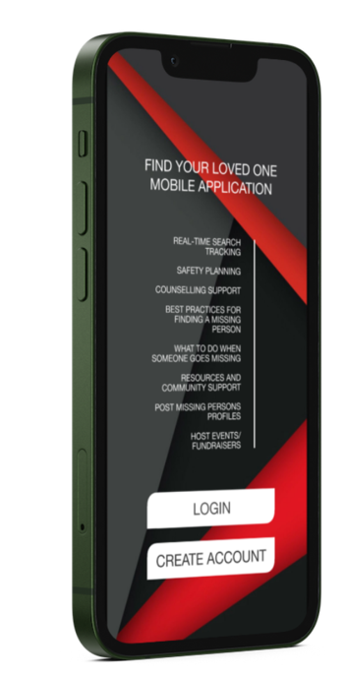
2023-24 Support for Search Parties
Find Your Loved One app
Purpose: provide supports during the search, investigation, and follow-up process, while also helping them navigate various institutional systems.
Data Sovereignty: Personal data will be considered the property of each individual user and will be handled with care and will only be shared with municipal and provincial governments on an anonymized basis
Notes:
as and when needed or requested by the families or authorized personnel and with consent.
We want to know how you are using the data from engagement

Slide 8
2025 Progress Update
Does your action align with UNDRIP?
Does your action include the 7P into your work?
How will your action create safety for Indigenous women and 2S+?
Does your action have positive measurable impact?
Are there upcoming opportunities—like engagement sessions or Council presentations—where the community can listen in or take part?
How will you keep Indigenous women, girls, and 2SLGBTQQIA+ Peoples informed about what’s happening?
Are there plans to assess how effective this action is?
Notes:
We worked with 11 City Depts and Partners (Police, Library, Parks, Engineering, Planning, Finance, Social Policy, City Manager’s Office, Real Estate Services, Development Buildings and Licensing, Facilities Planning and Development.)
They identified City actions that align with the Calls for Justice
The advisory was weary and wanted to see the data
We looked at JEDI curriculum and concluded that MMIWG2S and intersections and systemic harms were not included in materials.

