Slide 1
How Journalists Tell Stories With Data
Ellis Simani @emsimani

Slide 2
What is data journalism?

Slide 3
Social science on deadline
“Data journalism is really just another way of gathering information. It’s the equivalent of interviewing sources and looking at documents, except with data journalism you are essentially interviewing the data to let it tell you its secrets”
– Steve Doig, Arizona State University

Slide 4
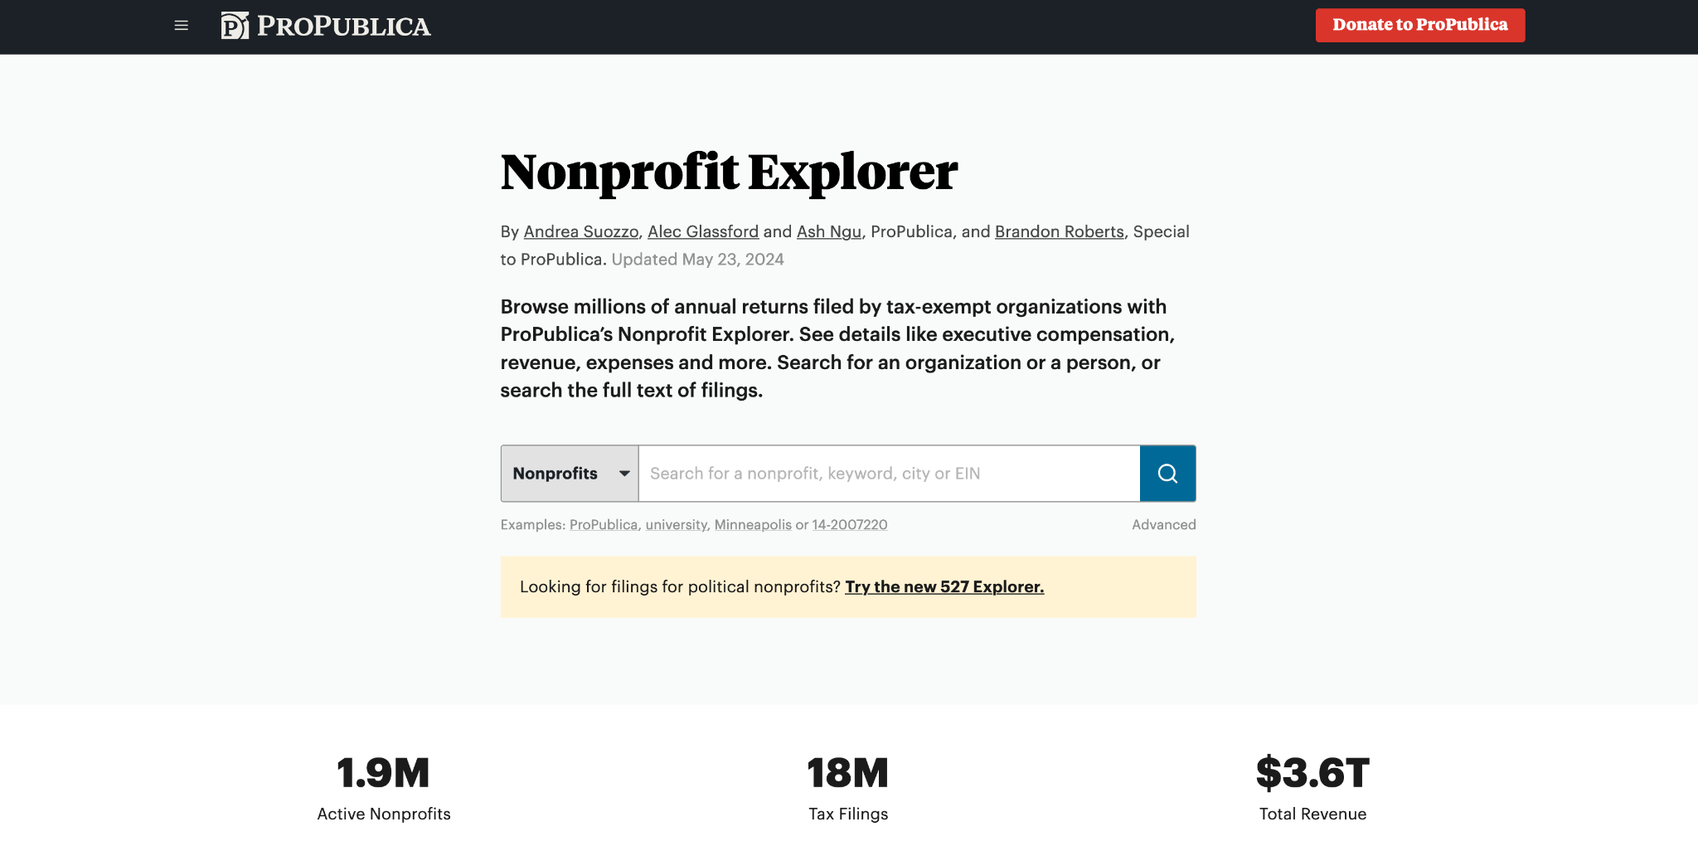

Slide 5
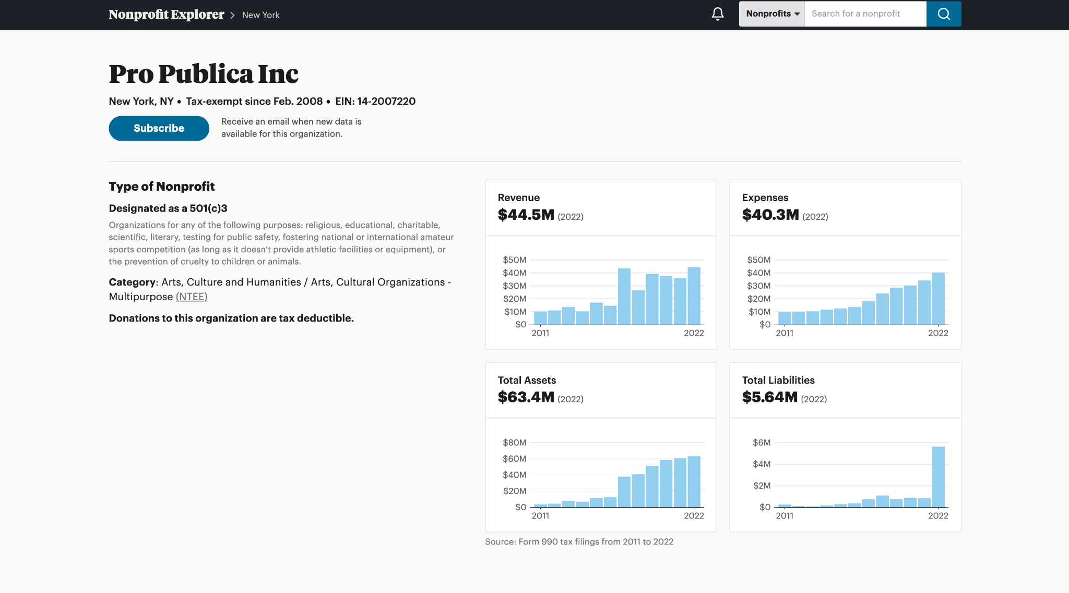

Slide 7
Is this new?

Slide 8
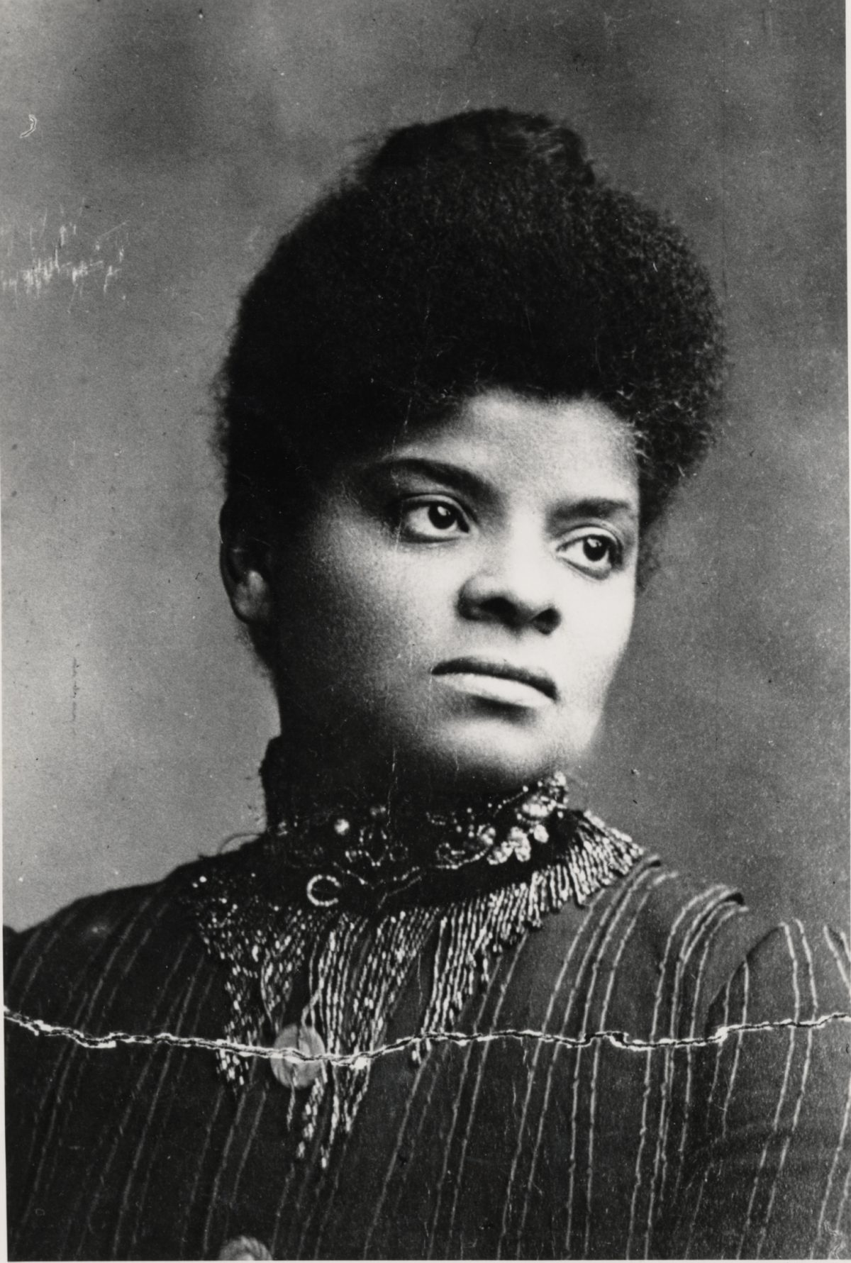
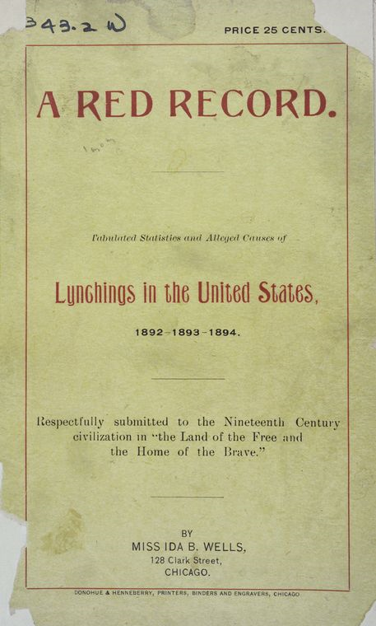
Ida B. Wells
1862-1931
“It can also be said that Wells was among the first data reporters, as she kept meticulous records on the numbers of lynchings, where they were occurring and why.”
– Ida B. Wells Society for Investigative Reporting

Slide 9
How do we find data?

Slide 10
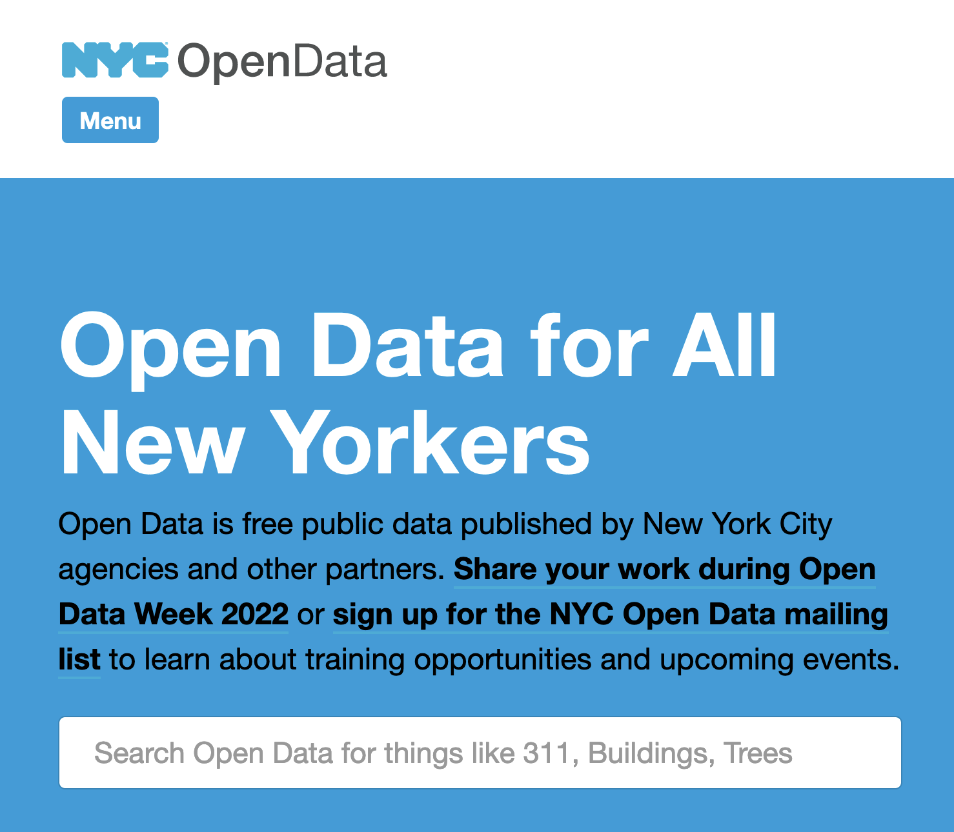
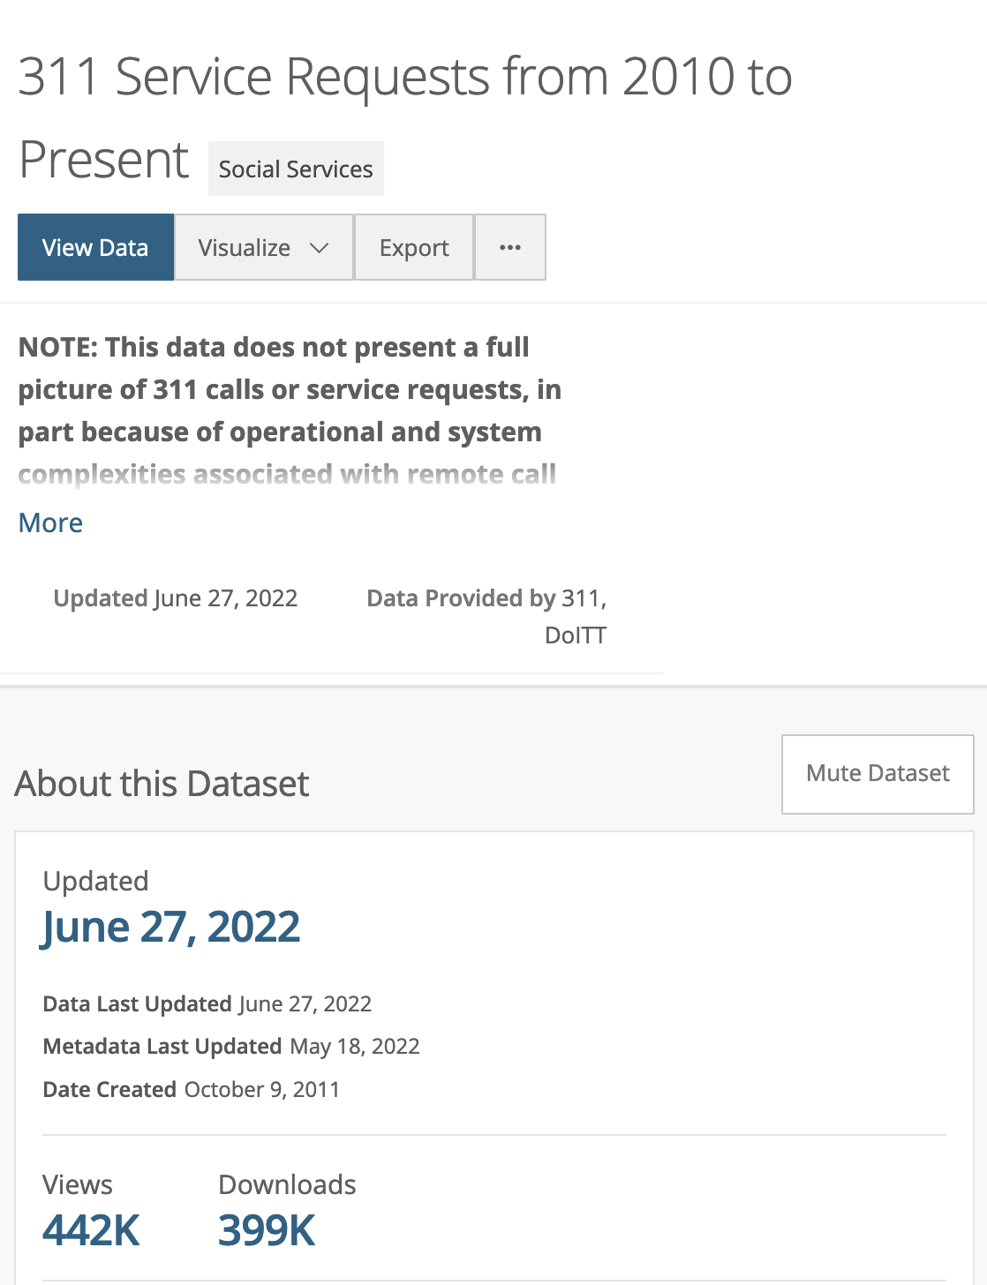
Open Data Portals

Slide 11
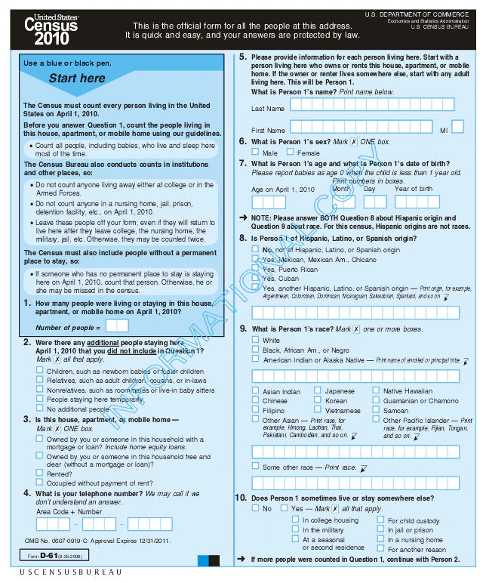
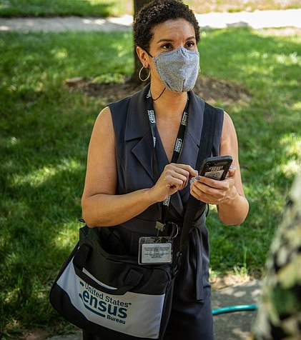

Slide 12
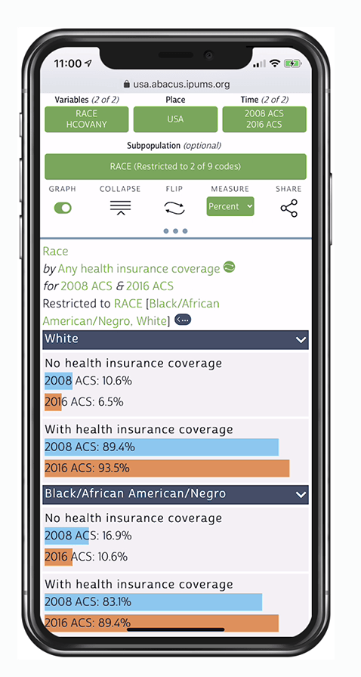
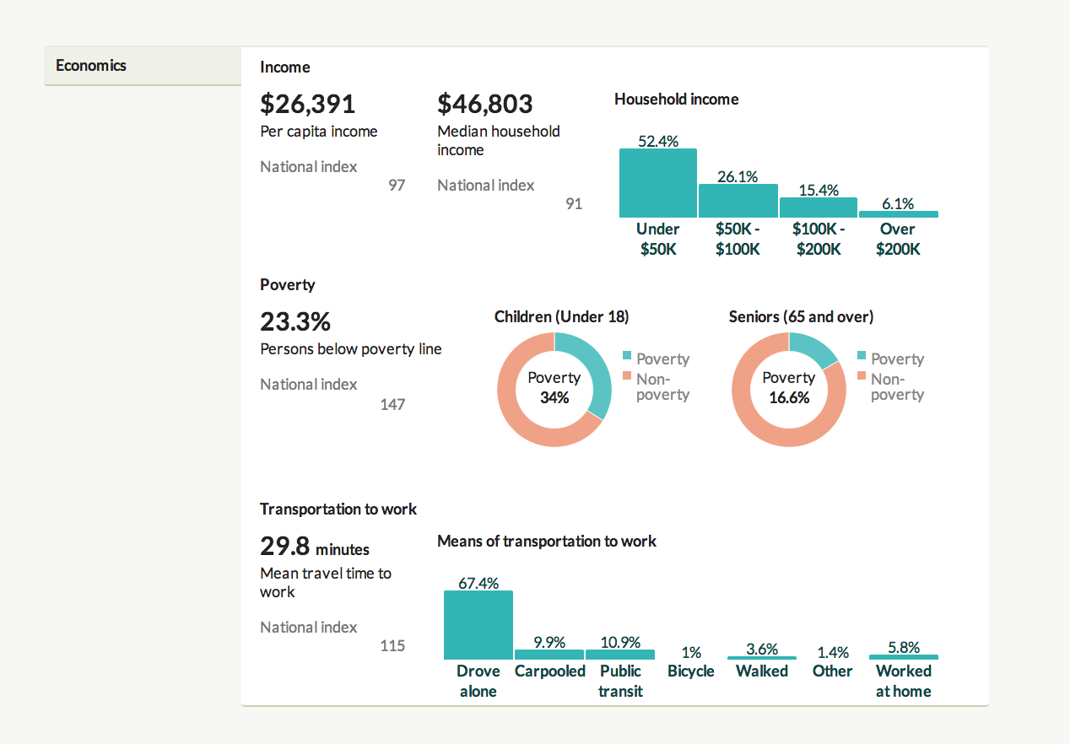
Accessing Census Data
Census Reporter
To explore, visualize and download census data
IPUMS
To explore detailed topics using census microdata

Slide 13
And many other ways, too!
Requesting records from government agencies
Getting data from academics
Scraping websites
Leaked records from sources
Building a database yourself!

Slide 14
Questioning our data

Slide 15
For years, members of Arab and Iranian communities have lobbied the U.S. Census Bureau to create a separate category for people of Middle Eastern or North African descent. In 2018 the bureau announced that it would not include a “MENA" category.
Source: “Are Arabs and Iranians white? Census says yes, but many disagree,” Los Angeles Times

Slide 16
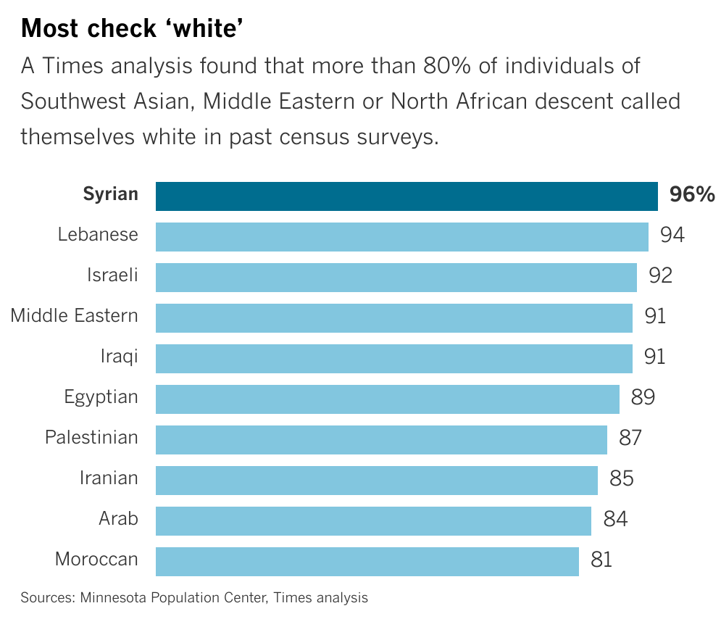
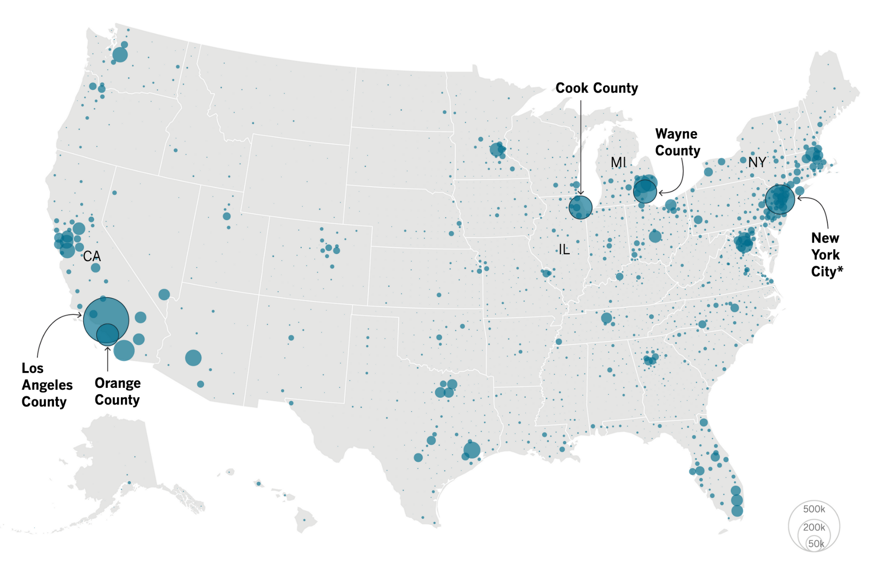
Source: “Are Arabs and Iranians white? Census says yes, but many disagree,” Los Angeles Times

Slide 17
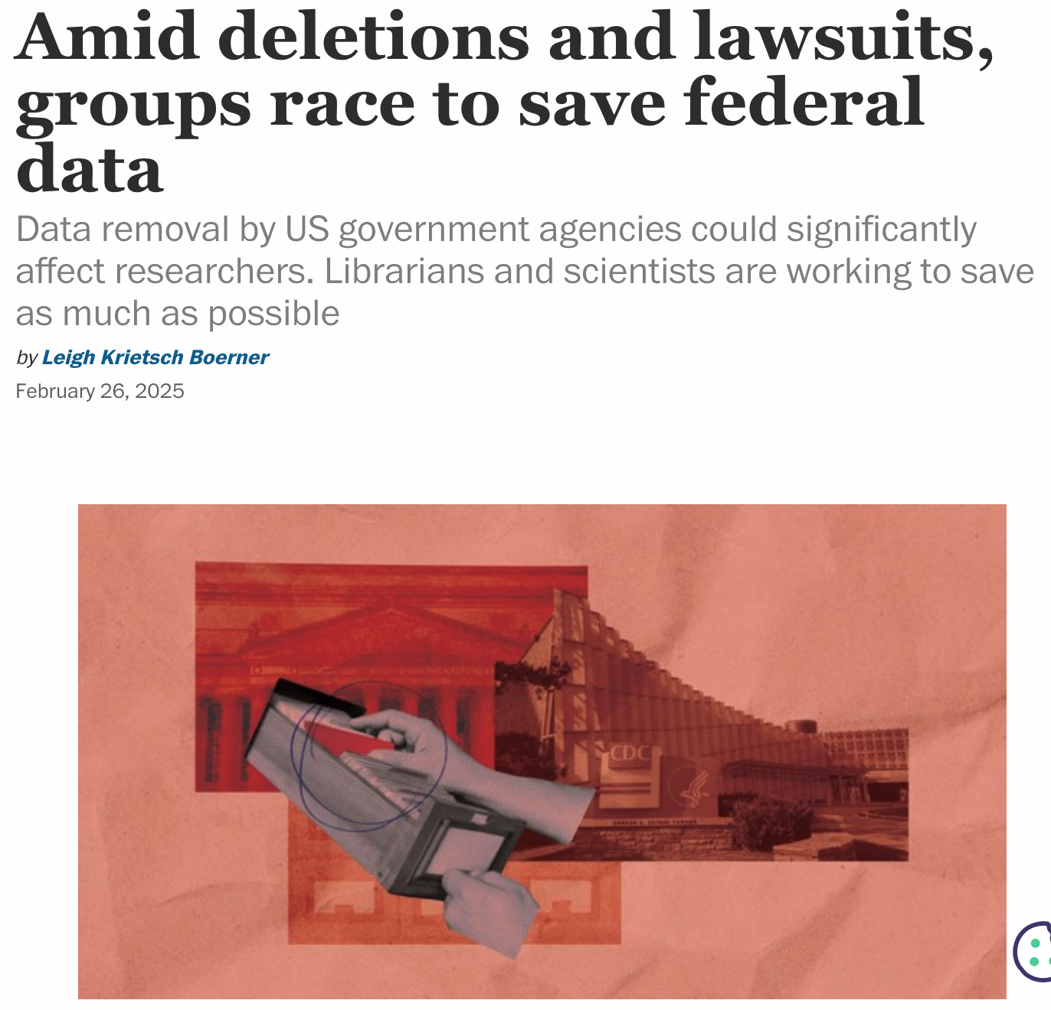
Current challenges in data journalism
Source: “ Trump’s War on Measurement Means Losing Data on Drug Use, Maternal Mortality, Climate Change and More” ProPublica
Source: “ Amid deletions and lawsuits, groups race to save federal data Chemical & Engineering News

