Slide 1
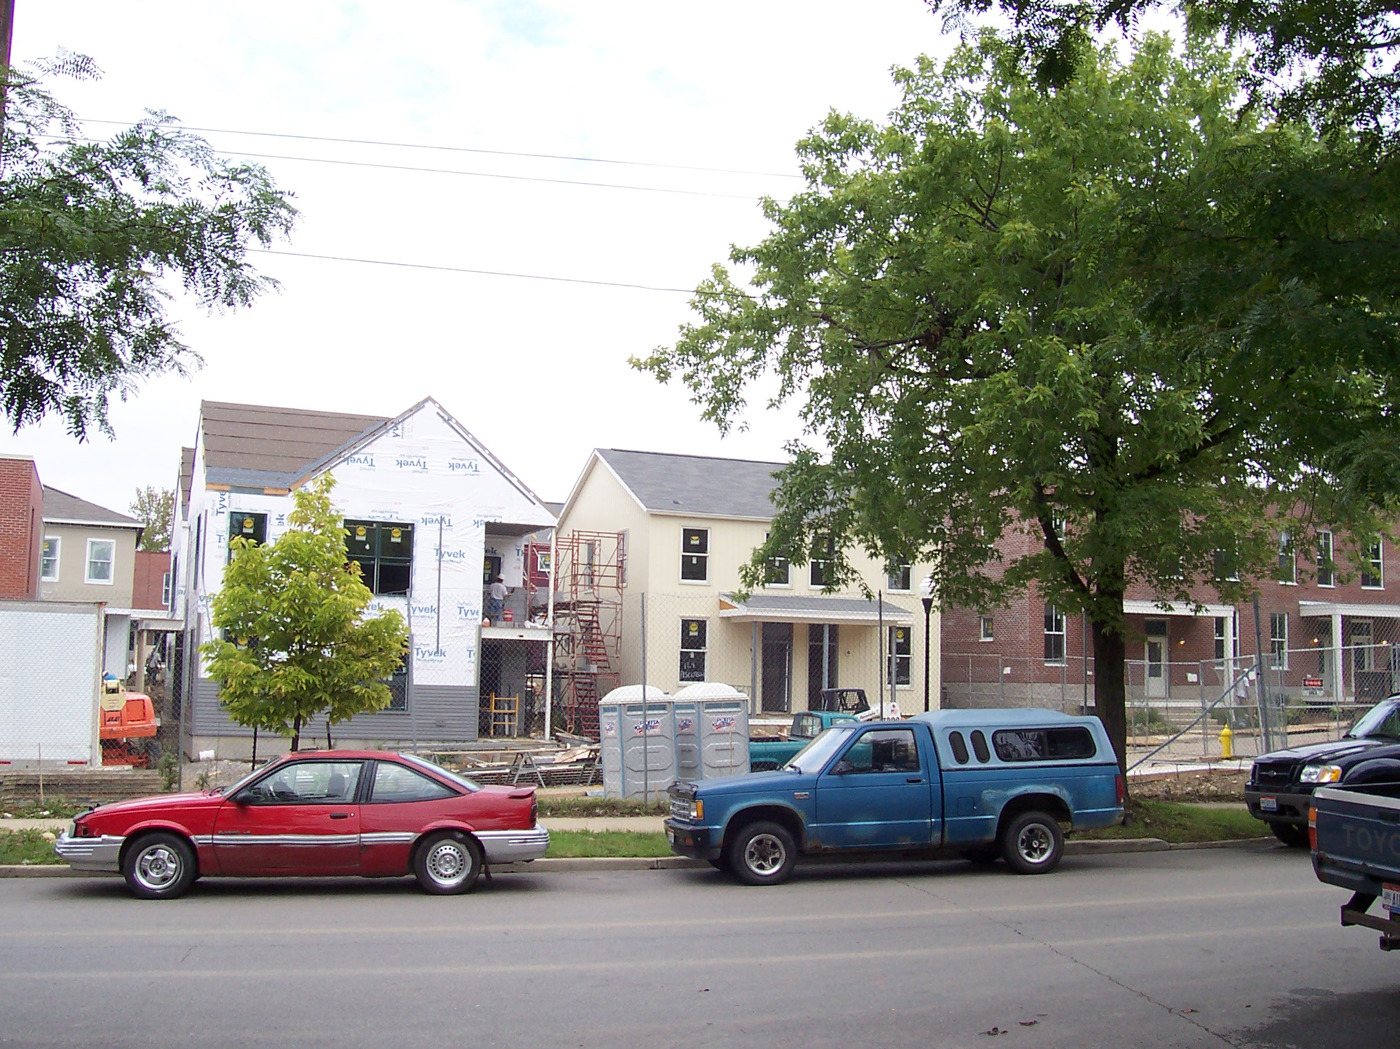
Structural Fairness &
Targeted Universalism:
Reflections on Detroit
Professor john a. powell
Haas Diversity Research Center, Executive Director
and The Robert D. Haas Chancellor’s Chair in Equity and Inclusion
University of California, Berkeley
Presentation for the Kresge Foundation
September 28, 2012

Slide 2
Presentation Overview
An unsustainable strategy
Opportunity matters
Growing a sustainable city for all
Notes:
2

Slide 3
Targeted Universalism
Requires a universal goal
What is that in Detroit?
If it is missing
  A shared value or vision
  A shared sense of the problem to be solved

Slide 4
Targeted Universalism
It is both a way of communicating fairness
And a way of structuring programs to achieve fairness.
All people are regarded
  Who decides?
  Who benefits?
  Who pays?
  Are there identifiable groups that pay

Slide 5
Targeted Universalism
Fairness does not mean you treat all people the same
It means you treat all with similar regard

Slide 6
A New Paradigm
Universal Programs
Targeted Programs
Targeted Universalism
Notes:
6

Slide 7
Why Universalism Does not work
False universal
It focuses on a universal strategy
Need to focus on universal goal
It ignores our situatedness

Slide 8
Targeted Universalism
Why targeted program don’t work?
It pits groups against each other
It ignores and undermine our share (universal) goal
It undermine our relatedness
It ignores our situatedness

Slide 9
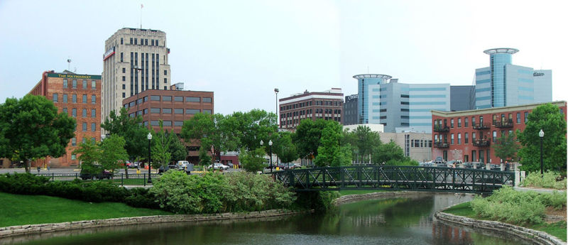
situatedness

Slide 10
What Are We Situated In?
Notes:
Structures/relationships/stories

Slide 11
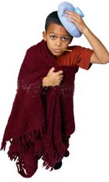
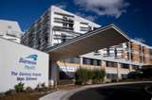

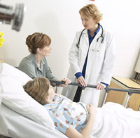
Situatedness
Different communities are situated differently with respect to structures, stories and regard
  Example: Universal Healthcare
Community A has no insurance and no hospitals in the area.
Community B has no insurance, but there’s a hospital down the street.
Community C has access to both insurance an a hospital.

Slide 12

How People are Situated (example)
Problem: Three people are out to sea and a big storm is coming
Goal: To reach the people within six hours
Assumption: If we can reach them in six hours, we will save them all

Slide 13


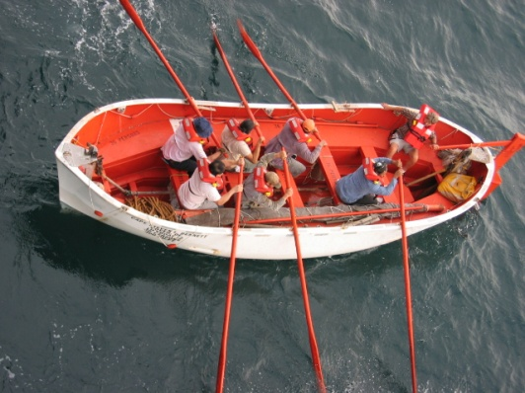
How People are Situated (ex. con’t.)
13
But the three are not all in the stormy water in the same way
Which person would be most likely to survive the 6 hours it would take to reach them?
If water is a “structure,”(housing, education, etc.) some groups are able to navigate the structure more successfully than other groups

Slide 14
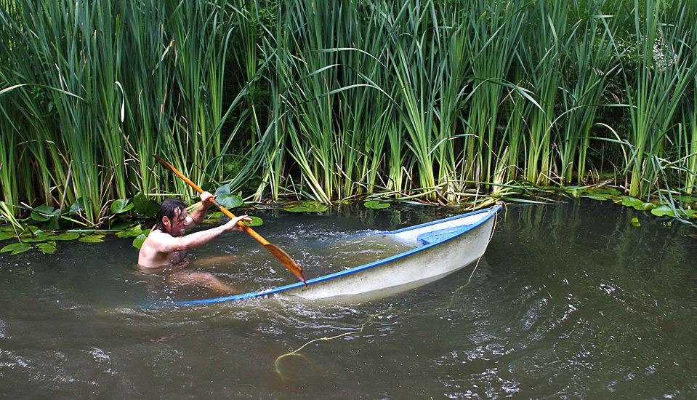
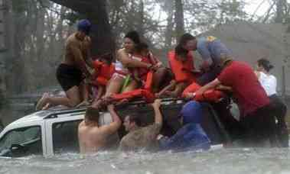
Oh, thank goodness, a rising tide!
Notes:
14
Targeted vs. universal
Rising tide lifts all boats
Vs.
African Americans and Latinos are
disparately impacted and solutions
must factor this in directly

Slide 15
Paying Attention to Structures and Systems: We are not Islands
“methodological individualism presumes that social life results chiefly or exclusively from the actions of self-motivated, interest-seeking persons.”
“Methodological individualists who seek to explain social inequality have so far faced an insurmountable obstacle. Their causal mechanisms consist of mental events: decisions. . . . [E]ssential causal business takes place not inside individual heads but within social relations among persons and sets of persons.”

Slide 16
What Matters
Where we are: geographic/zip code
Who family/group/membership matter: relations
Our structures
The story/our story
Notes:
Have them tell stories. Have Teri Help. Group A is much likely to attend and college over group B. In fact group A is have almost twin the BA degrees as B.

Slide 17
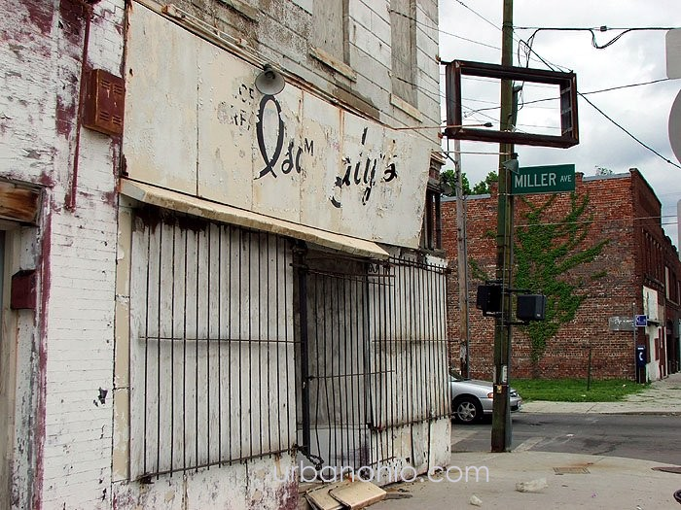
How do we grow together or apart? The first is sustainable the second is not

Slide 18
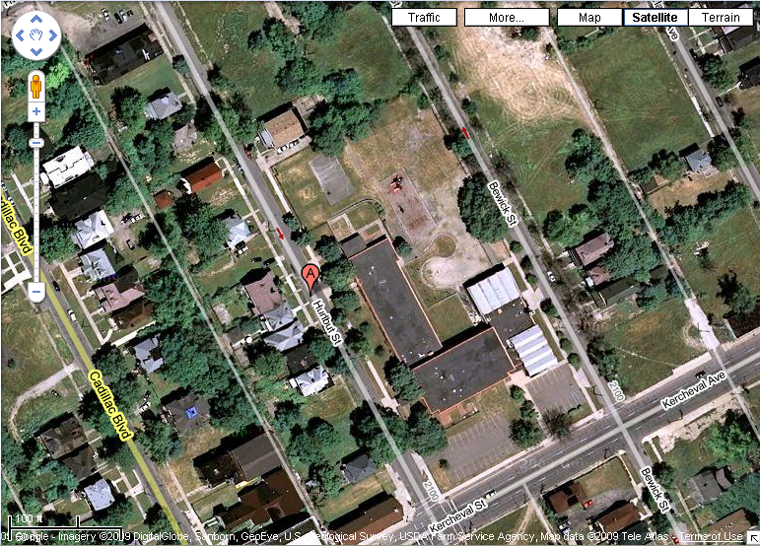
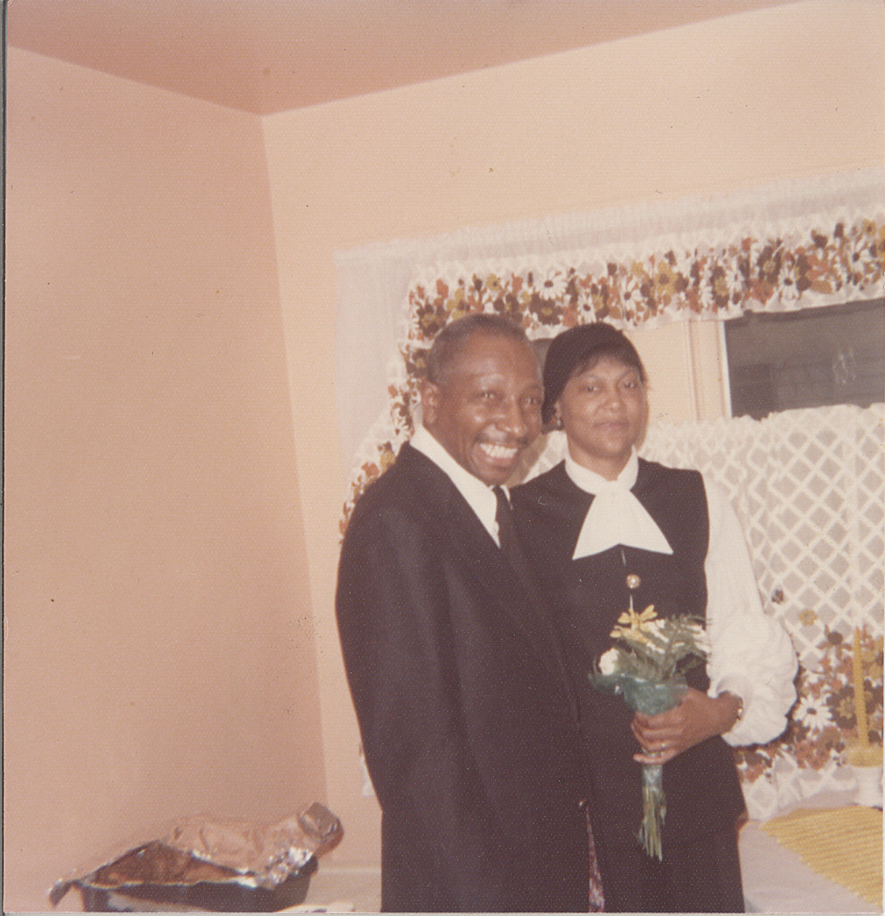
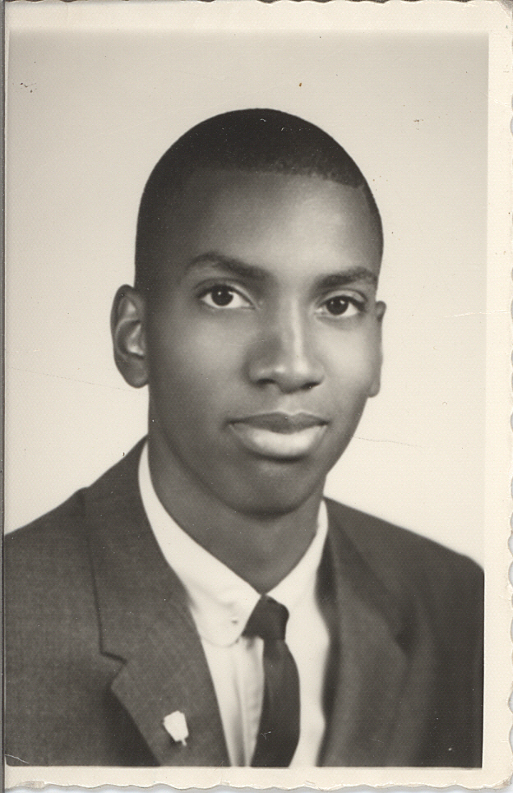
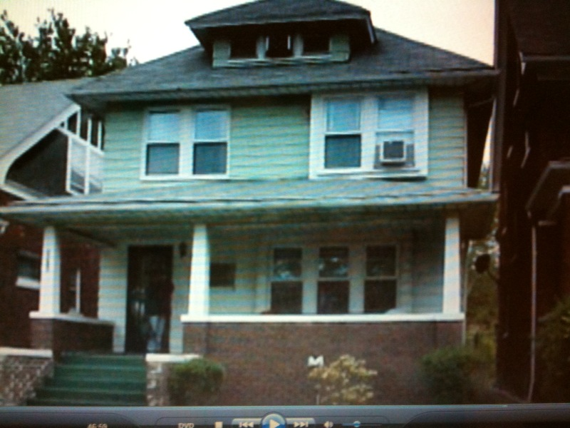
The Story of the City

Slide 19




Transformation of the City & its Suburbs
Suburbs
Suburbs
Central City
Suburbs
This fragmentation depresses the whole region.
Suburbs

Slide 20
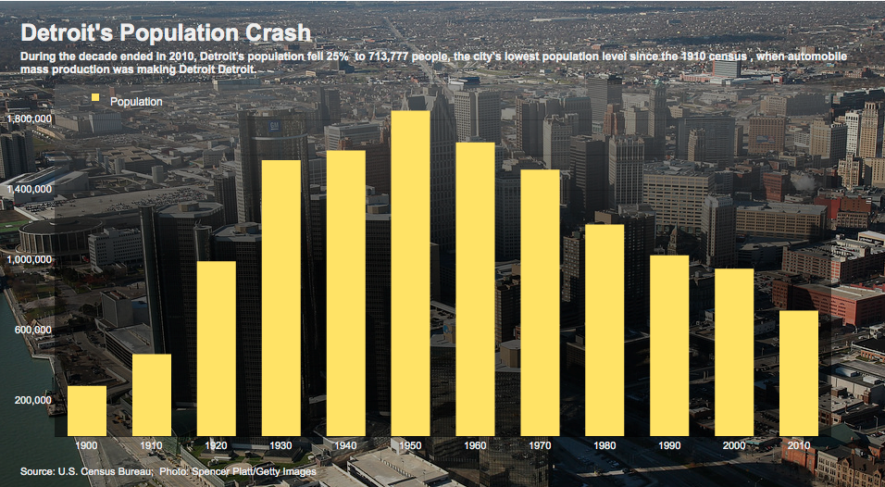
Rapid Demographic Changes
Source: The Wall Street Journal, March 23, 2011
http://online.wsj.com/articleSB10001424052748704461304576216850733151470.html

Slide 21
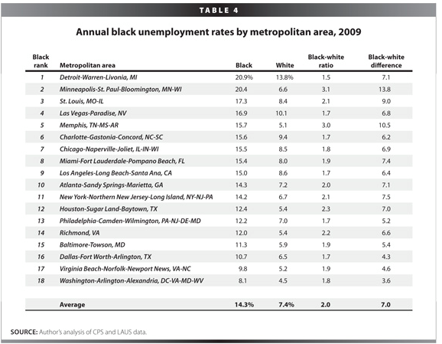
Uneven Unemployment
Source: Economic Policy Institute, http://www.epi.org/publication/ib278/

Slide 22
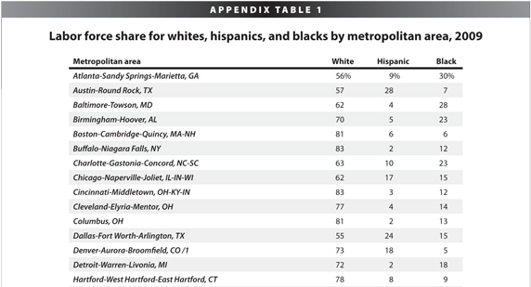
Unequal Labor Force Share
Source: Economic Policy Institute, http://www.epi.org/publication/ib278/

Slide 23
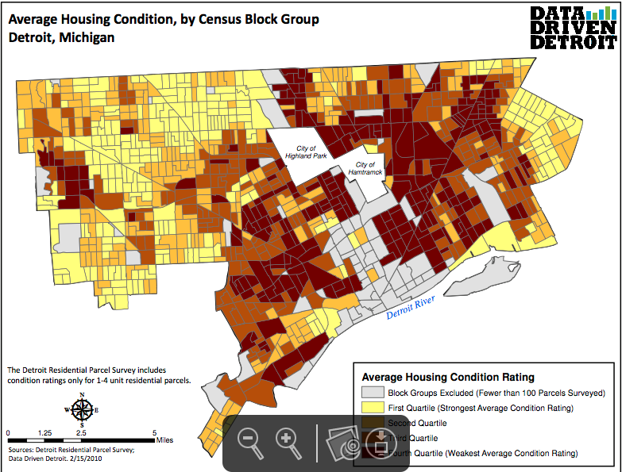
Housing Condition
Source: Data Driven Detroit

Slide 24
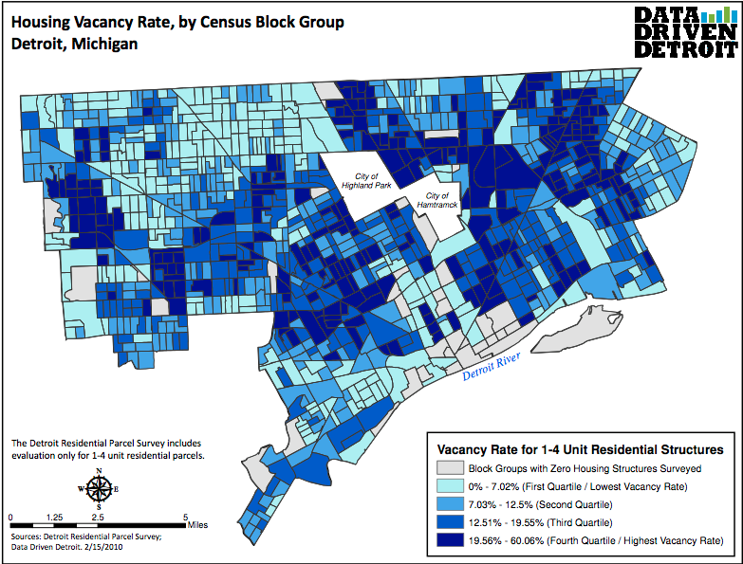
Housing Vacancy Rate
Source: Data Driven Detroit

Slide 25
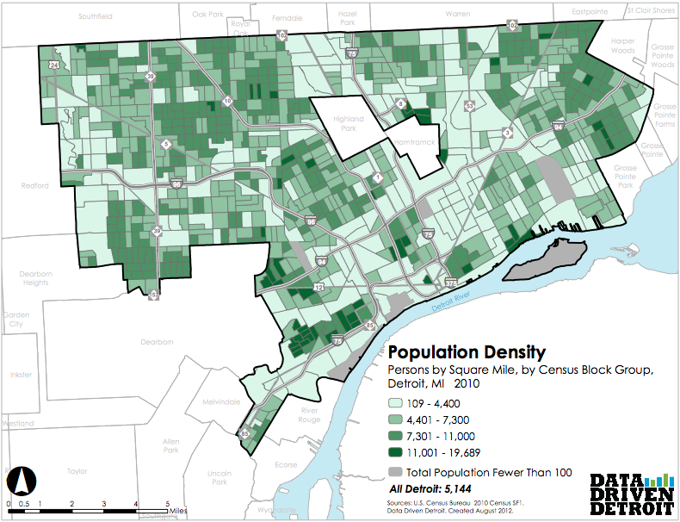
Population Density
Source: Data Driven Detroit

Slide 26
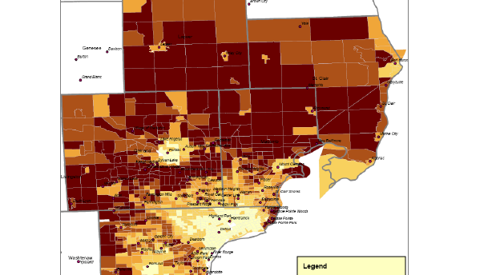
o

Slide 27


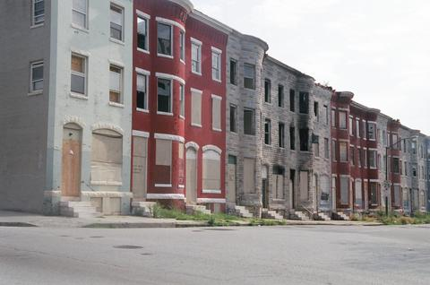
Opportunity Matters
Race, Place and Life Outcomes

Slide 28


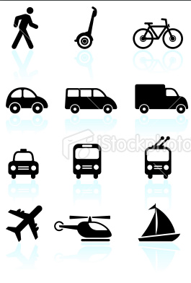
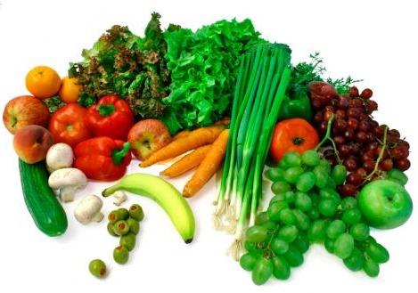




Defining Opportunity
We can define opportunity through access to:
Education
Economic
Transportation
Food
Housing
Justice
Healthcare
Communications

Slide 29
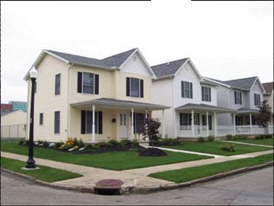
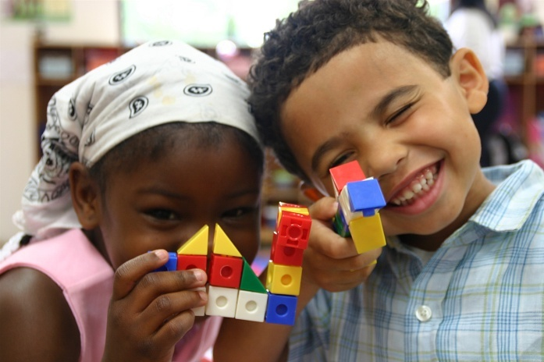
Opportunity Structures
Opportunity structures are the web of influences beyond our control that enhance and constrain our ability to succeed and excel.
Life chances are shaped by opportunity structures, and those structures are often just as important, if not more so, than the choices that individuals make.
Notes:
29

Slide 30
Opportunity Structures
The opportunity structure includes the geographically varying set of institutions, systems, and markets of the area where one lives.
Local Jurisdictional Characteristics (health, education, safety programs)
Neighborhood Characteristics (peers, networks, institutions, transportation)
Malleable Personal Characteristics
(skills, experience, etc)
Achieved Outcomes
Fixed
Parental and Personal Characteristics (marital status, race, gender, status, ethnicity, primary language)
Metropolitan Characteristics
(employment, income, industry)

Slide 31
Cross-Domain Impacts of
Opportunity Segregation
Segregation impacts a number of life-opportunities
Impacts on Health
School Segregation
Educational Achievement
Exposure to crime
Transportation limitations and other inequitable public services
Neighborhood Segregation
Job segregation
Racial stigma, other psychological impacts
Community power, civic participation and individual assets
31
Adapted from figure by Barbara Reskin at: http://faculty.washington.edu/reskin/
Notes:
31

Slide 32
Opportunity is uneven
Structures and policies are not neutral. They unevenly distribute benefits and burdens.
Institutions can operate jointly to produce racialized outcomes.
This institutional uneven distribution & racial marking has negative consequences for all of us.
Lower Educational
Outcomes
Increased Flight
of Affluent
Families
Racial and Economic
Neighborhood
Segregation
School
Segregation &
Concentrated Poverty

Slide 33
Structural inequity
This is a claim that these opportunity structures are racialized, meaning that they produce and reinforce racial advantages and disadvantages.
The linkage between race, place, and life outcomes is mediated by three related forces:
  Concentrated Poverty
  Racial and Economic Segregation
  Sprawl (Jurisdictional Fragmentation)

Slide 34
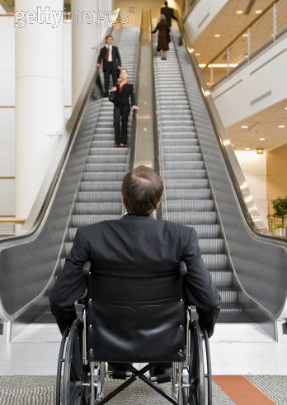
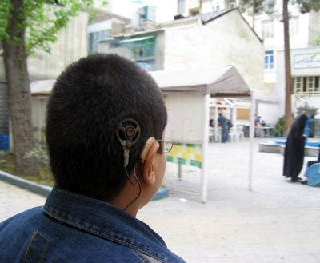
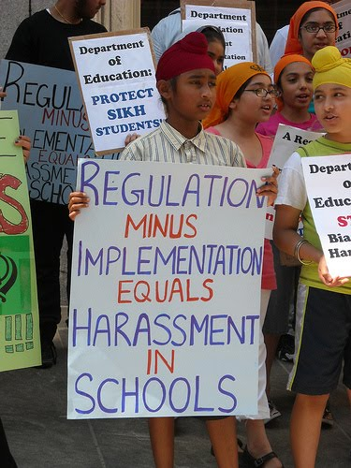
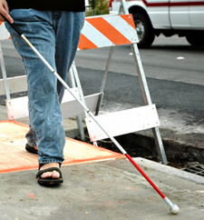
Situatedness Matters
Not only are people situated differently with regard to institutions, people are situated differently with regard to infrastructure
People are impacted by the relationships between institutions and systems…
…but people also impact these relationships and can change the structure of the system.

Slide 35
Who are we?
Who are they?

Slide 36
Belonging & Exclusion
Differential positioning in these structures is a way to understand who inhabits the circle of human concern as a full member and who is pushed out of it

Slide 37
The Circle of Human Concern
Non-public/non-private

Slide 38
The Circle of Human Concern
Citizens
Children
Mothers
Elderly
Felons
Undocumented
Non-public/non-private Space

Slide 39
Questions for
Our Shared Future
Who belongs to the circle of human concern in the Detroit Works Plan?
Who is excluded from it? How do race, class, age, and other forms of difference affect groups’ positioning?
How can we include everyone in creating a vibrant, economically sustainable Detroit for all?

Slide 40
Growing a Sustainable City
for All
Addressing uneven conditions and exclusions in a fair, equitable, and inclusive way

Slide 41
What would a fair, equitable & inclusive process look like?
Define universal goals, create a differentiated strategy for achieving them
Develop & fund a participatory planning and implementation process at the grassroots
Protect the most vulnerable

Slide 42
Create a Framework:
Targeted Universalism
Define shared, universal goals for all
  In this case, economically viable, healthy, and educated individuals and communities.
These include the interrelated goals targeting economic opportunity, employment, housing, education, health, transportation, food security, civil rights, etc.
  Prioritize these goals

Slide 43
Developing the Plan
The plan should support the identification of specific obstacles in particular geographies that limit certain populations/neighborhoods from reaching these universal goals
All populations/neighborhoods must be included in this plan
Strategies should then be tailored to address the specific needs and differentiated situatedness of targeted populations/neighborhoods

Slide 44
Considering Structural Inequality
When purportedly neutral strategies or programs and policies are overlaid on already unequal practices, norms, and institutional arrangements, it is likely to not only leave such arrangements undisturbed, but perpetuate and exacerbate them

Slide 45
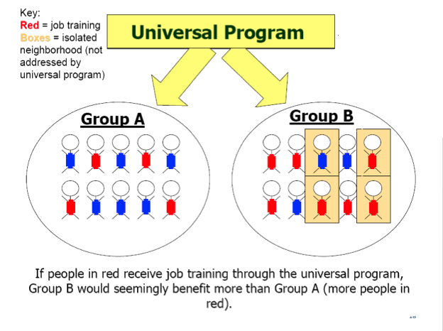

Slide 46
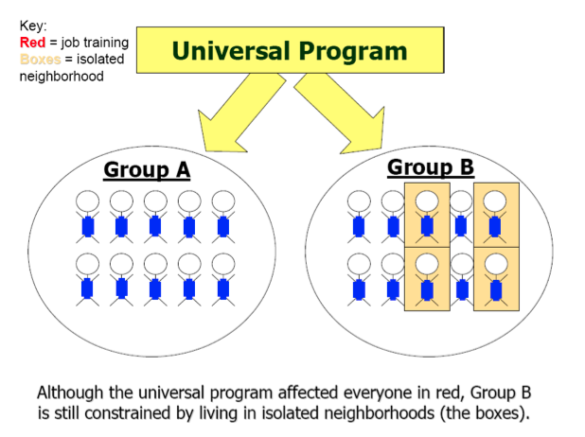

Slide 47
Our Linked Fates & Shared Futures
Our fates are linked, yet they have been socially
constructed as disconnected
Thus, it is difficult to effectively benefit one group or neighborhood while leaving others marginalized
Consider the social costs of failure and shared rewards of success in the future for all

Slide 48
2. Empower the marginal
How does Detroit ensure that all communities/neighborhoods benefit and not just some?
Create participatory planning and implementation processes to include critical stakeholders from each sector and at all levels
Equalize power around the table by including grassroots/neighborhood groups in the development and implementation of the economic growth plan

Slide 49
The Grassroots
Empower the grassroots by funding neighborhood groups and other organizations to work with interdisciplinary technical specialists & planners
Reach out to all over reach to the margins
Build capacity so marginal and effective participate

Slide 50
3. Include All in the
Circle of Human Concern
Protect all but especially the most vulnerable from social & economic exclusion through the implementation of the new plan
  For example, if low-income individuals and families are moved to more stable neighborhoods, interventions must also target biases by those in new their communities
Ensure that they are protected now and in the future wherever they may be geographically located (low density/opportunity or high density/opportunity neighborhoods)

Slide 51
What are the constraints and benefits?
Are the discussed and shared?
People are more willing to make sacrifices if our also sacrifice and they have a change to participate in the benefit

Slide 52
4. Incentivize Those with More Resources to stay & share
Individuals, communities, and corporations with more resources need to work to ensure that the benefits and successes are shared among all
  Give them a reasonable reason to stay
  Incentive policies and programs can be created to benefit them while at the same time ensuring they are committed to economic growth for all

Slide 53
Social, Political & Economic Context
Different social climates require different solutions
Recommendations for Detroit’s future require sensitivity to the socio-cultural & political- economic context and to the limitations that context imposes
Funding decisions must mirror this sensitivity to ensure that past commitments and future plans incorporate everyone

Slide 54

For more information, visit: http://www.iupress.indiana.edu/catalog/806639

