Slide 1
Building Community in an Age of Growing Anxiety and Polarization
PRESENTER:
john a. powell
Director of the Haas Institute
for a Fair and Inclusive Society
Professor of Law at UC Berkeley School of Law
DATE:
9/27/16
Scripps College

Slide 2
Presentation Overview
Implicit Bias & Othering
  Implicit Bias
  What is Othering?
Solutions and Practices to Reduce Bias
  Debiasing
  Belonging
Structural Racialization
  Opportunity Structures
  Situatedness (Space, Place & Life Outcomes)
  Targeted Universalism

Slide 3
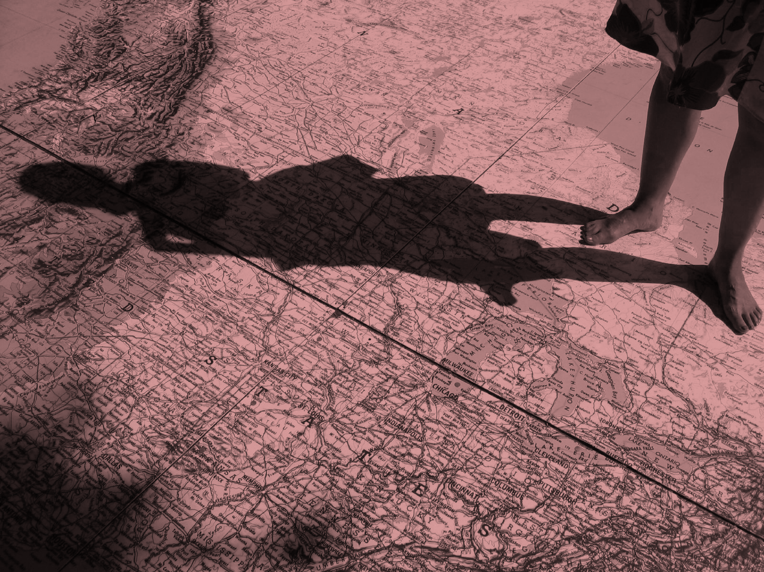
The problem of “Othering” is the problem of the 21st century

Slide 4

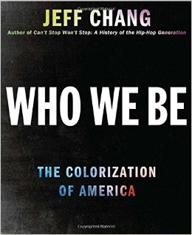
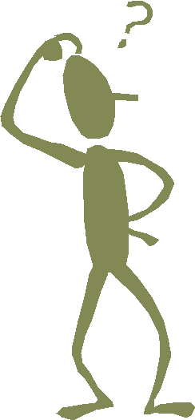
In the United States…

Slide 5
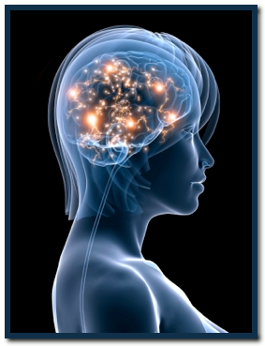
Implicit Bias
Today, explicit bias has largely been condemned in American society
Does not mean that bias does not exist. It can exist implicitly:
Unconsciously and unintentionally
Explaining the mismatch of our values and our behaviors
Notes:
Research suggests that Americans report values of egalitarianism and inclusion
We tend not to report attitudes that are perceived as socially undesirable
We may not be consciously aware that we hold bias attitudes

Slide 6
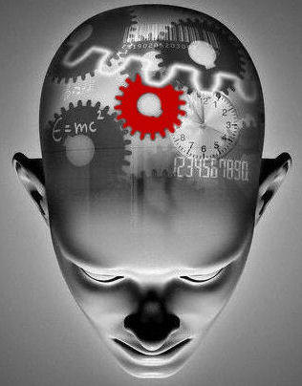
The Role of the Unconscious Mind
The human brain processes 11 million
bytes of information per second
Consciously aware of any 40 of these, at best
Only 2% of emotional cognition is available to us consciously
Messages can be framed to speak to our unconscious
The process of Othering occurs in our unconscious network: this can lead to racial, ethnic, or religious bias
Notes:
See David Brooks, The Social Animal (2011)
6

Slide 7

The Role of the Unconscious Mind
The subconscious mind uses three processes to make sense of the millions of bits of information that we perceive
Sorting into categories
Creating associations between things
Filling in the gaps when we only receive partial information
These three processes together add up to schemas: the “frames” through which our brains help us understand and navigate the world
Notes:
7

Slide 8
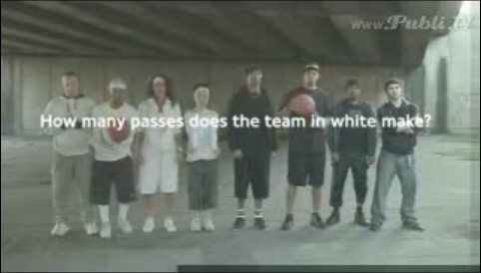
Activity: Awareness Test
Source: http://www.youtube.com/watch?v=yrqrkihlw-s

Slide 9
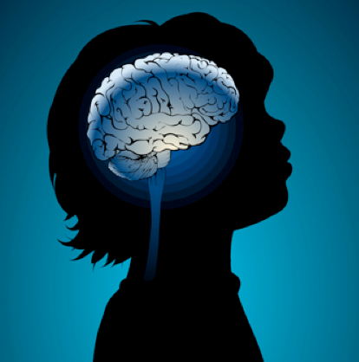
The Cycle of Implicit Bias
Historical & Ongoing Segregation
Racialized Schemas
Implicit Bias
Self-Reinforcing Expectations
Structural & Systemic Inequalities
Notes:
9

Slide 10
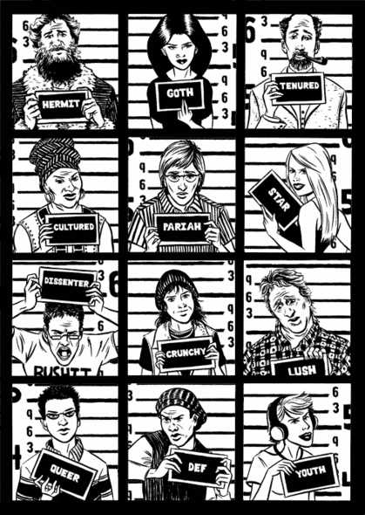
Stereotypes and Stereotype Threat
Categorizing People:
  Schemas about people are referred to as “stereotypes” and we use them all the time.
Stereotypes:
  traits associated with a particular group.
Attitudes:
  warmth or coldness toward a particular group.
Notes:
Stereotypes influence our attitudes
Source: Rachel Godsil (Powerpoint: “Fairness in the Courts”). Seton Hall University School of Law, Perception Institute; perception.org

Slide 11
Impacts of Implicit Bias and Stereotype Threat
Implicit bias can leak into everyday interactions
Stereotype threat, “the threat of being viewed through the lens of a negative stereotype, or the fear of doing something that would inadvertently confirm that stereotype” (Cluade Steele)
“Micro-aggressions” and subtle body language affect interpersonal interactions
Cumulatively, these interactions reinforce or exacerbate already existing inequalities within and across systems
  A recent survey found that white college students bought into the trope that Asian Americans are more competent, and blacks and Latinos need to “work harder.” (Park et al. 2015)
Notes:
For example, tell students about to take a test that Asian students tend to do better than Whites, and the whites will perform significantly worse than if they had not been primed to think of themselves as less capable than Asians
See: https://drive.google.com/file/d/0Bwic1r7wb7bpQXh6X2tkUTE4QkE/view
http://www.theatlantic.com/education/archive/2016/01/white-college-students-buy-in-to-stereotypes-of-minority-peers/426813/
11

Slide 12
Impacts of Implicit Bias and Stereotype Threat
Implicit bias can leak into everyday interactions
In reality, the perceived performance of some minority students might have less to do with personal effort and more to do with structural inequalities.
  For Example:
    Residential segregation and low-income jobs work together to reduce the taxes available for poor neighborhoods with children.
    This results in poor quality education for many minority students.
Notes:
For example, tell students about to take a test that Asian students tend to do better than Whites, and the whites will perform significantly worse than if they had not been primed to think of themselves as less capable than Asians
See: https://drive.google.com/file/d/0Bwic1r7wb7bpQXh6X2tkUTE4QkE/view
http://www.theatlantic.com/education/archive/2016/01/white-college-students-buy-in-to-stereotypes-of-minority-peers/426813/
12

Slide 13
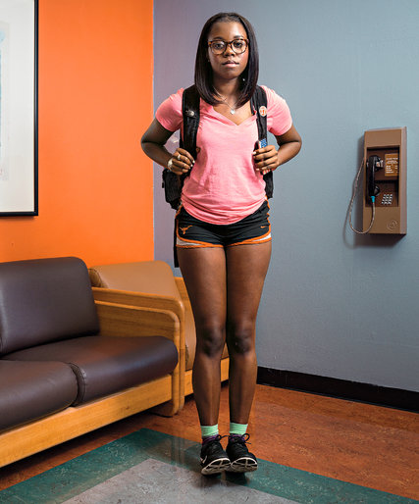
Who Gets to Graduate?
Vanessa B. at the University of Texas at Austin
Low-income family
First generation college student
Top 7% percent of her high school class
Failed her first college exam in statistics
Mother tried to comfort her: “maybe you just weren’t meant to be there.”
Why didn’t Vanessa excel like her high school record suggested?
Source: Tough, P. (2014). Who gets to graduate? New York Times
Notes:
For example, tell students about to take a test that Asian students tend to do better than Whites, and the whites will perform significantly worse than if they had not been primed to think of themselves as less capable than Asians
See: https://drive.google.com/file/d/0Bwic1r7wb7bpQXh6X2tkUTE4QkE/view
http://www.theatlantic.com/education/archive/2016/01/white-college-students-buy-in-to-stereotypes-of-minority-peers/426813/
13

Slide 14
Who Gets to Graduate?
What Makes Students Successful?
Quality of high school education
Availability of college
Family support system
Resources
UT Austin has put in place programs that promote:
Growth Mindset
Sense of belonging
Source: Tough, P. (2014). Who gets to graduate? New York Times
Notes:
For example, tell students about to take a test that Asian students tend to do better than Whites, and the whites will perform significantly worse than if they had not been primed to think of themselves as less capable than Asians
See: https://drive.google.com/file/d/0Bwic1r7wb7bpQXh6X2tkUTE4QkE/view
http://www.theatlantic.com/education/archive/2016/01/white-college-students-buy-in-to-stereotypes-of-minority-peers/426813/
14

Slide 15
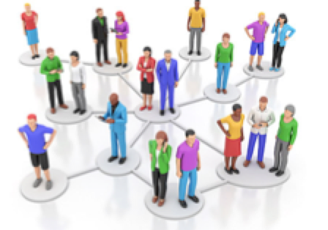
Reducing the Negative Impact of Bias
Individual debiasing
  change representations in local environment
Create Diverse teams
  diverse groups not only exchange more information and bring more new info to the group but are also more open-minded and consider more alternatives.
  Critical mass
Importance of Networks and Relationship
  Networks carry info and if the network is well-connected, info will travel fast
  Networks also impact inclusion
Notes:
For example, tell students about to take a test that Asian students tend to do better than Whites, and the whites will perform significantly worse than if they had not been primed to think of themselves as less capable than Asians
See: https://drive.google.com/file/d/0Bwic1r7wb7bpQXh6X2tkUTE4QkE/view
http://www.theatlantic.com/education/archive/2016/01/white-college-students-buy-in-to-stereotypes-of-minority-peers/426813/
15

Slide 16
Othering
Othering is a set of common processes that engender marginality and persistent inequality across any of the full range of human differences
Although the axes of difference that undergird these expressions of othering vary considerably and are deeply contextual, they contain a similar set of underlying dynamics, discursive heuristics, and structurally reinforcing mechanisms
Mechanisms of “othering” occur in the mind
  It explains not only how group-based differences become socially relevant, but how difference itself is constructed in the first place. Categorical boundaries are not natural, but emerge or are created, often deliberately, from a social context
sexuality
class
ability
skin tone
race
gender
ethnicity
religion

Slide 17
Othering & Political Polarization
Dominant hierarchy of organizing our sense of self:
What happens when the hierarchy is reversed?

Slide 18
Othering & Political Polarization
The Role of Resentment
“The various forces challenging the core American culture and creed could generate a move by native white Americans to revive the discarded and discredited racial and ethnic concepts of American identity and to create an America that would exclude, expel, or suppress people of other racial, ethnic, and cultural groups. Historical and contemporary experience suggest that this is a highly probable reaction from a once dominant ethnic-racial group that feels threatened by the rise of other groups. It could produce a racially intolerant country with high levels of intergroup conflict.”
— Samuel Huntington, Who are We? (2004)

Slide 19
Othering & Political Polarization
The conventional wisdom is that the economic losses suffered by working-class people throughout the developed world explain the rise of the new right.
  This economic anxiety argument holds that working-class white men have lost economic ground relative to women and other racial and ethnic groups over the past several decades, sparking feelings of anger and resentment.
However, political polarization doesn’t need economic insecurity to thrive.
  The 1950s saw both historic income growth and Jim Crow laws. But economic anxiety can “amplify racial threat effects” by leading the majority to fear losing scarce resources to the rising minority.
Notes:
See http://www.vox.com/2016/9/19/12933072/far-right-white-riot-trump-brexit

Slide 20
Othering & Political Polarization
Bridging
Restorative
Different
Diversity
Change
Anxiety
Narratives that give meaning
Divisive
Isolation
Anger
Fear
Notes:
See http://www.vox.com/2016/9/19/12933072/far-right-white-riot-trump-brexit

Slide 21
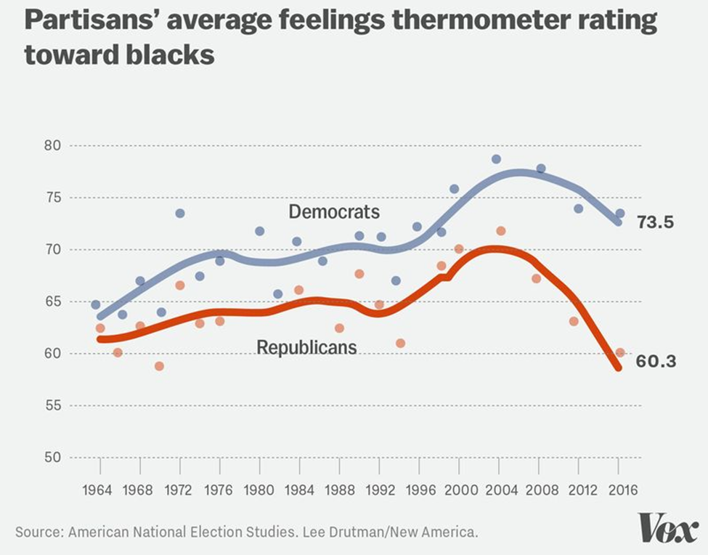
Othering & Political Polarization
Notes:
See http://www.vox.com/2016/9/19/12933072/far-right-white-riot-trump-brexit

Slide 22
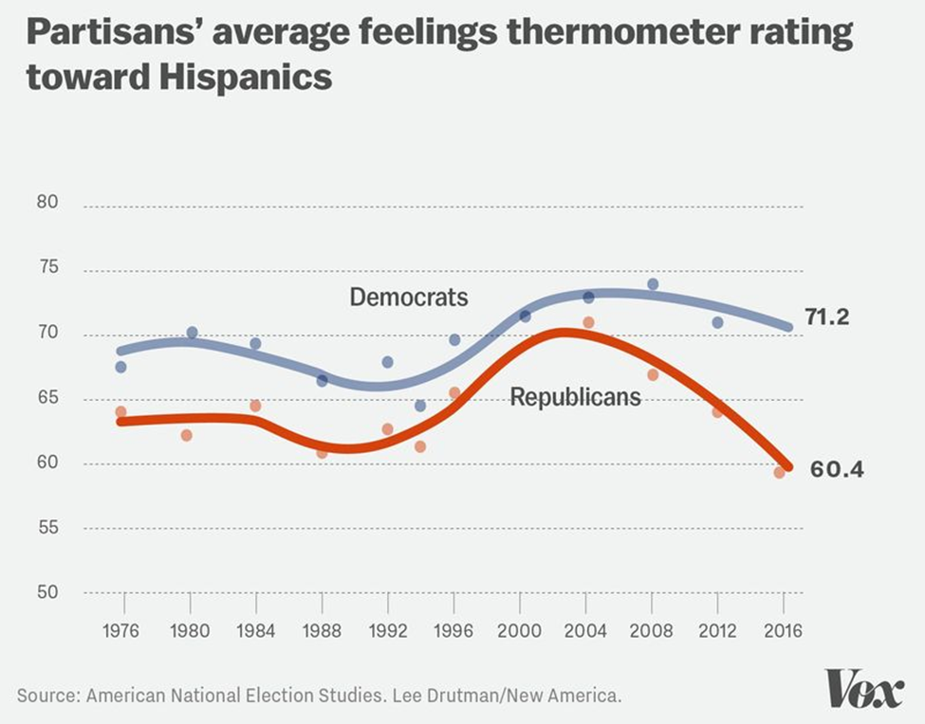
Othering & Political Polarization
Notes:
See http://www.vox.com/2016/9/19/12933072/far-right-white-riot-trump-brexit

Slide 23
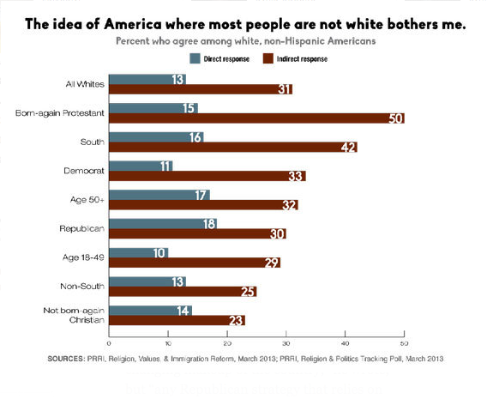
New York Times Article: The Great White Hope
Notes:
Region
Organization – tea party
race

Slide 24
Marginalization
What are the ways structures can marginalize groups?
Race, gender, class, sexual orientation, disability, religion, etc.
Groups are pushed toward the edges or outside of the circle of human concern through a process of marginalization
Although these groups may be comprised of individuals, living in vulnerable conditions, that vulnerability is not intrinsic; it is a result of that process
Notes:
24

Slide 25
The Circle of Human Concern
People formerly & currently incarcerated
Sexual Minorities
Citizens
Muslims
Children
Mothers
Undocumented Immigrants
Elderly
African Americans, Latinos

Slide 26
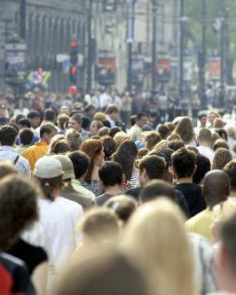
Where Does Bias Come From?
“Implicit bias is the result of the pervasive stereotypical images in our society—not individual views and ideas.”
From Society
From Structures
From Stories and Associations present in our larger environment
Under what conditions is bias most likely to occur?
Stress
Cognitive Overload
Time Pressure
Competing tasks and priorities
Competition for resources
Notes:
could talk about how this affects everyone - liberals, young people
even in the texts

Slide 27
Reducing the Negative Impact of Bias
Acknowledge your bias: it’s human!
Bias is not reduced by…
Suppression and avoidance
Telling people not to be biased
Self-perceived objectivity
Efforts to be colorblind can increase racial anxiety and tension
Create positive associations and experiences
Constructive to name anxieties
Pay attention to structures and the work they are doing; make them work for us
Research has confirmed that instead of repressing one’s prejudices, if one openly acknowledges one’s biases—and directly challenges or refutes them—one can better manage them (Lama & Cutler 2009)
Notes:
For reference list:
(Devine et al., 2002; Legault et al., 2011)(Apfelbaum et al., 2008; Galinsky & Moskowitz, 2000; Macrae et al., 1994; Plaut et al., 2009) (Uhlmann & Cohen, 2007)
“bias” here = implicit bias, racial anxiety, and biased behavior. some of the individual level interventions that don’t work on these…
start with an exercise — I’d like to ask you not to think about a white bear. Don’t think about
Tel people white bears – ironic effect can’t stop thinking about white bears; scar study
Trying to avoid race or to appear unbiased can backfire
Legault: In the autonomy-brochure condition, the value of nonprejudice was emphasized. Participants’ inner motivation for prejudice reduction was encouraged by emphasizing choice and explaining why prejudice reduction is important and worthwhile. In the controlling-brochure condition, participants were urged to combat prejudice and to com- ply with social norms of nonprejudice. In the no-brochure condition, participants read only introductory information about the definition of prejudice.
___
External motivation to control prejudice is linked to/incites greater bias (Devine et al., 2002; Legault et al., 2011)
Suppression leads to stereotype rebound; Avoidance norm backfires (Apfelbaum et al., 2008; Galinsky & Moskowitz, 2000; Macrae et al., 1994; Plaut et al., 2009)
Self-perceived objectivity leads to more bias (Uhlmann & Cohen, 2007)
Uhlmann, E. L., & Cohen, G. L., ‘‘I think it, therefore it’s true’’: Effects of self-perceived objectivity ..., Organizational Behavior and Human Decision Processes (2007):
“Personal objectivity prime. Participants were primed
with a sense of personal objectivity by asking them
to complete (ostensibly as part of a separate study)
four self-perceived objectivity questionnaire items.
These items were ‘‘In most situations, I try to do what
seems reasonable and logical,’’ ‘‘When forming an
opinion, I try to objectively consider all of the facts
I have access to,’’ ‘‘My judgments are based on a logical
analysis of the facts,’’ and ‘‘My decision making is
rational and objective’’ (0 = very strongly disagree,
10 = very strongly agree; see Armor, 1999). Half the
participants completed the personal objectivity items
before making their hiring evaluations. The other half
did so after making their hiring evaluations. The
manipulation was not necessarily designed to increase
evaluators’ conviction in their own objectivity, which
would be difficult given that most people already see
themselves as objective (Armor, 1999; Pronin et al.,
2002 ).
Indeed, in each of the present studies, over
88% of the participants rated themselves as above
average in objectivity.”

Slide 28

Reducing the Bias
“Debiasing”
  Research is fairly new on eliminating implicit biases.
  Challenging in light of the prevalence of stereotyping in the media and culture.
  Some promising interventions.
Bias Over-ride
  Research is much more developed that we can use our conscious and explicit intentions to over-ride the behavioral effects of implicit bias.
  Requires effort and thoughtful approaches that are context dependent.
Notes:
Source: Rachel Godsil (Powerpoint: “Fairness in the Courts”), Slide 30 . Seton Hall University School of Law, Perception Institute; perception.org

Slide 29
Belonging
To achieve transformative change, we must create an environment in which everyone belongs.
Belonging is the greatest gift society can give us.

Slide 30
What is our story
Moving from your story and my story to
Our story

Slide 31
Belonging
Unity
Focus on terms that bring people together rather than those that are divisive
A “we” perspective rather than an “us/them” mindset
Linked Fate
The fates of all people are linked
We need to understand the effect that institutional arrangements have on all individuals
“We the people” recognizes all the people

Slide 32
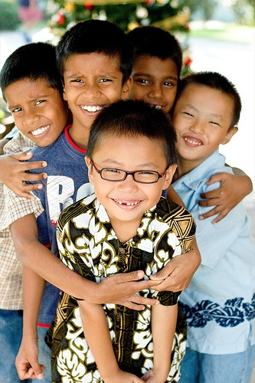
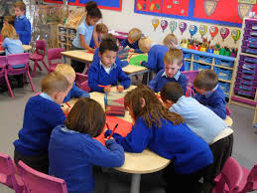
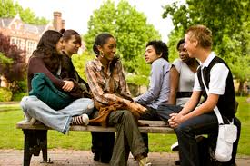
Belonging and Health
Social connection improves health and well-being
Social connection improves physical health and psychological well-being
The lack of social connection is a greater detriment to health than obesity, smoking, and high blood pressure
Strong social connections leads to a 50% increased chance of longevity
Those who are not socially conected are more vulnerable to anxiety, depression, antisocial behavior, and even suicidal behaviors
Source: Sheppälä, Connect to Thrive
Notes:
Sheppälä, Connect to Thrive https://www.psychologytoday.com/blog/feeling-it/201208/connect-thrive
See also https://bewell.stanford.edu/features/social-ties-good-health

Slide 33
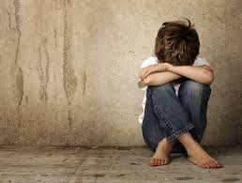
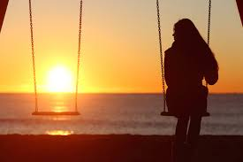
Social Network and Health
Our social network impacts our health and well-being
A person’s social network is a key predictor in whether an individual will become a victim of a gun homicide, even more so than race, age, gender, poverty, or gang affiliation
Individuals who lack social networks tend to suffer higher rates of morbidity and mortality, as well as infection, depression and cognitive decline
Social disconnectedness is associated with worse physical health, regardless of whether it prompts feelings of lonelineness or perceived lack of social support
Source: Cornwell et al, Social Disconnectedness
Notes:
McDonald, Study Finds Social networks are key to city violence http://news.yale.edu/2013/11/14/study-finds-social-networks-are-key-city-violence
See also Cornwell et al, Social Disconnectedness, Perceived Isolation and Health Among Adults http://www.ncbi.nlm.nih.gov/pmc/articles/PMC2756979/

Slide 34
Belonging
Structural interventions alone do not help change dominant conversations that racialize.
How we talk about race matters
Need to create an empathetic space
What work are the structures doing?
Importance of understanding at the macro-level
Importance of understanding relationality within systems: density and thickness
Importance of leverage points
[ 59 ]

Slide 35
Belonging
Thinking of spirituality through the creation of Martin Luther King, Jr.’s beloved community
Global vision in which all people can share the wealth of the earth. It is a community where all the ills that currently exist in our society will no longer be tolerated
Hatred and prejudice will be replaced with a willingness to transcend differences and work together in the spirit of cooperation and compassion
Justice as the public face of love: recognizing our shared humanity/inner being. We are profoundly related
If we are to have any kind of peace or happiness on a sustainable and collective level, we must recognize the connections that exist among us and then organize around it

Slide 36
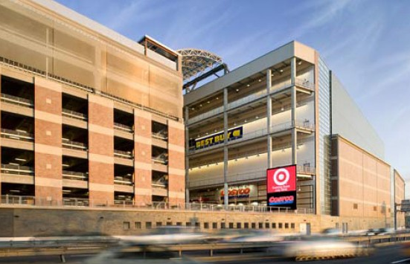

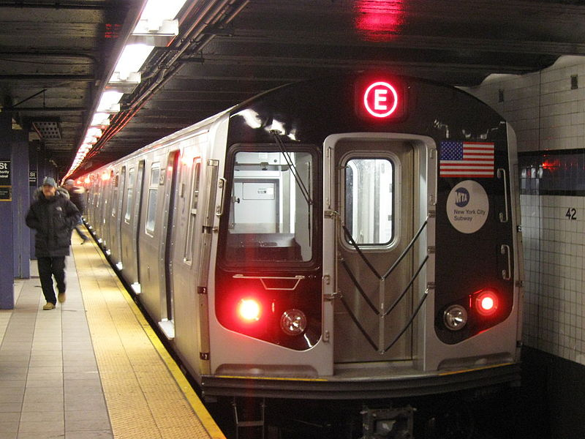
Structural Racialization
→ We all live in systems/structures
→ These structures are not neutral
→ They enhance or retard life outcomes
→ We live in Structures and structures live in us

Slide 37
Structural Racialization
Modern forms of racial inequity are caused by systems and structures more than individual “bad apples.”
These practices, cultural norms and institutional arrangements help create and maintain (disparate) racialized outcomes
Structural racialization refers to the ways in which the joint operation of institutions produce racialized outcomes
  In this analysis, outcomes matter more than intent

Slide 38
Structural Racialization
Structural Racism
Structural Racialization
  Race is a process
Structural racialization leads to marginalization (race, gender, ability, etc.) and blocked access to opportunity
Although invidious discrimination persists, structural exclusion is the underlying problem
  E.g. not enough teachers of color in the “pipeline” or enough workers of “color” in the labor market.

Slide 39
Structural Racialization
How race works today
There are still practices, cultural norms and institutional arrangements that help create and maintain (disparate) racialized outcomes
Structural racialization addresses inter-institutional arrangements and interactions
  It refers to the ways in which the joint operation of institutions produce racialized outcomes
    In this analysis, outcomes matter more than intent

Slide 40
Structural Inclusion
Design structures to promote the outcome you want
Not just ending structural marginalization
Bridge

Slide 41
Understanding Systems as Structures
We are all situated
within structures
but not evenly
These structures interact in
ways that produce a differential in outcomes in opportunity
Cultural Structures
Physical Structures
OUTCOMES
Social Structures

Slide 42
Engage the System
There is wide agreement that to challenge the elites and the system, we need more unity with marginalized groups
In the United States, this means common strategies and organizing among different race and ethnic groups
  However, there is little consensus on how you might achieve that unity
Consensus difficult to achieve with dominant colorblind ideology
  What’s an alternative narrative? Do we even have one?

Slide 43
Structural Marginalization & Racialization
Shift in focus from people to structures and institutions
Structures are not neutral; they require intervention and monitoring if they are to serve justice and promote inclusion
Marginalized/racialized groups are not situated in the same structures and their structures/systems are not the same.
Race plays a direct and indirect role in the development of these structures
  Not dependent on individual racialization
  Beyond the practices and procedures with any one institution
  Ways in which various institutions interact and arrange themselves
  Produces predictable unjust outcomes that are cumulative

Slide 44


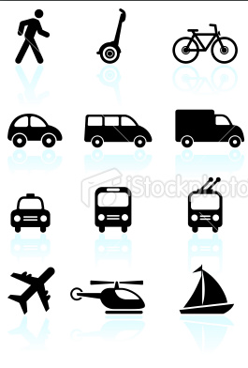
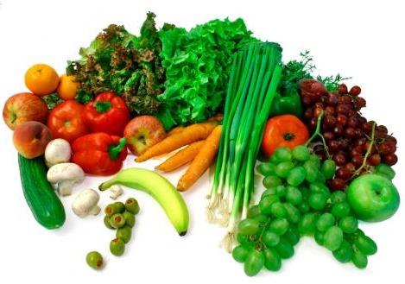


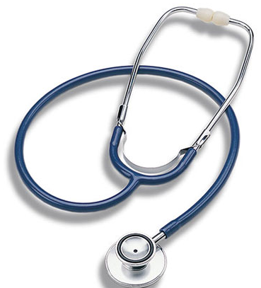

Defining Opportunity
We can define opportunity through access to…
education
economic
transportation
food
housing
justice
healthcare
communications

Slide 45
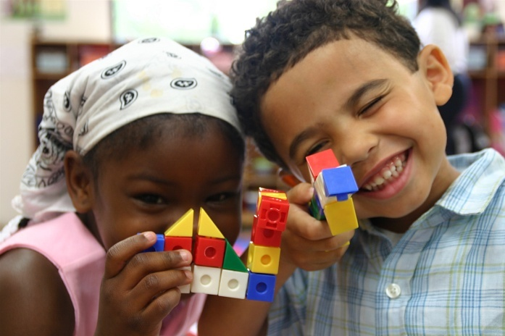
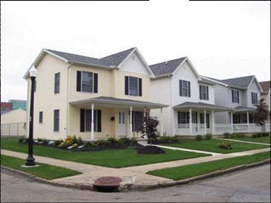
Opportunity Structures:
Space, Place, & Life Outcomes
Opportunity structures are the web of influences beyond our individual control that enhance and constrain our ability to succeed and excel
Life chances are shaped by opportunity structures, and those structures are just as important, if not more so, than the choices that individuals make
Notes:
What is important from a systems and structures perspective is the relationship between the nodes as well as networks

Slide 46
Opportunity is...
Racialized…
In 1960, African-American families in poverty were 3.8 times more likely to be concentrated in high-poverty neighborhoods than poor whites.
Spatialized…
marginalized people of color and the very poor have been spatially isolated from opportunity via reservations, Jim Crow, Appalachian mountains, ghettos, barrios, and the culture of incarceration.
Globalized…
Economic globalization
In 2000, they were 7.3 times more likely.
Climate change
the Credit and Foreclosure crisis

Slide 47
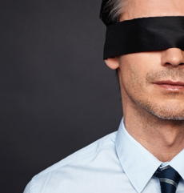
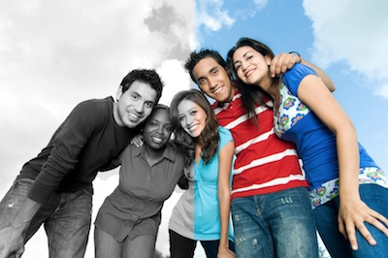
Color Blindness/Not
Racial ideology: best way to end discrimination is by treating individuals as equally as possible
Focuses on commonalities between individuals, such as their shared humanity: no regard to race, culture, or ethnicity
Notes:
http://www.psychologytoday.com/blog/colorblind/201112/colorblind-ideology-is-form-racism

Slide 48
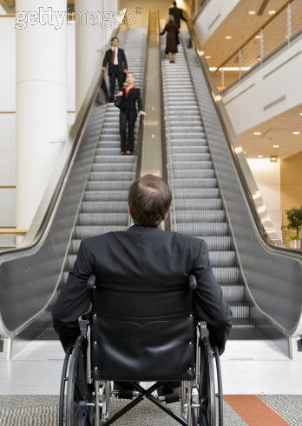
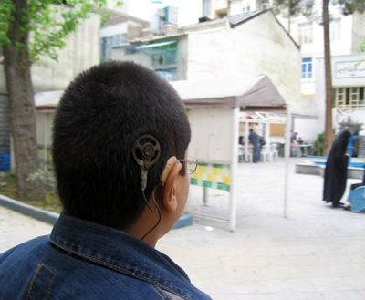
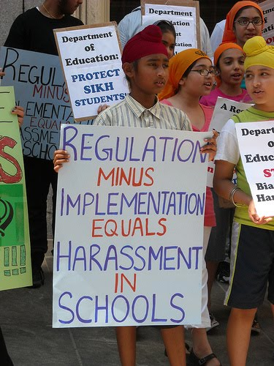
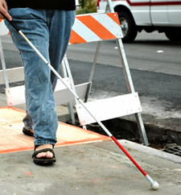
People are “differentially situated”
Not only are people situated differently with regard to institutions, people are situated differently with regard to infrastructure
People are impacted by the relationships between institutions and systems…
…but people also impact these relationships and can change the structure of the system.

Slide 49
Targeted Universal
Universal goals
Targeted strategies
Based on our situatedness in
  Structures
  Culture

Slide 50
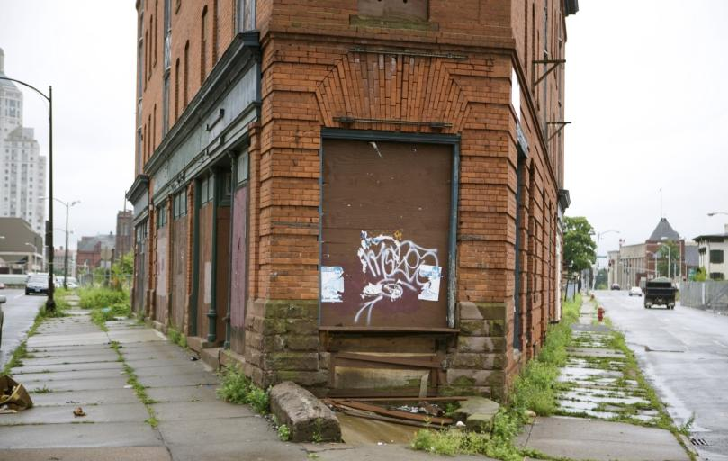

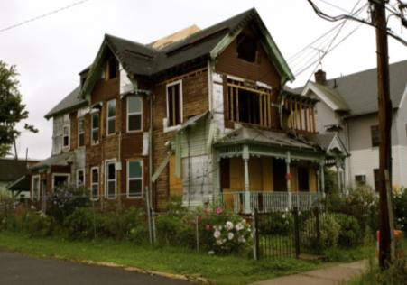
Opportunity Structures:
Space, Place, & Life Outcomes
Five decades of research indicate that your environment has a profound impact on your access to opportunity and likelihood of success
High poverty areas with poor employment, underperforming schools, distressed housing and public health/safety risks depress life outcomes
  A system of disadvantage
  Many manifestations
    Urban, rural, suburban
People of color are far more likely to live in opportunity deprived neighborhoods and communities
[ 5 ]
Notes:
What is important from a systems and structures perspective is the relationship between the nodes as well as networks

Slide 51
Situatedness, Trauma and Race
We carry our histories in our bodies
Example:
Children exposed to racial and other traumas early on versus those who are not are more likely to engage in risky behaviors, including violence
Example:
College educated Black women more likely to have premature babies than white women without high school diploma
  Due to stress caused by racialization
Example:
Twins who grow up in different environments of opportunities have dramatically different health outcomes
  Recommended: “Unnatural Causes…Is Inequality Making Us Sick?” on PBS

Slide 52
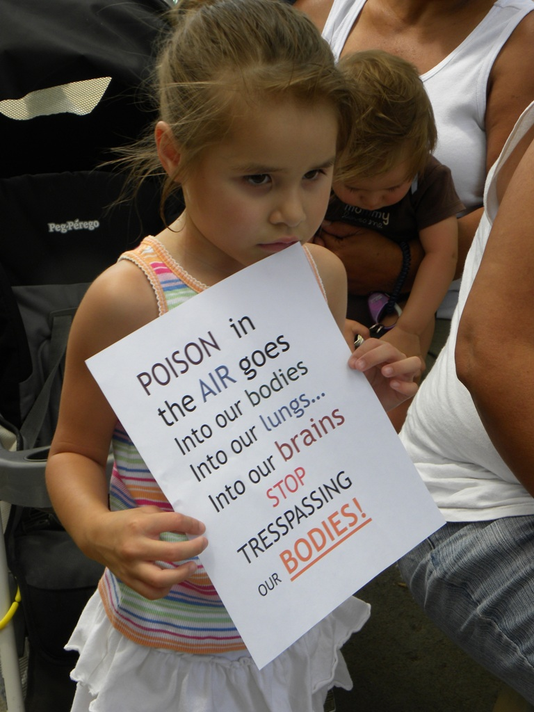
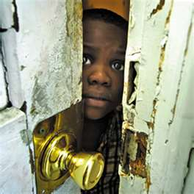
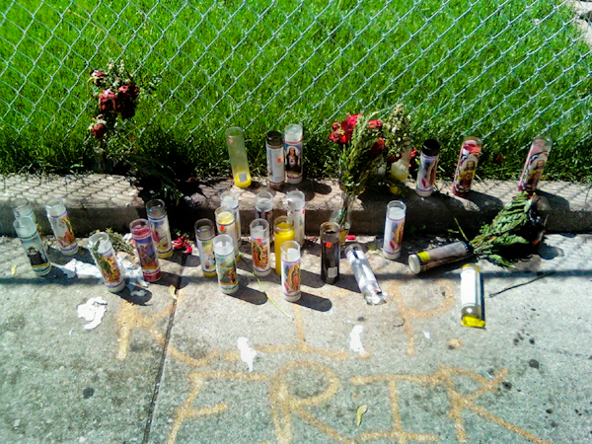
Other health effects of living in low opportunity
Children growing up in very poor families with low social status can also experience unhealthy levels of stress hormones, which impair neural development. The biggest negative effects were found on language and memory (Cookson, 2008)
The impact of health status on school achievement is so important that an estimated 25% of the achievement gap in education is attributable to differences in child and maternal health. (Currie 2005)

Slide 53
Why do structures have such persistent racialized inequities?
Race in America:
Implicit & Explicit Bias
“More Americans have attitudes that are both implicit and explicitly racist than when the same survey was conducted four years ago…
When measured by an implicit racial attitudes test, the number of Americans with anti-black sentiments jumped to 56%, up from 49% during the last presidential election.”
— Paul Harris, The Huffington Post (2012)

Slide 54
Targeted Universalism
Recognizes that structural inequities produces consistently different outcomes for different communities
Targeted universalism responds with universal goals and targeted solutions.
Recognizes racial disparities while acknowledging their presence in a larger inequitable, institutional framework.

Slide 55
Targeted Universalism
Some people ride the “Up” escalator to reach opportunity.
Others have to run up the “Down” escalator to get there.

Slide 56
Targeted Universalism
Structural inequity produces consistently different outcomes for different communities
Targeted universalism responds with universal goals and targeted solutions
VS.

Slide 57
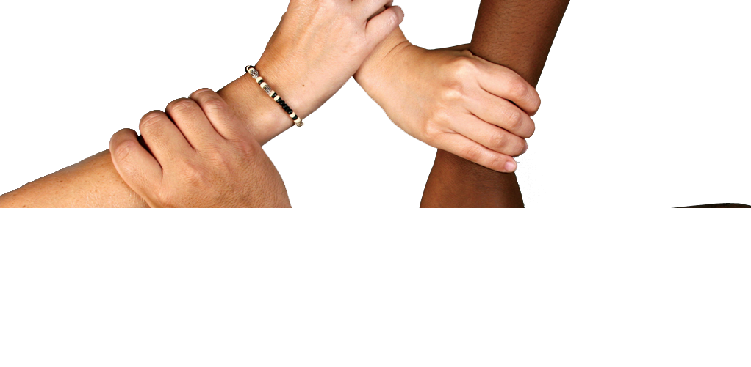
Targeted Universalism
Recognizing Our Linked Fates:
Targeted universalism emphasizes our linked fates, it’s a model where we all grow together, and where we embrace collective solutions.
In order for interventions to bring about effective solutions in the Division of Violence Prevention, you must understand the different ways in which people are situated differently.
Interventions should account for situatedness.
Notes:
57

Slide 58
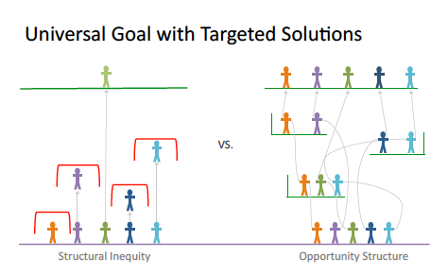
Universal Goal with Targeted Strategy

Slide 59
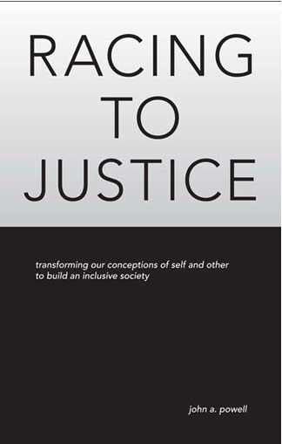

For more information, visit:
http://www.iupress.indiana.edu/catalog/806639
Like the Haas Institute on Facebook!
www.facebook.com/haasinstitute
[ 59 ]

