Slide 1
POPULATION HEALTH
Determinants, Outcomes, Inequities and the Role of Targeted Universalism

Slide 2
Notes:
So, let’s get started, I would like to begin by showing you a video on “population health” that will provide you with some framing and context for better understanding moving forward.
Population Health Video (6 mins, 53 secs): https://www.youtube.com/watch?v=aJbpRt4r5cE&list=PLFLwSDBafdA93x8bahQtysgarZVBDuw2Q

Slide 3
KEY THEMES
Population Health
The determinants of health--both natural and social (or structural)
How we move forward collaboratively to implement strategies to counteract impediments that continue to undermine the health of our population.
Notes:
As a guide, the key themes of my presentation will focus on (1) population health; (2) the determinants of health, both natural and social (or structural); and (3) how we move forward collaboratively to implement strategies to counteract impediments that continue to undermine the health of our population. I will explain why a concept I call, Targeted Universalism, is instrumental to the latter.

Slide 4
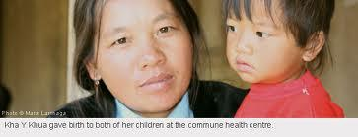
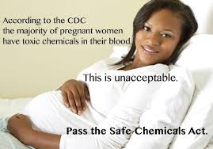
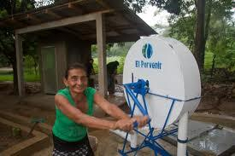
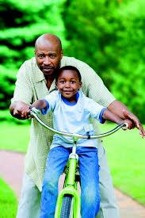
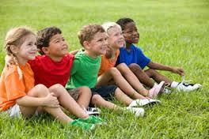
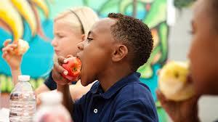
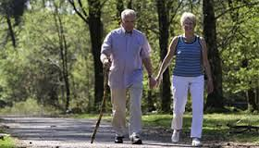
DEFINING POPULATION HEALTH
Notes:
Population health highlights the overall health status of our communities.
The study of population health links traditional public health services with many aspects of life not normally associated with health, and is centered on the recognition that an individual’s health is strongly influenced by certain “determinants.”

Slide 5
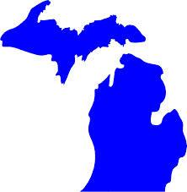
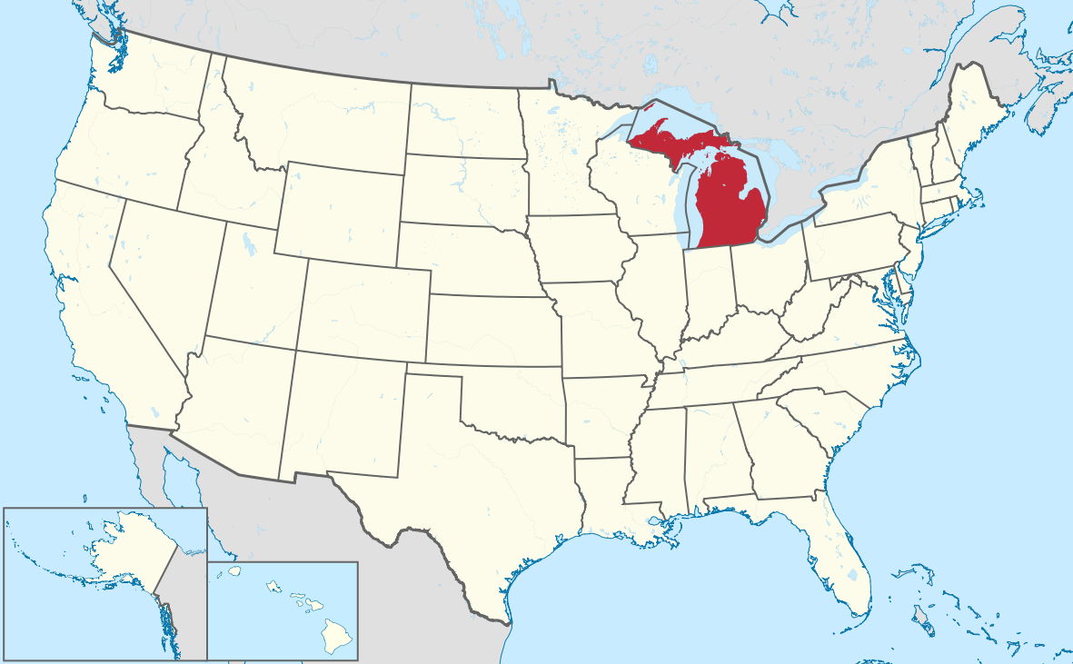
POPULATION HEALTH IS IMPORTANT AT ALL LEVELS
At all levels, unhealthy communities negatively affects our economy
economic viability begins with healthy neighborhoods
At all levels, unhealthy communities result in higher health-care costs for providers, payers, and communities; lower educational performance; and diminished productivity generally.
Notes:
At all levels, unhealthy communities negatively affects our economy
economic viability begins with healthy neighborhoods
At all levels, unhealthy communities result in higher health-care costs for providers, payers, and communities; lower educational performance; and diminished productivity generally.

Slide 6
HOW DO WE DETERMINE POPULATION HEALTH?

Slide 7
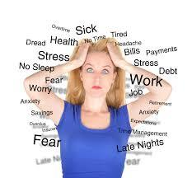
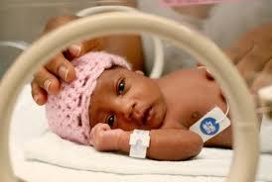
NATURAL DETERMINANTS
Genetics
Infant mortality rate
Stress
Average Life Expectancy
Notes:
Natural Determinants of population health:
Some examples
The infant mortality rate in a given population
Infant mortality rates of the number of infant deaths for every 1,000 live births are reliable indicators of population health because “factors affecting the health of entire populations can also impact the mortality rate of infants.”
These factors might include, but are not limited to, race and ethnicity, age, socioeconomic levels, and education.
They are also a reflection of inequities associated with access to medical insurance, or preventive and primary care.
Stress
Stress: Tied to socioeconomic position, particularly high for individuals residing in disadvantaged neighborhoods, translate into poor health behaviors and outcomes.
The effects of toxic stress plays out over an individual’s life course in creating a substantially increased risk for a range of diseases from asthma, to cardiovascular, to diabetes. Patrick Sharkey, stuck in place…University of Chicago Press: Chicago and London, 114 (2012).
“The cascade of emotional, social, and physical health vulnerabilities that flow from a dysfunctional stress response system is profound.” (See Maia Szalavitz and Bruce D. Perry, Born For Love, 165 (2010).
Examples of these vulnerabilities include alcoholism, drug abuse (illegal drugs and self medication), obesity, high blood pressure, heart disease, stroke, and the list keeps going. (See Maia Szalavitz and Bruce D. Perry, Born For Love, 165 (2010).
Average life expectancy

Slide 8
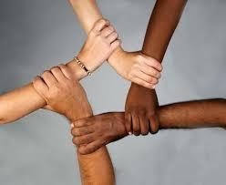
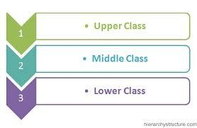
SOCIAL/STRUCTURAL DETERMINANTS
Neighborhood
Race
Social Class
Gender
Income
Education
Occupation
Food Security
Notes:
Social/Structural Determinants of population health: includes the full set of often overlapping social conditions in which people live and work. They “operate at every level of development--early childhood, childhood, adolescence and adulthood--both to immediately influence health and to provide the basis for health or illness later in life.” (See A Conceptual Framework For Action on the Social Determinants of Health, World Health Organization at 18)
Some examples of social/structural determinants (Slide )
Neighborhood: Population health is decisively shaped by where we live. “Neighborhoods influence a remarkably wide variety of social phenomena, including crime, health, [], home foreclosures, teen births, altruism, leadership networks, and immigration.” (See Robert J. Sampson, Great American City…(2013).
Race: In societies, like the U.S., marked by racial discrimination and exclusion, people’s belonging to a marginalized racial/ethnic group affects every aspect of their status, opportunities and trajectory over their lifetimes. Health status and outcomes among oppressed racial/ethnic groups are often significantly worse than those registered in more privileged groups or than population averages. (See A Conceptual Framework For Action on the Social Determinants of Health, World Health Organization, at 34).
For example African-Americans (AA) life expectancy is significantly lower than whites; AA women are twice as likely as white women to give birth to an underweight baby. Heart disease, diabetes, and AIDs disproportionately affect people of color.
Racism is closely intertwined with other determinants of health (such as low income, poor education, poor housing, etc.).
Social Class: One of the strongest predictors of illness and health and depicts a particular population’s amount of ownership or control over productive resources (physical, financial, and organizational). Those of the lower class have less power and are therefore of greater risk of running down their stocks of energy and ending up in some kind of physical or psychological “health deficit.” (See A Conceptual Framework For Action on the Social Determinants of Health, World Health Organization, at 33).
Gender (involves un-natural culture-bound conventions): Socially constructed models of masculinity can have deleterious health consequences for men and boys (e.g. when these models encourage violence or alcohol abuse). Women and girls bear the major negative burden--as they suffer systemic discrimination in access to power, prestige, and resources. Women are more prone to suffer genital mutilation, rape, or be victims of domestic violence. (See A Conceptual Framework For Action on the Social Determinants of Health, World Health Organization at 33).
Income: Can influence a wide range of material circumstances with direct implications for health with a cumulative effect over the course of life. (See A Conceptual Framework For Action on the Social Determinants of Health, World Health Organization at 30)
Education: In part measured by early socioeconomic position. “The knowledge and skills attained through education may affect a person’s cognitive functioning, make them more receptive to health education messages, or better enable them to communicate with and access appropriate health services; and ill health in childhood could limit educational attendance and/or attainment and predispose a person to adult disease, generating a health selection influence on health equities.” (See A Conceptual Framework For Action on the Social Determinants of Health, World Health Organization at 31-32).
Occupation: “Reflect social standing and may be related to health outcomes because of certain privileges--such as easier access to healthcare and access to education of those of higher standing. May also reflect social networks, work based stress, control and autonomy, thereby affecting health outcomes through psychological processes, and exposure to physically damaging and/or toxic work tasks.(See A Conceptual Framework For Action on the Social Determinants of Health, World Health Organization at 32).
Food Insecurity: There is a relationship between food insecurity, obesity, diabetes, hypertension, and cardiovascular disease. Food insecure adults are 3 times more likely to be hospitalized.

Slide 9
More Equality is Good for Our Health
“We also found that living in a more equal place benefited everybody, not just the poor… Likewise, the benefits of greater equality spread right across society, improving health for everyone – not just those at the bottom. In other words, at almost any level of income, it’s better to live in a more equal place.”
Wilkinson, Richard; Pickett, Kate

Slide 10
BREAKING DOWN THE PERCENTAGES
How much of our health status is determined by biology?
How much of our health status is socially/structurally determine?
Health status is determined by: (1) genetics: 20-30%; (2) health-care: 10%; social, environmental conditions, and behavior: 60-70%
Notes:
Source: Jonathan Heller, Addressing the Determinants of Health using Health Impact Assessment, available at http://www.apha.org/NR/rdonlyres/969B7542-BF2D-4AC8-9F07-C319DFE33C05/0/W3JonathanHeller.pdf (citing Health Affairs, 2002)

Slide 12
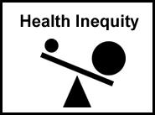
Notes:
How do we defined health inequity?
“Health inequities are health differences that are socially produced, systemic in their distribution across the population, and unfair.” (See A Conceptual Framework For Action on the Social Determinants of Health, World Health Organization at 12).
Health inequities are a result of patterns of social separation or geographic and structural segregation, often cutting along racial lines--flowing from “the systemically unequal distribution of power, prestige and resources among groups in society.” (See A Conceptual Framework For Action on the Social Determinants of Health, World Health Organization at 20).

Slide 13
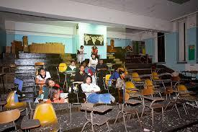
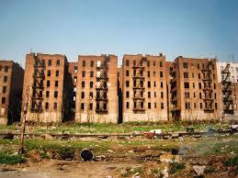
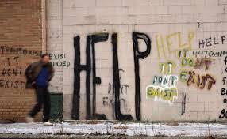
Notes:
Let’s Provide Context with a look at Detroit. The health outcomes and health inequities in Detroit is what happens when multiple negative social/ structural determinants overlap.

Slide 14
CURRENT STATE OF HEALTH OUTCOMES
Detroit’s health outcomes lags substantially behind Michigan and most of the nation.
In 2010, Detroit’s rates for congestive heart failure, asthma, diabetes, and grand mal and other epileptic conditions were more than twice that of the State of Michigan.
Within Detroit, there are 3 areas of greatest concerns--south of I-75, immediately west of Woodward, and immediately east of Woodward. These areas have Ambulatory Care Sensitive (ACS) discharge rates of 500 or more per 10,000 residents, greater than twice the rate of the State of Michigan.
Notes:
This area is a display of the inequities that occur when there is a concentration of racial minorities, lower income, lower social class, lower education, etc.
Source: State of Population Health Report

Slide 15
CURRENT STATE OF HEALTH INEQUITY
Lack of access to healthcare, appropriate care, and under-utilization of available services.
Social and Structural determinants continue to remain a barrier to improved health outcomes.
89% of Detroit’s population live in a Medically Underserved Area (MUA) and 81% of the Detroit population is classified as living in a Health Professional Shortage Area (HRSA).
Detroit’s unemployment rate continues to exceed that of Michigan and the U.S.
Detroit officials project that the demand for food assistance will increase substantially, while resources necessary for providing such assistance are expected to decrease.
Notes:
Source: State of Population Health Report

Slide 16
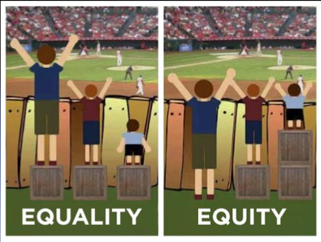
WHAT IS OUR AIM MOVING FORWARD?
Turn This:
Into This:
Notes:
Our aim is to achieve population health equity
This means “the absence of unfair and avoidable or remediable differences in health among population groups defined socially, economically, demographically or geographically.” (See A Conceptual Framework For Action on the Social Determinants of Health, World Health Organization, at 12).
Starting with Detroit,
we need to (1) orchestrate a coordinated geographically-oriented response to fortify communities/neighborhoods with special attention to the most disadvantaged zip codes. (2) We need to better coordinate management efforts relating to chronic disease, infant mortality, and healthy child development. (3)We need to promote collaboration among healthcare organizations, and encourage policy makers to work against the marginalizations of the most vulnerable populations. (4) We need to take a more holistic approach in identifying the overlapping of structural forces, race, impoverished neighborhoods, food and housing instability, and poor health outcomes. (See State of Population Health Report).
So how do we going about taking these steps and implementing subsequent measures effectively?
Answer: Utilizing a Targeted Universalism approach to undertake these forward looking measures

Slide 17
COMPARING APPROACHES TOWARD A HEALTHIER FUTURE
Universalist Approach
Applies to everyone; treats everyone the same.
Targeted Approach
Applies to particular populations and treats only those populations.
Targeted Universalism Approach
Sets universal goals for everyone, while targeting populations to help specific groups.
Notes:
Universal and targeted approaches are false choices.
Targeted universalism acknowledges how people are situated differently while also respecting our linked fates.
Means setting universal goals and targeted means/processes.

Slide 18
CLOSING REMARKS
While we look at health inequities and the social determinants of health, our goal is improving the health of the entire population, not just achieving equity for disenfranchised groups who may live in disenfranchised areas. The future of Detroit is linked to the future of Southeast Michigan, the future of our individual communities is linked to the future of the U.S., and the future of the U.S. is linked to the future of the world.

